Slide 1
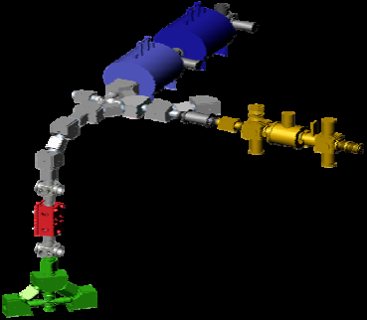
Version Control:
Basics and Best Practices
January 5, 2017
elMhurst College
Daniel D Lascar
Postdoctoral Researcher
Low-energy group

Slide 2
Coding best practices
This list is NOT exhaustive
Comment & Document
Consistent indentation
Avoid deep nesting
Consistent and descriptive names
DRY – Don’t Repeat Yourself
Group your code logically
Limit line length

Slide 3
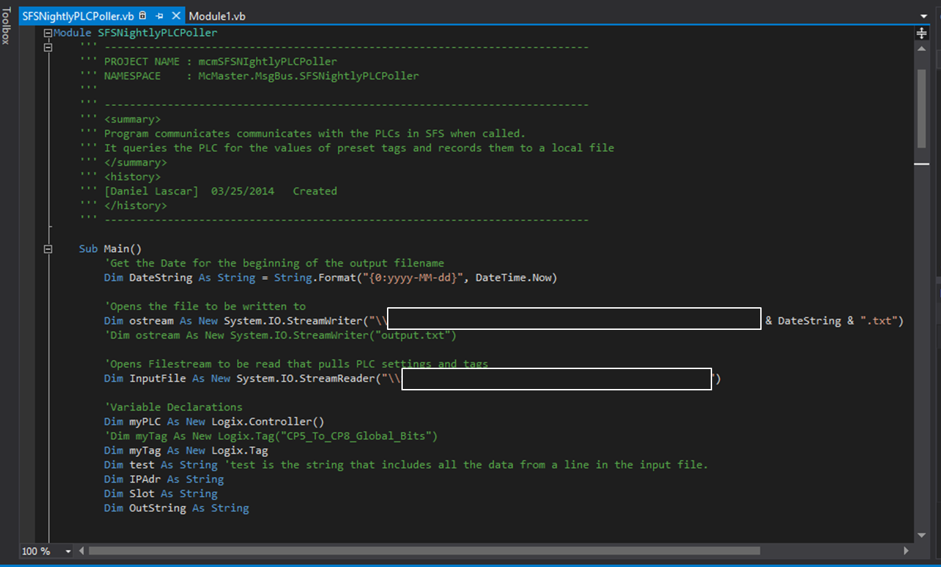
Coding best practices
I. Comment & Document

Slide 4
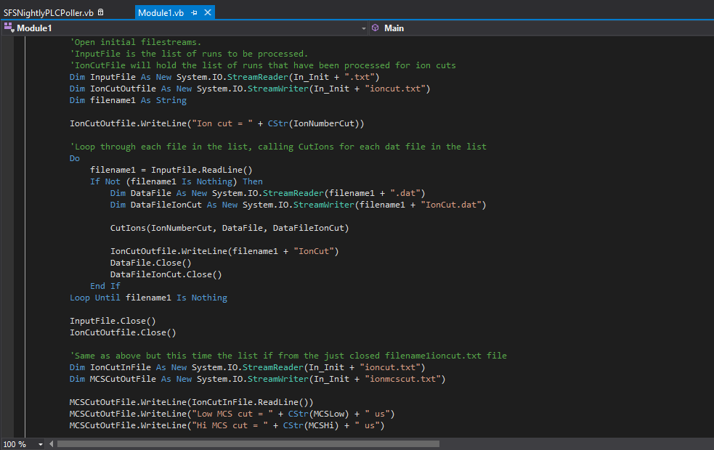
Coding best practices
II. Consistent Indentation

Slide 5
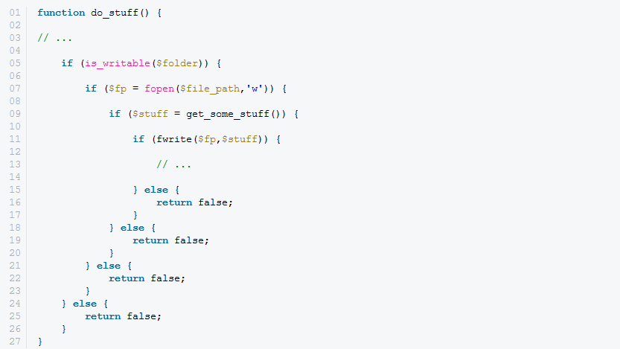
Coding best practices
III. Avoid deep nesting…not always possible

Slide 6
Coding best practices
IV. Consistent and descriptive names

Slide 7
Coding best practices
IV. Consistent and descriptive names

Slide 8
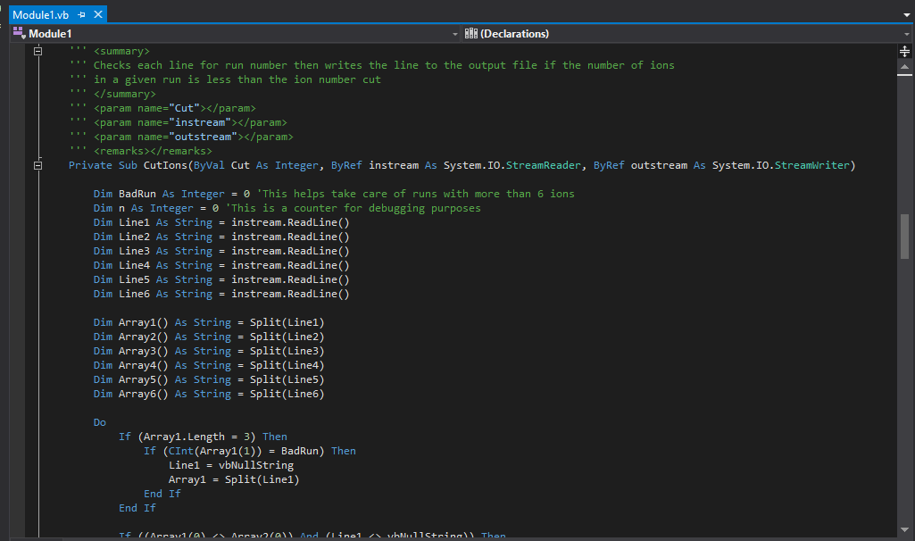
Coding best practices
V. DRY – Don’t Repeat Yourself
Notes:
This function is about 180 lines long. If I had followed this principle, it could have been as short as 10. Probably 15 to keep it readable.

Slide 9

Coding best practices
VI. Group code logically

Slide 10
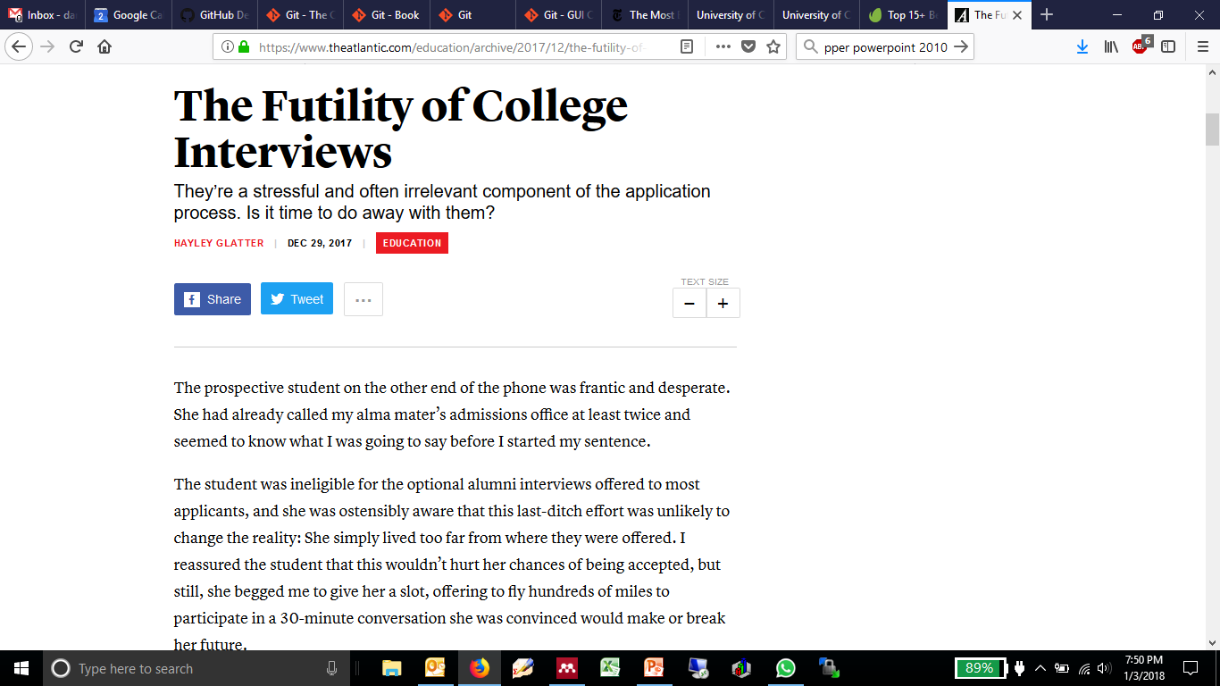
Coding best practices
VII. Limit line length…this one is more aspirational

Slide 11
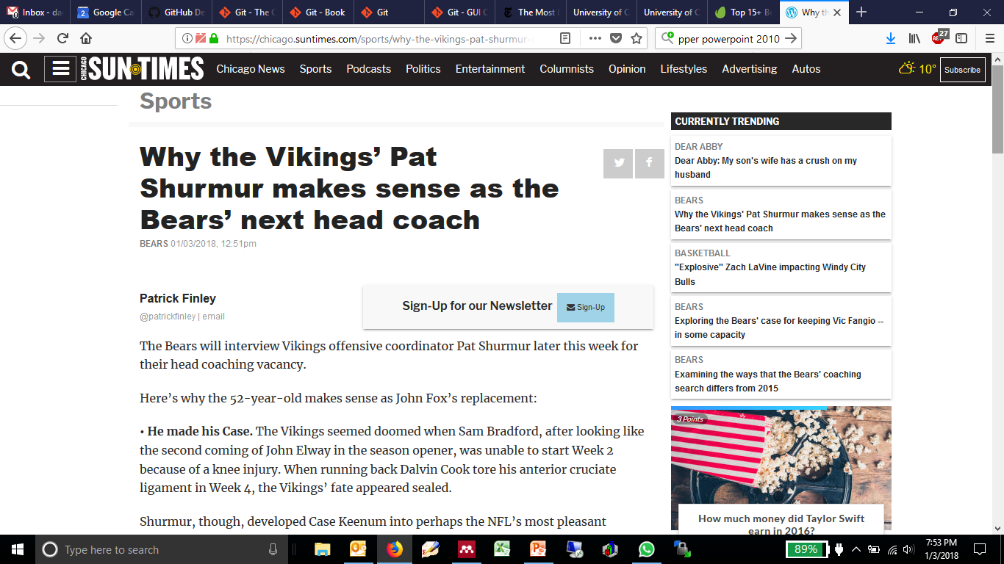
Coding best practices
VII. Limit line length…this one is more aspirational

Slide 12
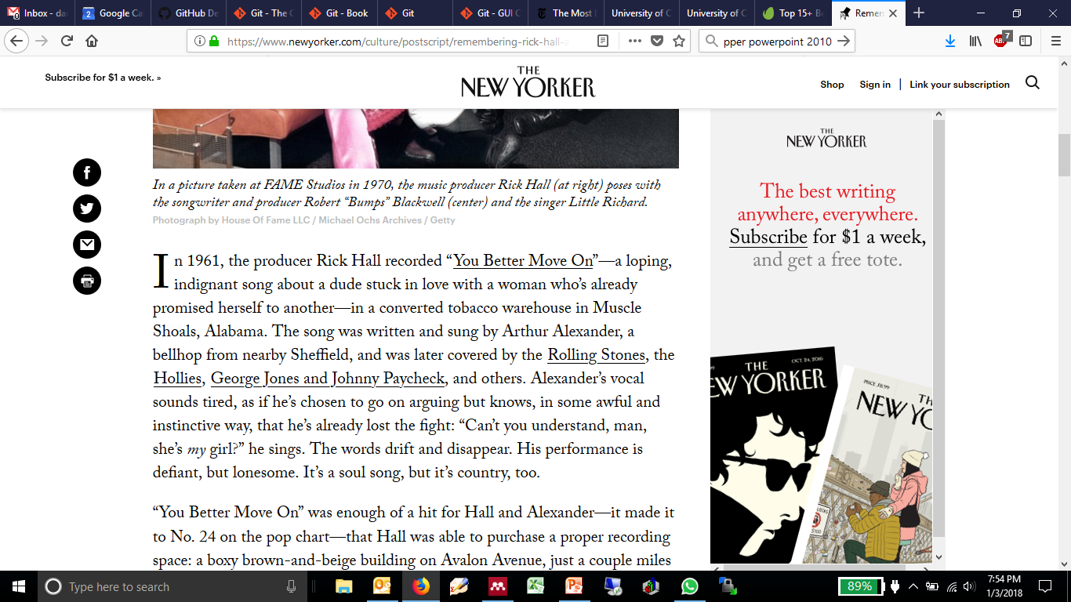
Coding best practices
VII. Limit line length…this one is more aspirational

Slide 13
Your daily tasks
Student, Knowledge Worker, Developer, Scientist, etc
Create things
Save Things
Edit Things
Save the thing again

Slide 14
Your daily tasks
Student, Knowledge Worker, Developer, Scientist, etc
Create things
Save Things
Edit Things
Save the thing again
Critical information can be lost

Slide 15
Your daily tasks
The old way – No version control
Advisor changes mind
Advisor wants new section
Created document
Edited for spelling
Edited for grammar
Time

Slide 16
Your daily tasks
The old way – No version control
Advisor changes mind
Advisor wants new section
Created document
Edited for spelling
Edited for grammar
Time

Slide 17
Your daily tasks
The old way – No version control
Advisor changes mind
Advisor wants new section
Created document
Edited for spelling
Edited for grammar
Time

Slide 18
Your daily tasks
The old way – No version control
Advisor changes mind
Advisor wants new section
Created document
Edited for spelling
Edited for grammar
Time

Slide 19
Your daily tasks
The old way – No version control
Advisor changes mind
Advisor wants new section
Created document
Edited for spelling
Edited for grammar
Time

Slide 20
Your daily tasks
The old way – No version control
Advisor changes mind
Advisor wants new section
Created document
Edited for spelling
Edited for grammar
Time
Notes:
If you just reverted back to this, you’d have saved yourself a bunch of work.
Before VC, you had: The waste paper basket, “garbage” sections or files -> track changes.

Slide 21
History Tracking
Version control preserves all of this
Advisor changes mind
Advisor wants new section
Created document
Edited for spelling
Edited for grammar
Time

Slide 22
History Tracking
Always useful
Not critical for single user document or short programming project
  Still nice though
  Many programs incorporating history tracking
    Office, Google Docs, etc.
Once projects:
  Incorporate multiple users
  Incorporate multiple files
  Version Control Shines

Slide 23
Basics of version control
When you start working with a team, on the same files
  History tracking isn’t enough
You need to know:
  What the changes is
  Why the change was made
  Who made the change
  When they made the change
VC keeps track of the changes and creates a framework to merge them into the main project

Slide 24
Basic vcs workflow
Functioning
Project
Check out segment
Work on segment
Test segment
Check in segment

Slide 25
Basic VCS workflow
Original Project
Segment I
v1
Feature II
v1
New merged project
Segment II
v2

Slide 26
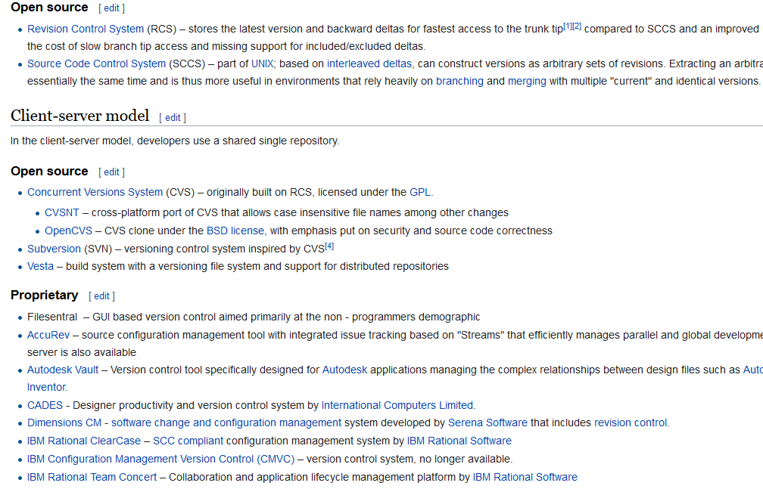
Many options
Notes:
Depends if you want to always work with the server or just occasionally

Slide 27
Git – The basis of github
Not the best but it is ubiquitous
With all types of VCs you have to make choices
  Local or server based storage
  Local or server based development
  Data stored as complete files or as changes to the master
  Private or Public repositories
  Lock files being worked on or not

Slide 28
Git – The basis of github
Not the best but it is ubiquitous
With all types of VCs you have to make choices
  Local or server based storage
  Local or server based development
  Data stored as complete files or as changes to the master
  Private or Public repositiories
  Lock files being worked on or not
  Project is small enough to fit and run on a local machine
Notes:
If it’s only server based then you have a potential for a single point of failure. Git gives you everything but then size matters.

Slide 29
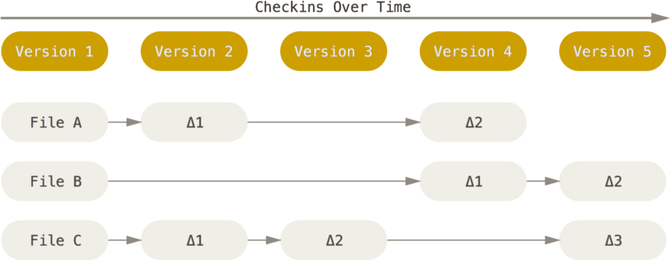
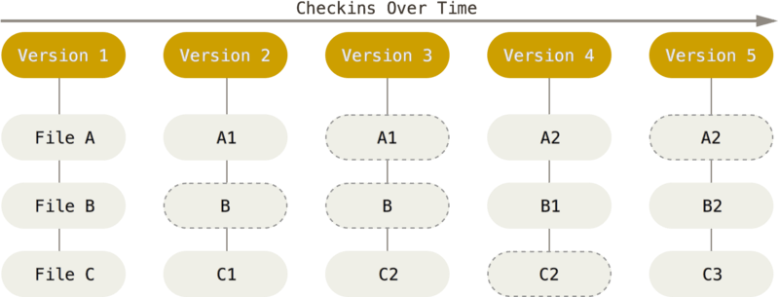
Notes:
The promulgation of cheap memory allows for the “snapshot” model to exits.

Slide 30
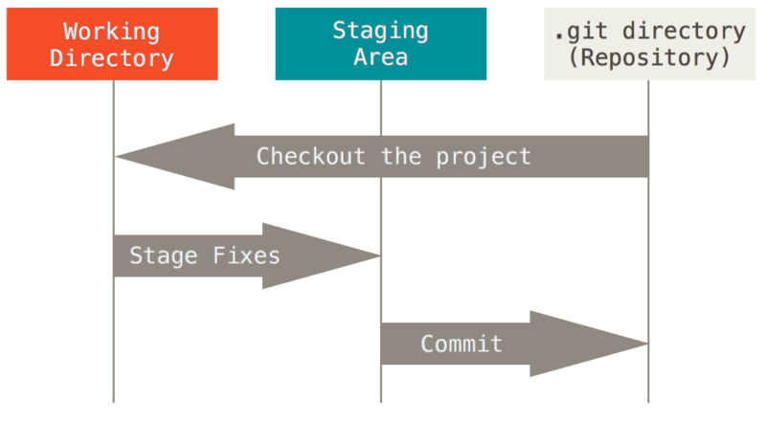
Work with git is performed locally
Every stage in this diagram occurs on your local machine!

Slide 31
Wait! I thought you said that there was a central server
There can be.
Remote server
Clone project
Push project
Notes:
Remote server also running git so it knows what to do with your new project because it set itself up to receive it once you cloned.

Slide 32
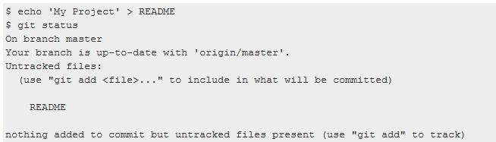
Using git is kind of cumbersome
We really want to use Github BUT…
Git has to be told which files are to be tracked
Git is designed for command line interface
  Only at the command line are all the functions available

Slide 33
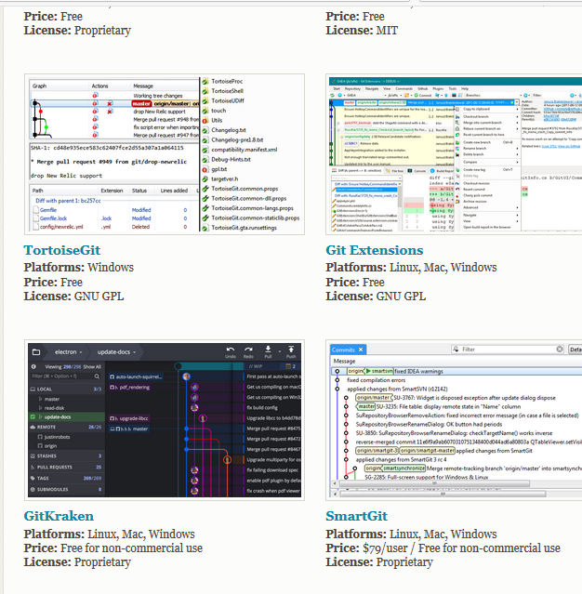
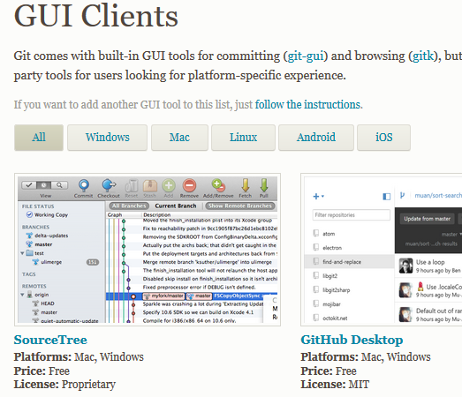
Using git is kind of cumbersome
We really want to use Github BUT…
Git has to be told which files are to be tracked
Git is designed for command line interface
  Only at the command line are all the functions available

Slide 34
Using git is kind of cumbersome
We really want to use Github BUT…
Git has to be told which files are to be tracked
Git is designed for command line interface
  Only at the command line are all the functions available
If you understand how Git works then you’ll know how to get the most out of the GUIs
READ THIS:
  https://git-scm.com/book/en/v2

Slide 35
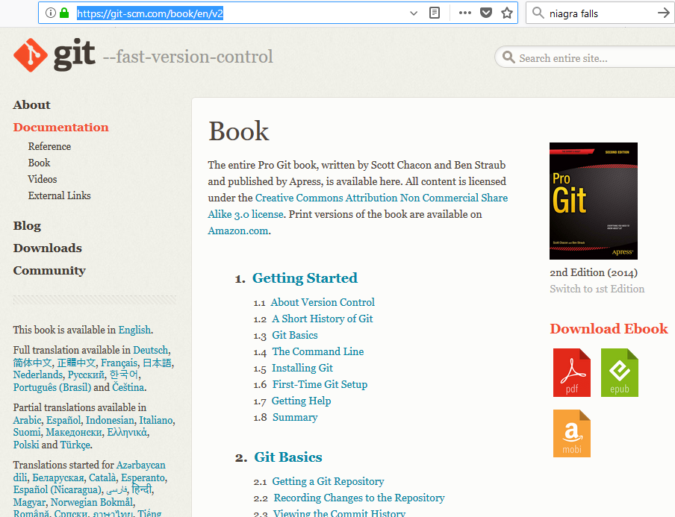

Slide 36
Seriously: READ THIS

Slide 37
GITHUB
A remote service that uses Git
Pros
cons
Easy to use
Well known and accepted source
No server to maintain
Public repositories are free
  You still maintain write access control
Desktop application is pretty good
Any GitHub user can comment on your public project
Private accounts cost
  $7/month personal
  $9/month organization

Slide 38
Do desktop demo

Slide 39
resources
Git book and references
  https://git-scm.com/doc
List of places to host your project
  https://git.wiki.kernel.org/index.php/GitHosting
GitHub Desktop
  https://desktop.github.com/
RaspberryPi Resources
  https://www.raspberrypi.org/help/
  https://www.element14.com/community/community/raspberry-pi
  https://www.raspberrypi.org/documentation/usage/gpio-plus-and-raspi2/README.md

