Slide 1
Detector Physics
Support Electronics
November 24, 2015
D. Lascar | Postdoctoral Fellow | TRIUMF

Slide 2
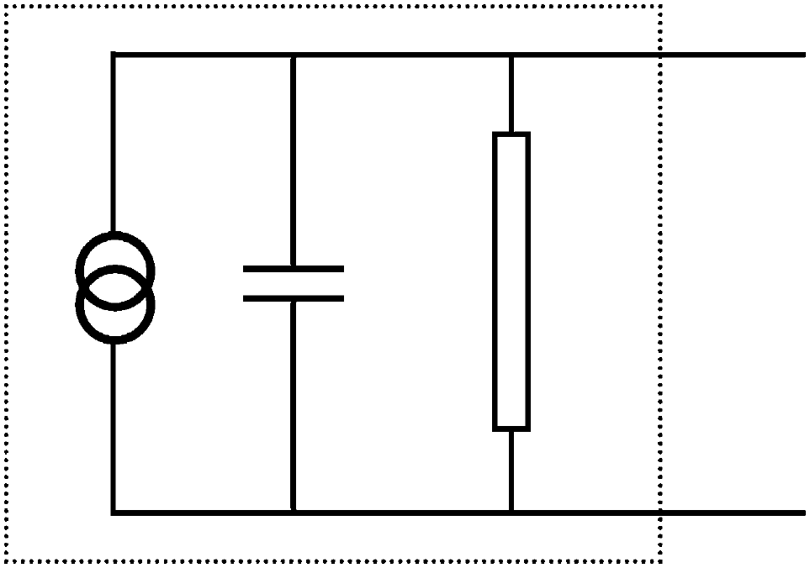
Outline
Signal Basics
Crate standards
NIM
CAMAC
VME
Processing electronics
Analysis Electronics
Transmission and Noise Reduction
Notes:
Much of nuclear electronics has been standardized to the point where you don’t actually need to know what is in the circuit.
All you need to know is the logic of how given devices/module works.
How many of you can use and ADC? How many can build an ADC?
From an electronics perspective, a detector is a current source with a large internal resistance and small capacitance

Slide 3
Signals are small…(for the most part)
You are (almost) always trying to extract an electrical signal from your detector
Phosphor screens are a notable exception
Gaseous detectors and photomultiplier tubes can make life easier with charge multiplication but semiconductors normally don’t multiply
Electronics can…
Sort
Amplify
Determine timing/coincidence
Measure pulse height
Notes:
Ask for class thoughts before revealing

Slide 4
Two different ways for measuring signals
Pulse Mode
Current mode
Most common
Observe and count individual pulses
Timing preserved
Amplitude (Energy) is measured
Rate limited.
Not uncommon
All charge is measured via integration
Rate independent
Pileup is ok
Timing information lost
Amplitude is lost

Slide 5
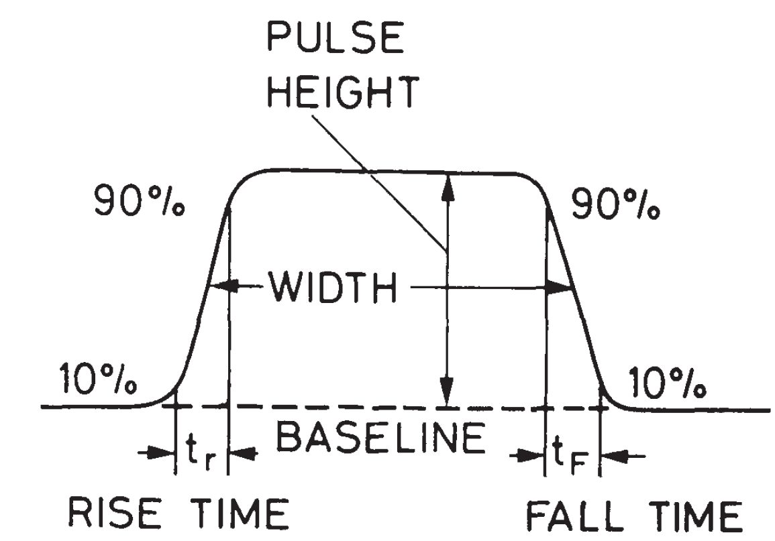
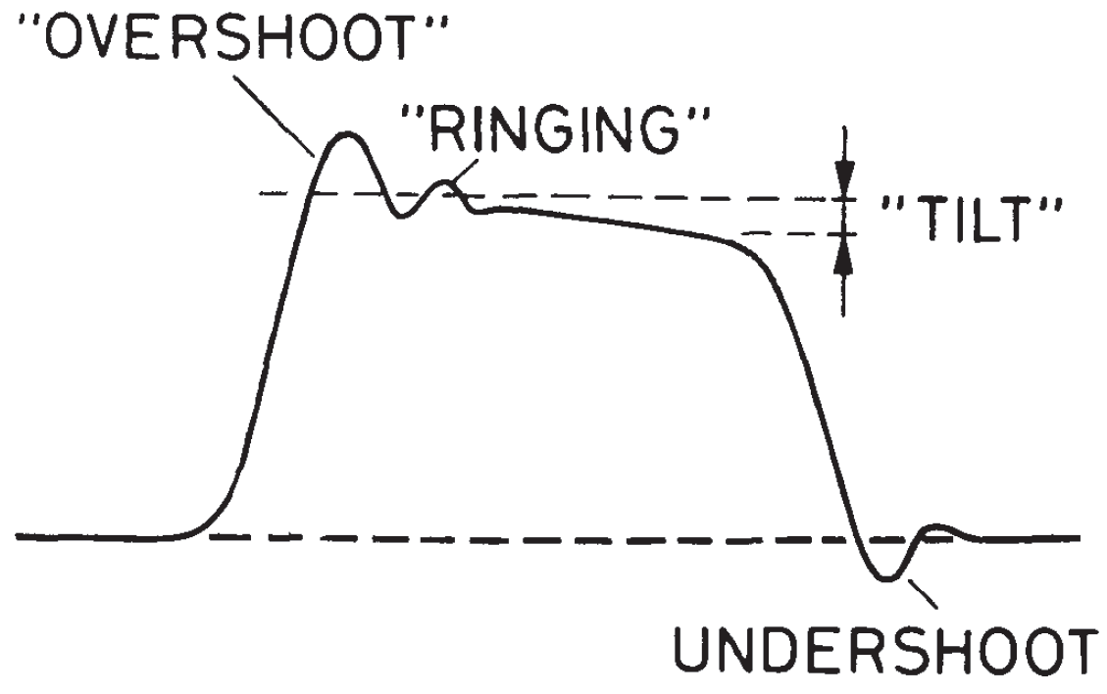
Analog pulse signals
Brief surges of current or voltage
We measure
Existence
Polarity
Shape
Amplitude
Width
Timing
Notes:
Ask about the Existence attribute
Baseline. The voltage or current level to which the pulse decays.
Pulse Height or Amplitude. The amplitude is the height of the pulse as measured from its maximum value to the instantaneous baseline below this peak.
Signal Width. The full width of the signal usually taken at the half-maximum of the signal (FWHM).
Leading Edge. The leading edge is that flank of the signal which comes first in time.
Falling Edge. The falling edge or tail is that flank which is last in time.
Rise Time. This is the time it takes for the pulse to rise from 10 to 90% of its full amplitude. The rise time essentially determines the rapidity of the signal and is extremely important for timing applications.
Fall Time. In analogy with rise time, the fall time is the time it takes for the signal to fall from 90 to 10% of its full amplitude.

Slide 6
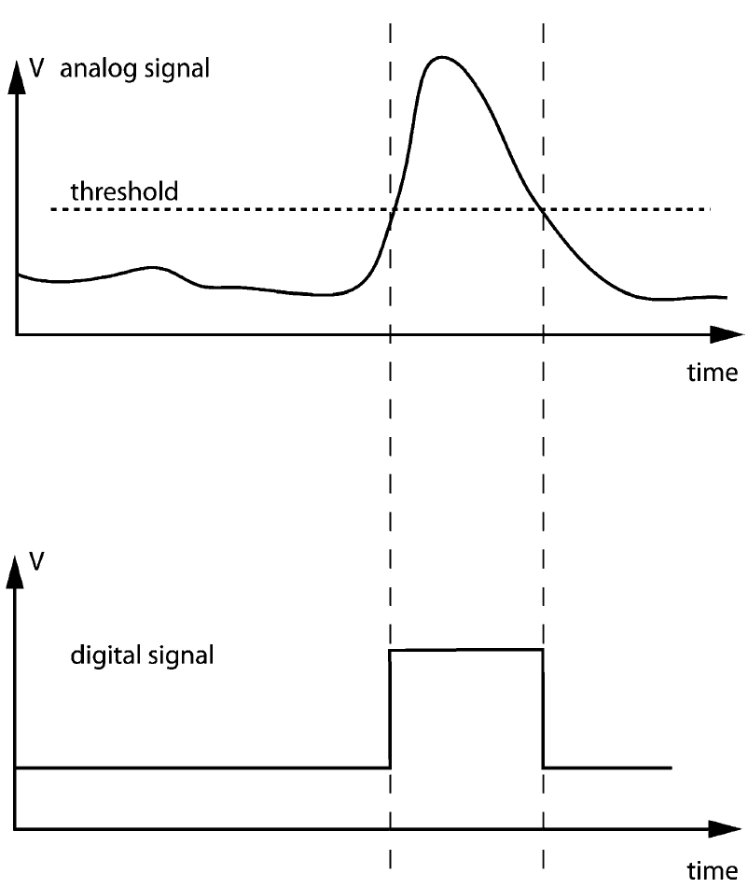
The discriminator – measuring existence
The input signal is always on.
A reference voltage is set by the user – threshold
When the voltage on the input goes higher than the threshold: Output = 1
1 and 0 set by user/device
Notes:
This is a digital signal generated from an analog signal. Only timing information and minimum energy survives

Slide 7
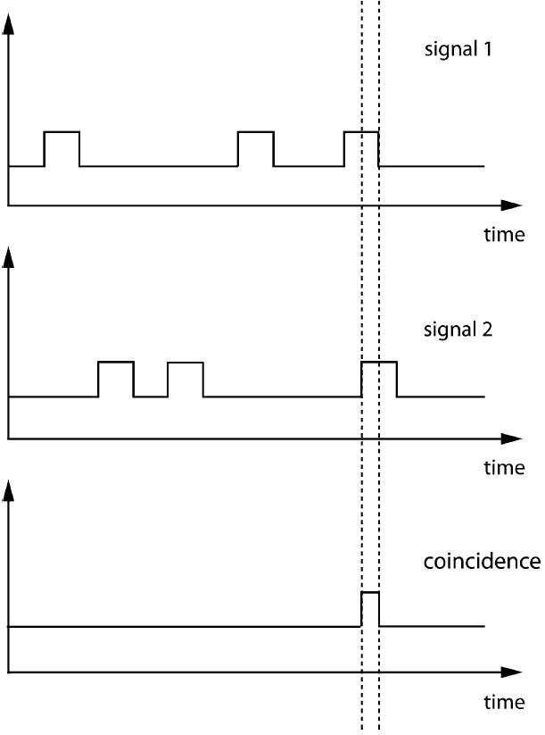
Coincidence measure
Not every signal has inherent value
Most events generate multiple signals
Timing correlates multiple signals with the same events
Random events must be accounted for
$\frac{{dN}_{Rand}}{dt}=\frac{dN_{1}}{dt}\frac{dN_{2}}{dt}Δt$
$$Δt$$

Slide 8
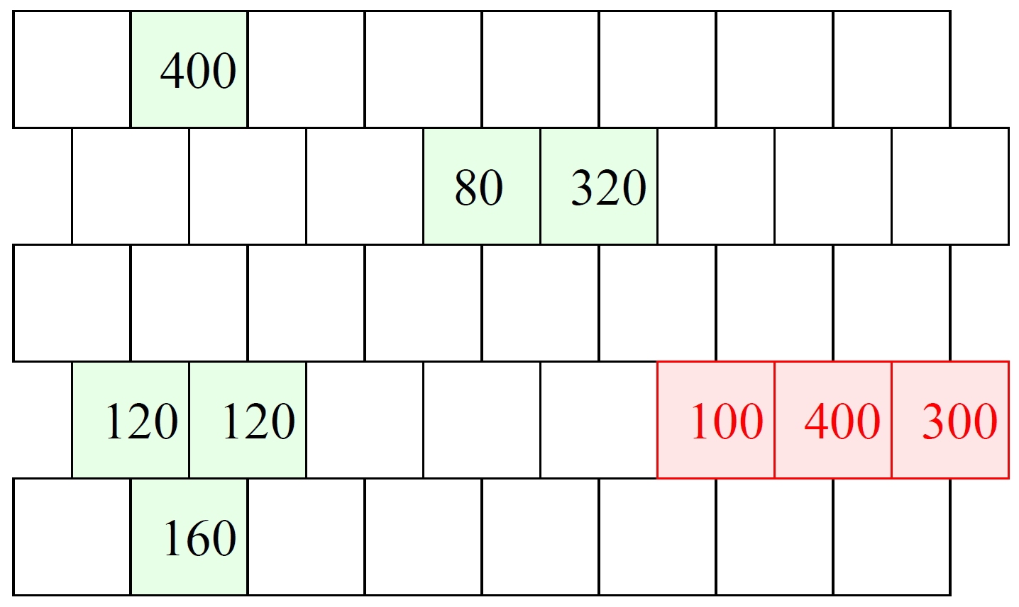
Photon calorimeter
Consider a segmented calorimeter designed to measure γ’s from 300 MeV to 2000 MeV.
γ can deposit energy in groups of one or more cells.
A charged pion might pass through the detector and leave energy that should be rejected.
Slide courtesy of M. Fortner, N. Illinois University

Slide 9
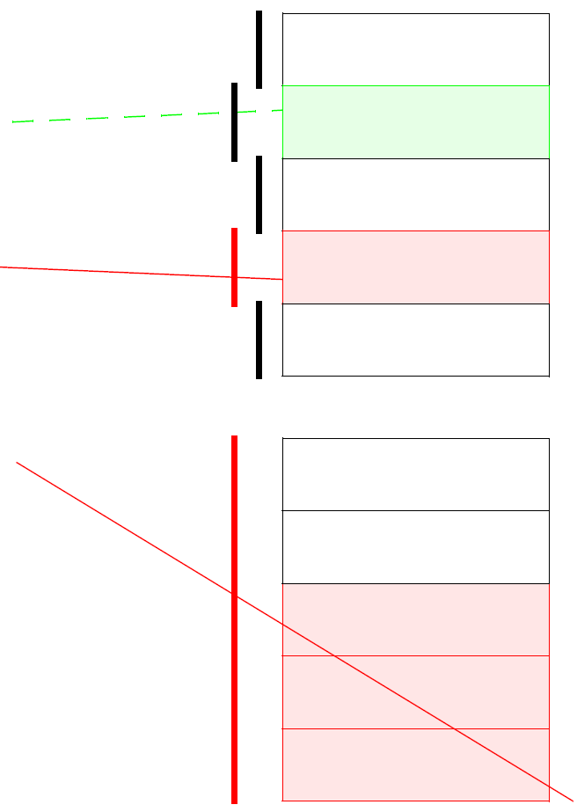
Veto Detector
Set of scintillators placed in front of a calorimeter to act as simple counters.
A charged particle will create a signal in the scintillator, but a photon will not.
Side view
Top view
Slide courtesy of M. Fortner, N. Illinois University

Slide 10
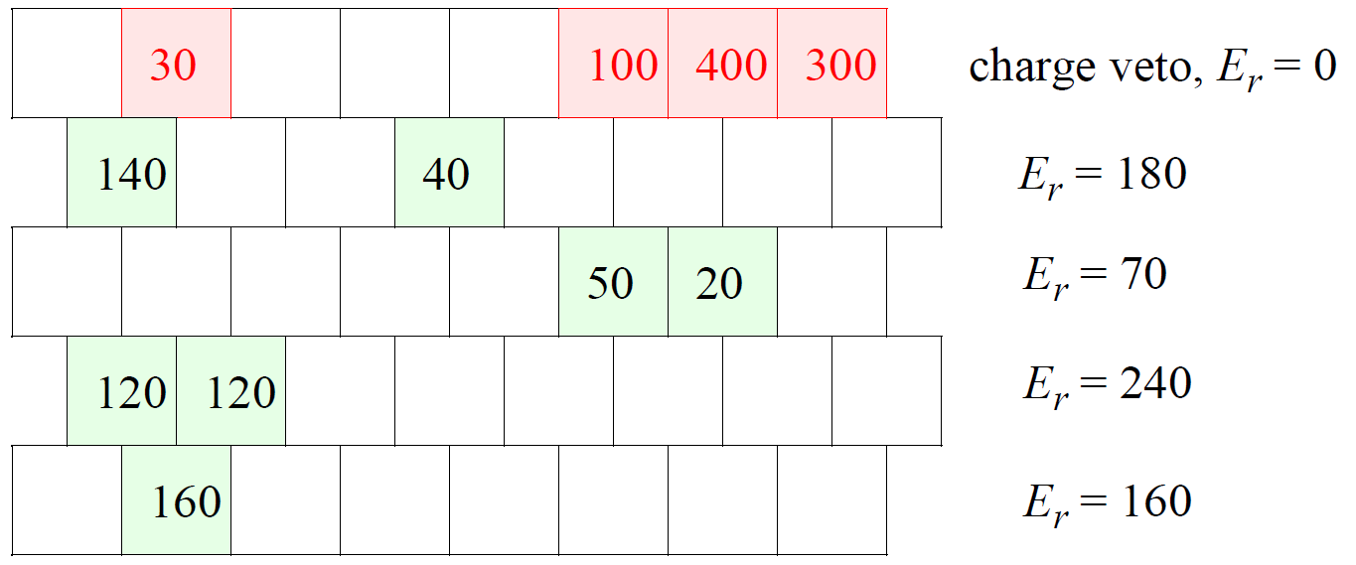
Neutral rows
Simple trigger solution: Sum all the energy in a row when not vetoed by the scintillator.
If any row exceeds 300 MeV it’s a good event.
Trigger will exclude $π$’s & soft-$γ$ spray.
Trigger inefficient when a good $γ$ spreads energy between two rows
Slide courtesy of M. Fortner, N. Illinois University

Slide 11
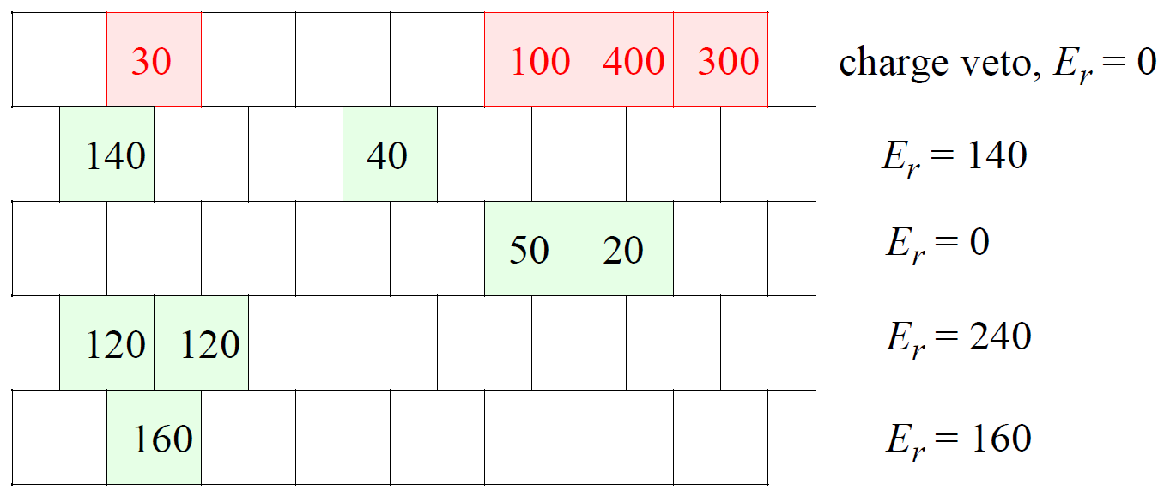
Selected Sum
Better trigger sums all blocks not vetoed, but insist that each cell exceed a 75 MeV threshold
Excludes $π$’s and soft-$γ$ spray
Better at finding 2-row $γ$’s
Slide courtesy of M. Fortner, N. Illinois University

Slide 12
Logic gates
A gate is a circuit element that operates on a binary signal
Logic operations typically have three methods of description:
Equation symbol
Truth table
Circuit symbol
When levels refer to Boolean expressions they are referred to as True and False.
Logic levels are T=True & F=False
Binary levels are 1=True & 0=False
When levels refer to electronic voltage levels they are called High and Low
Logic H=High & L=Low
Binary levels are 1=High & 0=Low

Slide 13
Unary operators – 1 input
The identity operator leaves the value unchanged
The inverse operation reverses the value and is called NOT.
$$A_{in}$$ | $$A_{out}$$
0 | 0
1 | 1
$$A$$
$$A$$
$$A_{in}$$ | $$A_{out}$$
0 | 1
1 | 0
$$A$$
$$\overline{A}$$
Slide courtesy of M. Fortner, N. Illinois University

Slide 14
Binary operators – 2 inputs
AND operator acts like multiplication
OR operator acts like addition
$$A$$ | $$B$$ | $$A⋅B$$
0 | 0 | 0
0 | 1 | 0
1 | 0 | 0
1 | 1 | 1
$$A$$
$$A⋅B$$
$$B$$
$$A$$ | $$B$$ | $$A+B$$
0 | 0 | 0
0 | 1 | 1
1 | 0 | 1
1 | 1 | 1
$$A$$
$$A+B$$
$$B$$
Slide courtesy of M. Fortner, N. Illinois University

Slide 15
Compound operations
Combination of NOT & AND is NAND
Combination of NOT & OR is NOR
$$A$$ | $$B$$ | $$\overline{A⋅B}$$
0 | 0 | 1
0 | 1 | 1
1 | 0 | 1
1 | 1 | 0
$$A$$
$$\overline{A⋅B}$$
$$B$$
$$A$$ | $$B$$ | $$\overline{A+B}$$
0 | 0 | 1
0 | 1 | 0
1 | 0 | 0
1 | 1 | 0
$$A$$
$$\overline{A+B}$$
$$B$$
Slide courtesy of M. Fortner, N. Illinois University

Slide 16
Compound operations
Combination of NOT & AND is NAND
Combination of NOT & OR is NOR
Either NAND or NOR gates can be used to create other logic gates
$$A$$
$$\overline{A⋅B}$$
$$B$$
$$\overline{\left(\overline{A⋅B}\right)⋅(\overline{A⋅B})}=A⋅B$$
$$\overline{\left(\overline{A+A}\right)+(\overline{B+B})}=A⋅B$$
Slide courtesy of M. Fortner, N. Illinois University

Slide 17
Many many many many many more
Exclusive OR
Flip-Flops
Clocks
Counters
Multistage dividers
A plethora of amplifiers
Summation
Difference
Multipliers

Slide 18
Analog to digital conversion
Signal attributes are most easily processed when converted to a digital signal

Slide 19
Analog to digital conversion
Signal attributes are most easily processed when converted to a digital signal

Slide 20
Analog to digital conversion
Signal attributes are most easily processed when converted to a digital signal

Slide 21
Analog to digital conversion
Signal attributes are most easily processed when converted to a digital signal

Slide 22
Analog to digital conversion
Signal attributes are most easily processed when converted to a digital signal

Slide 23
Analog to digital conversion
Signal attributes are most easily processed when converted to a digital signal

Slide 24
Digital signals make logic easy/possible
Electronics that analyze systems to be when measuring quantized pieces of information.
Improving the sampling rate allows for finer “level-splitting” but most electronics only have two states: 0 and 1 – Logic signals
Logic carries less information more reliably
Don’t have to worry about maintaining the full waveform

Slide 25
Digital signals make logic easy/possible
Electronics that analyze systems to be when measuring quantized pieces of information.
Improving the sampling rate allows for finer “level-splitting” but most electronics only have two states: 0 and 1 – Logic signals
Logic carries less information more reliably
Don’t have to worry about maintaining the full waveform
It would be easier to define a standard
Or 5 standards, it doesn’t really matter as long as we know what we’re dealing with

Slide 26
The Nuclear Instrument Module (NIM) standard
Slow positive logic
Fast negative logic (NIM logic)
Slow rise time
≥ 100 ns
Positive polarity
Designed for high input impedance (≥ 1000 Ω)
Low current
Can’t be transmitted over long cable
Not used so often
Fast rise time
~1 ns
Negative polarity
Current based standard & low impedance
Current into 50 Ω
Logic 0: 0 V
Logic 1: -0.8 V
 | Output must deliver | Input must accept
Logic 0 | -2 to +1 V | -2 to +1.5 V
Logic 1 | +4 to +12 V | +3 to +12 V
 | Output must deliver | Input must accept
Logic 0 | -1 to +1 mA | -4 to +20 mA
Logic 1 | -14 to -18 mA | -12 to -36 mA

Slide 27
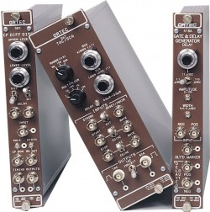
But wait…there’s more
NIM is also a standard for electronics modules.
Can be single-wide, double-wide or triple-wide

Slide 28
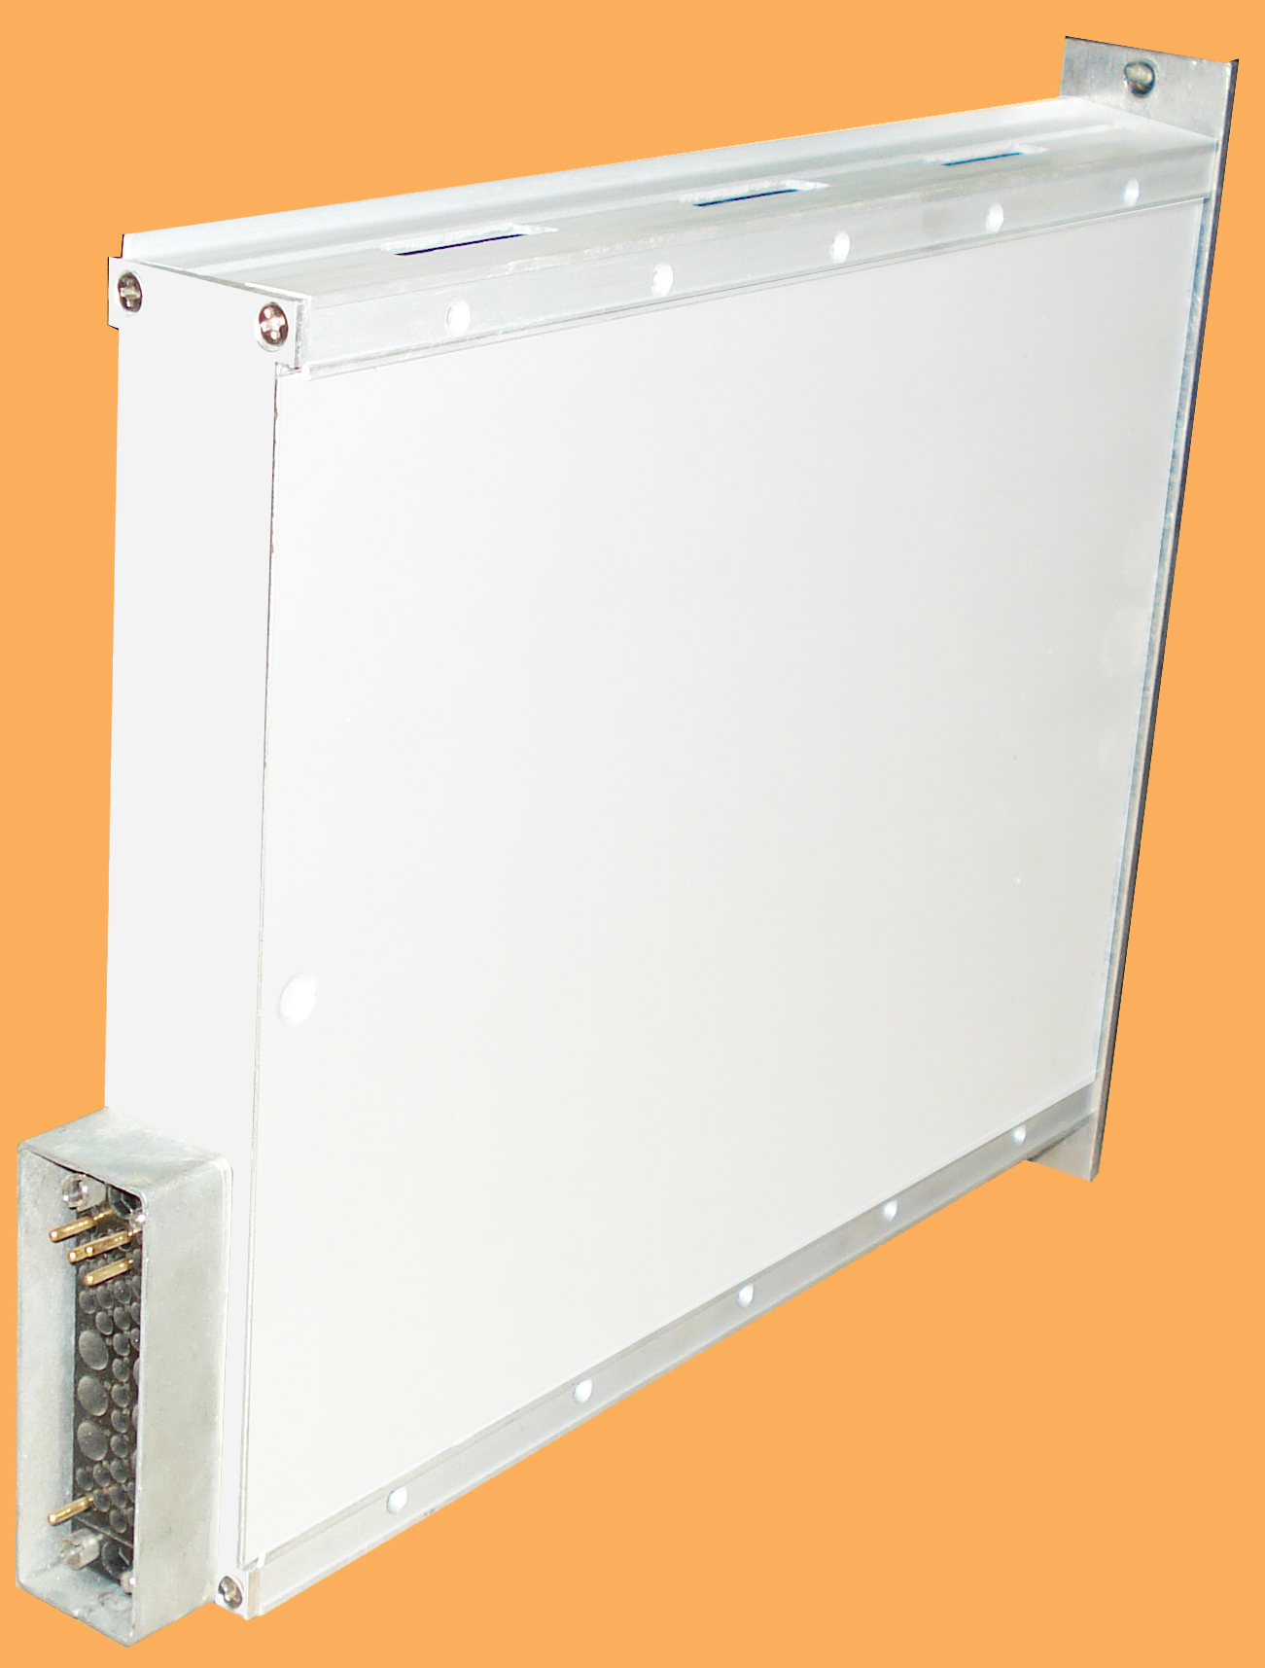
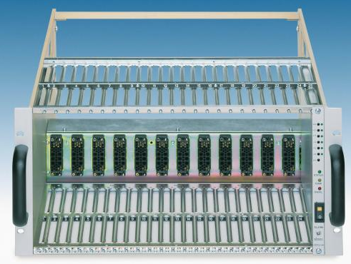
But wait…there’s more
NIM is also a standard for electronics modules.
Modules are designed to mate with a crate

Slide 29
But wait…there’s more
NIM is also a standard for electronics modules.
Modules are designed to mate with a crate
Crate provides
±6V
±12V
±24V
All pins bussed
No communication between modules
Modules can be quickly added for different experimental needs
Many lab have pools of NIM modules

Slide 30
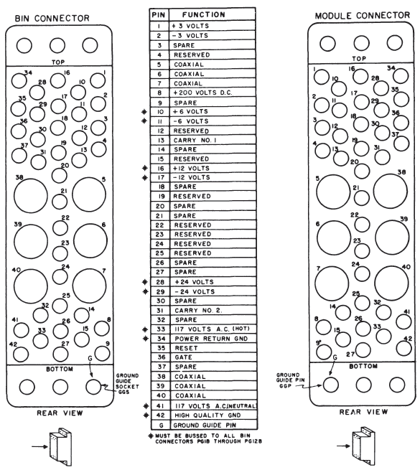

Slide 31
Common off-standard logic
NIM signals can be counterintuitive or limiting so other signal standards are often included
Transistor-Transistor Logic (TTL)
Positive going logic
Emitter Coupled Logic (ECL)
Faster & easier to use than fast negative NIM
 | TTL | ECL
Logic 0 | +0 to +0.8 V | -1.75 V
Logic 1 | +2 to +5 V | -0.90 V
Note the smaller jump

Slide 32
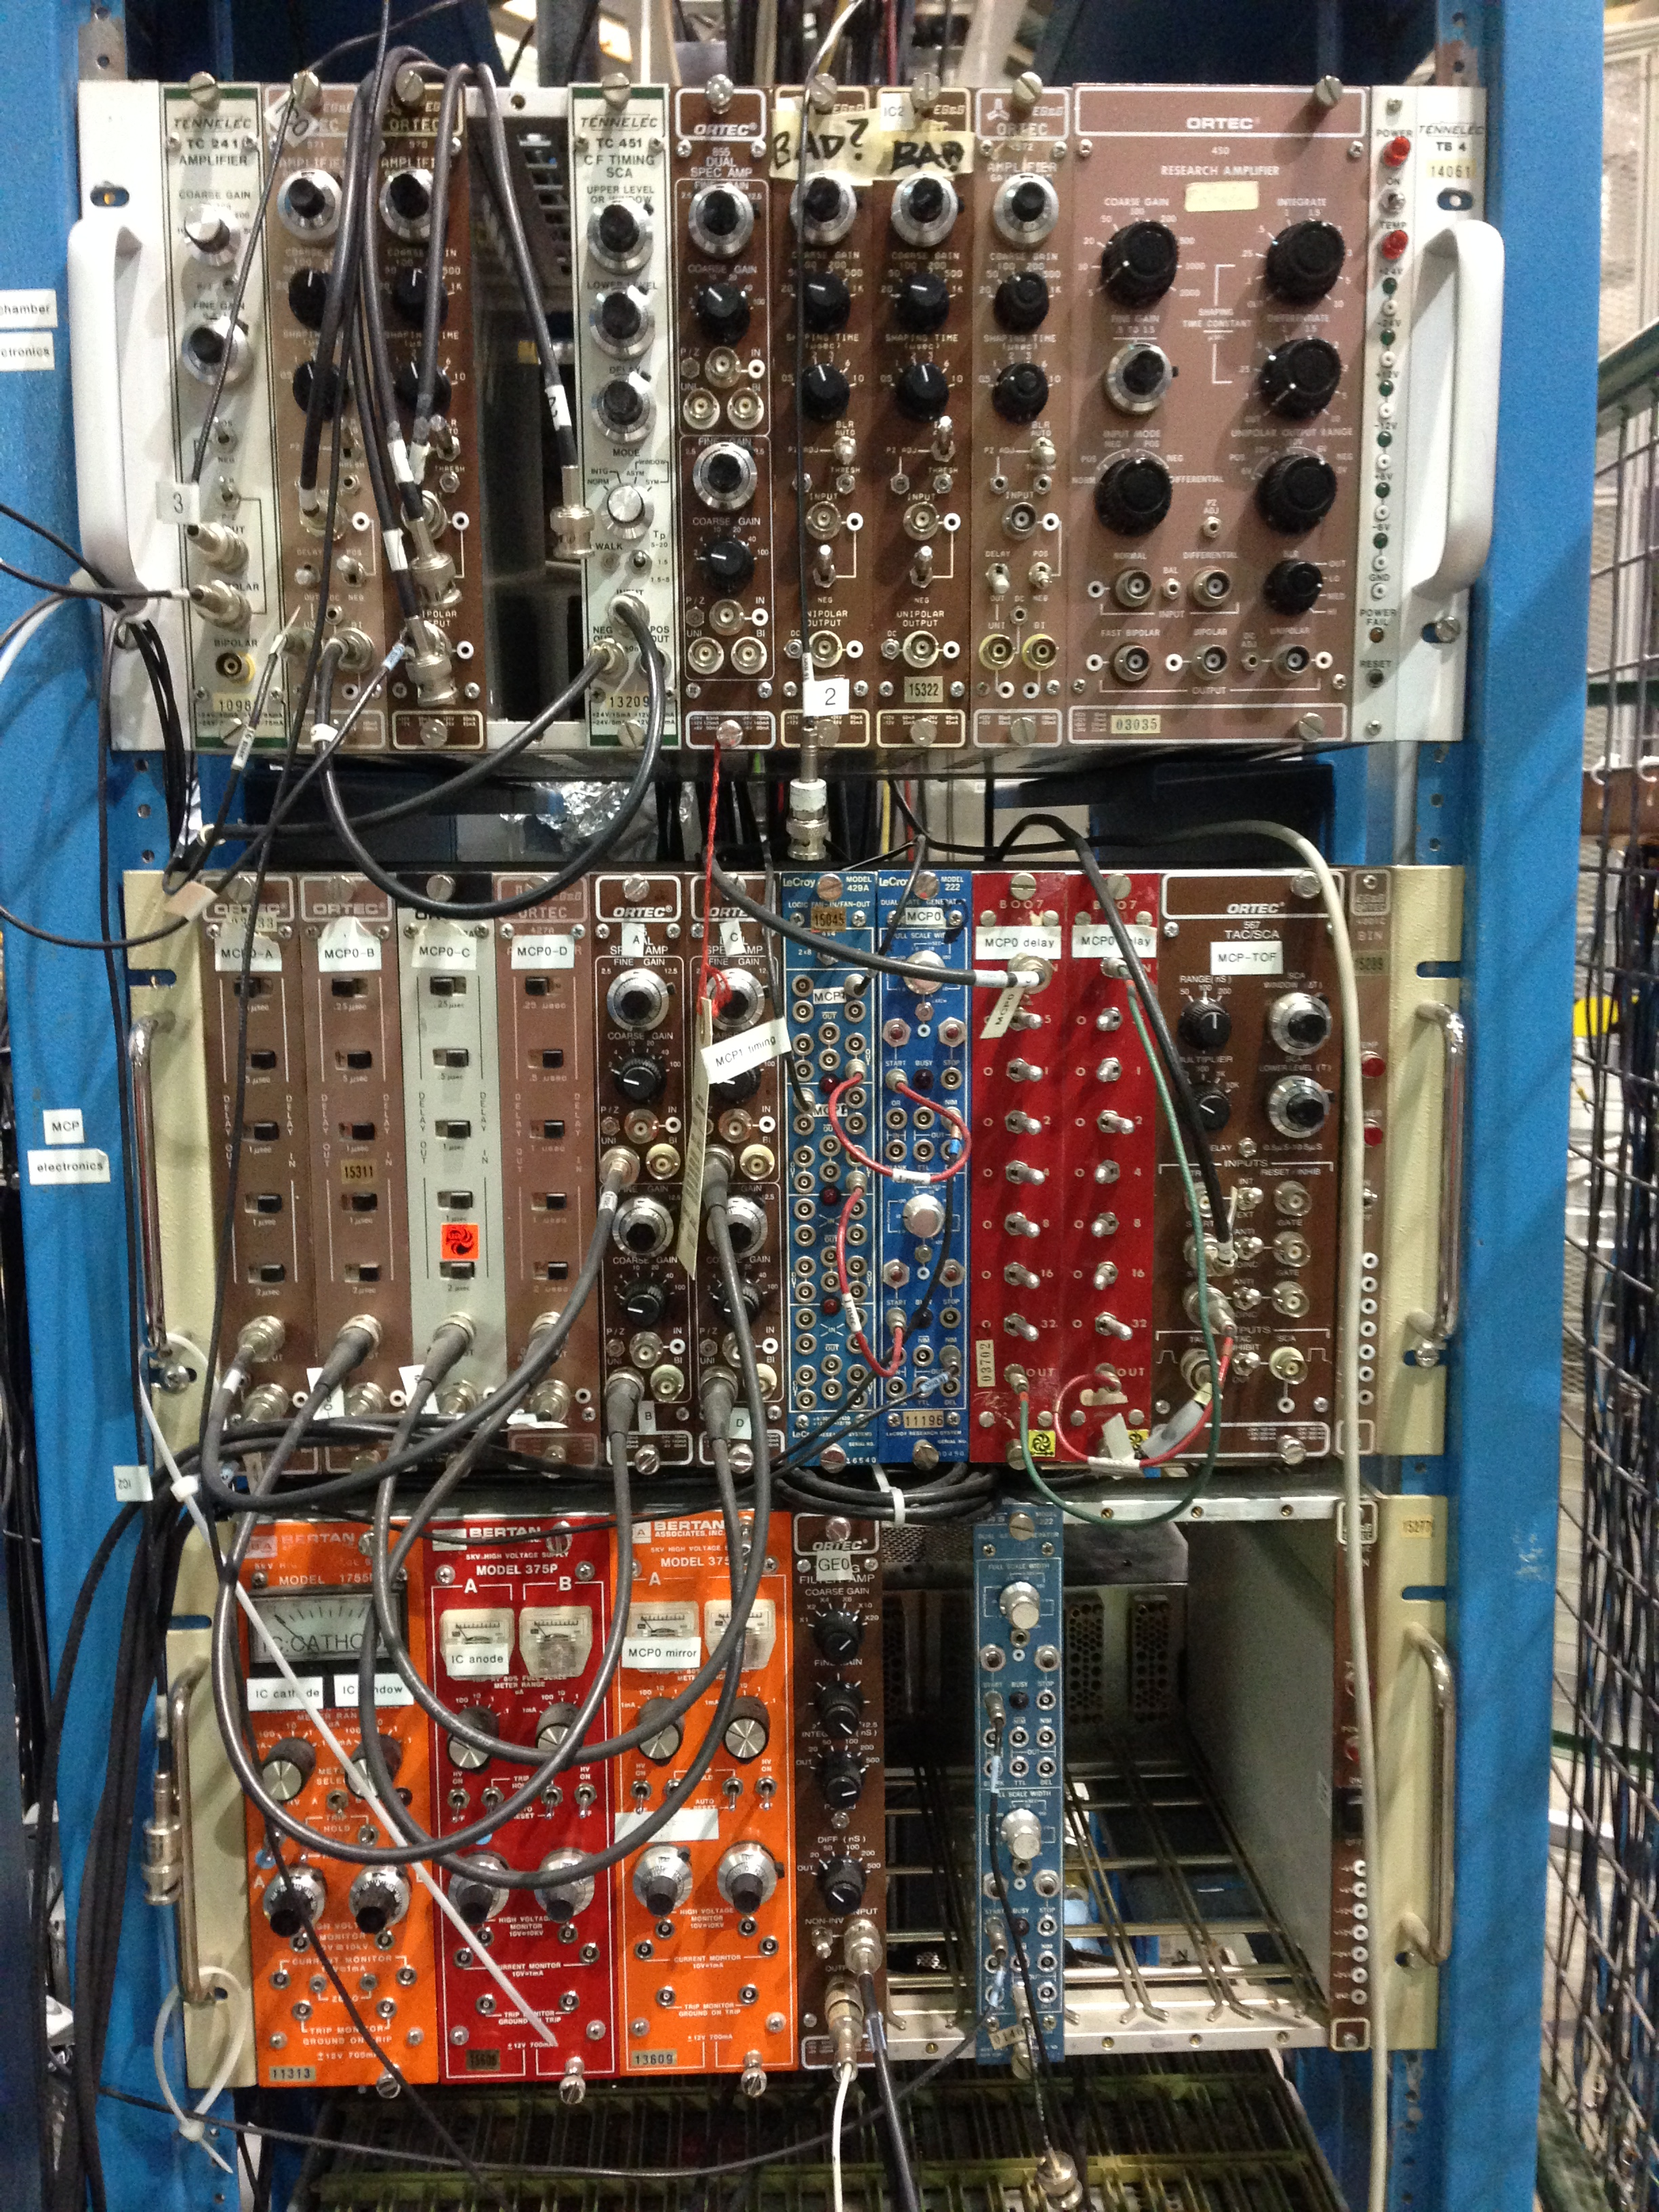

Slide 33
CAMAC: Time to make life more complicated…interesting
The NIM standard:
Doesn’t handle large amounts of digital data easily
Interface with a computer is done on a module by module basis
Modules are normally wider than they need to be if no readout meter is required.
A new standard to:
Make the modules thinner
Include a common dataway for communication
Still fit in a standard 19” rack

Slide 34
The Computer Automated Measurement And Control (CAMAC) Standard
Introduced in 1969 and adopted in 1972
25 module stations 17.2 mm wide
Double- and triple-wide modules are allowed
Modules normally made of a single PCB with an edge connector of 86 contacts.
Every station has:
±6V
±12V (not required by standard but normally there)
±24V
Separate read and write lines (24 pairs in total)
Notes:
Double wide modules are important for large components like relays.

Slide 35
The CAMAC controller
The extreme right station is the control station
All read and write lines connect.
A special crate controller module must go in the last station
System won’t function without a controller
Controller
Transfers data to/from control PC
Communicates with all modules
Mediates communication between modules
Communication designed for FORTRAN but by now there’s translators for every language

Slide 36
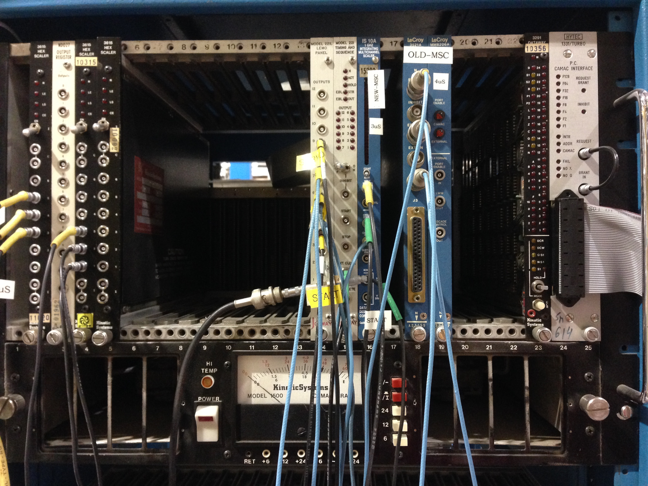

Slide 37
For more on CAMAC
Entire classes could be given on the CAMAC standard and communication
Leo Chapter 18 is a great start
Fermilab’s Introduction to CAMAC
http://cdorg.fnal.gov/ese/prep/introCamac.php
CAMAC Tutorial Issue, IEEE Trans. Nucl. Sci. NS-20 2 (1973)
http://ieeexplore.ieee.org/xpl/tocresult.jsp?isnumber=4327008&punumber=23

Slide 38
From CAMAC to VME
As experiments grew larger, the CAMAC data busses couldn’t keep up and latency increased
Dead time = Bad
Modules expensive
Not hot-swappable
VME designed to accommodate fast microprocessor control
Made with industry standard parts so cheaper

Slide 39
From CAMAC to VME
VME crate requires a controller
Performs bus arbitration
Provides and maintains timeout errors
System clock
Other system utilities
Modules can send messages directly to each other
Controller only opens and closes access to dataway
Communication is asynchronous and can proceed as fast as the slowest communicator
VMEbus modules tend to be set via software only
Notes:
All data transfers occur in terms of direct memory access
In CAMAC, all messages were passed through and processed by the controller, in VME, the controller simply grants access to the dataway to both sides for the duration of the communication.
For PC interface, Controller just grants access to the module. You communicate directly to the module.

Slide 40
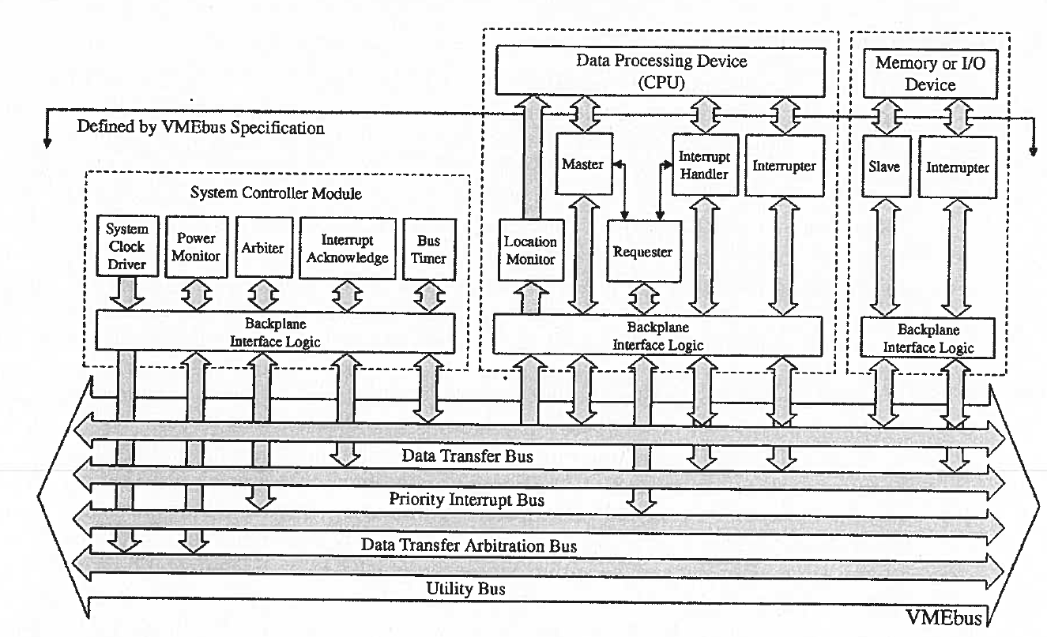
For more on VME
W. D. Peterson, The VMEbus Handbook, VITA, Scottsdale, Az 1997.
American National Standard for VME64 Extensions for Physics and Other Applications
https://ph-dep-ese.web.cern.ch/ph-dep-ese/crates/standards/Av23.pdf

Slide 41
Transmission lines
The goals of signal transmission
Get the signal from point A to point B
Preserve the signal’s information
We tend to think of a connecting wire as something with negligible C and negligible self-inductance where any voltage applied at one end is immediately present at the other end.
Not So
Rule of thumb: $l_{\text{line}}≤0.02t_{r}c$
For $t_{r}=10$ ns: $l_{line}≤6$ cm
Need transmission lines (wave guide)

Slide 42
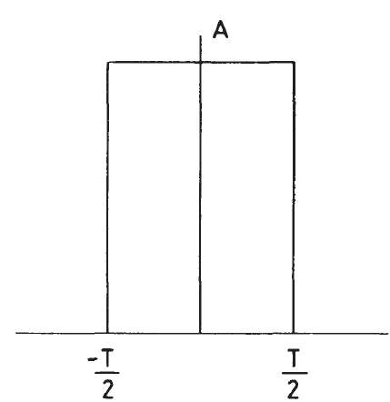
Transmission lines
Transmission lines carry rf signals efficiently
But a pulse isn’t rf.
What gives?
$$V$$
$$t$$

Slide 43
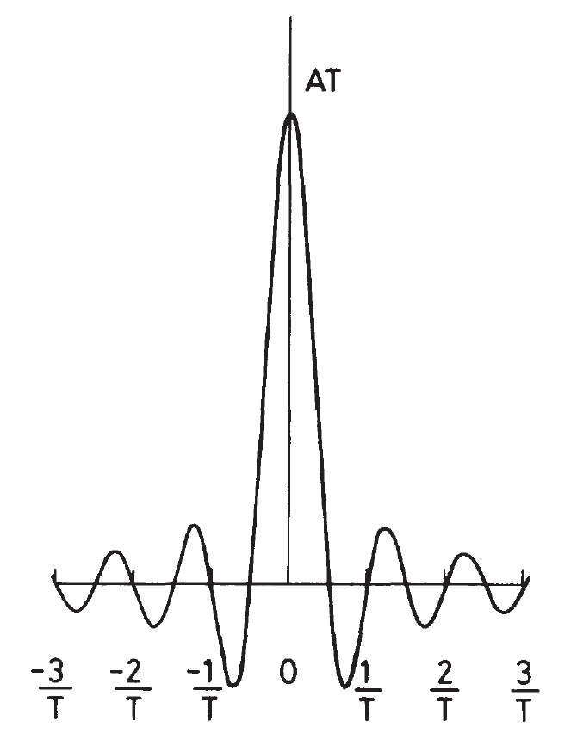
Fourier Analysis
Any pulse can be decomposed into a superposition of many pure sinusoidal frequencies
$$V$$
$$VT$$
$$t$$
$$ν=ω/2π$$
Notes:
When we perform a Fourier transform on the pulse we can see that the pulse contains a continuous spectrum of frequency components from 0 to $∞$.
As long as the bandwidth is sufficient, you can transmit anything over a transmission line.

Slide 44
Fourier Analysis
Any pulse can be decomposed into a superposition of many pure sinusoidal frequencies
A pulse:
Shape in time $f(t)$
$$V$$
$$V$$
$$t$$
$$f\left(t\right)=\frac{1}{\sqrt{2π}}\int_{−∞}^{∞}{g(ω)e^{iωt}dω}$$
$$g\left(ω\right)=\frac{1}{\sqrt{2π}}\int_{−∞}^{∞}{f(t)e^{−iωt}dt}$$
$$t$$
Notes:
When we perform a Fourier transform on the pulse we can see that the pulse contains a continuous spectrum of frequency components from 0 to $∞$.
As long as the bandwidth is sufficient, you can transmit anything over a transmission line.
$g(ω)$ is the Fourier transform or frequency spectrum of the pulse

Slide 45
Fourier Analysis
Any pulse can be decomposed into a superposition of many pure sinusoidal frequencies
A pulse:
Shape in time $f(t)$
$$V$$
$$VT$$
$$f\left(t\right)=\frac{1}{\sqrt{2π}}\int_{−∞}^{∞}{g(ω)e^{iωt}dω}$$
$$t$$
$$g\left(ω\right)=\frac{1}{\sqrt{2π}}\int_{−∞}^{∞}{f(t)e^{−iωt}dt}=\frac{V}{\sqrt{2π}}\int_{−\frac{T}{2}}^{\frac{T}{2}}{e^{−iωt}dt}=\frac{VT}{\sqrt{2π}}\frac{\sin\left({ωT}/2\right)}{\left({ωT}/2\right)}$$
$$f\left(t\right)=\left\{\begin{matrix}V \left|t\right|<T/2 \\ 0 \left|t\right|>T/2\end{matrix}\right.$$
Notes:
When we perform a Fourier transform on the pulse we can see that the pulse contains a continuous spectrum of frequency components from 0 to $∞$.
As long as the bandwidth is sufficient, you can transmit anything over a transmission line.
$g(ω)$ is the Fourier transform or frequency spectrum of the pulse
Negative frequencies are imaginary

Slide 46
Bandwidth
All frequencies contribute in a perfect reproduction…but who wants to be perfect?
If you perform the inverse Fourier transform over a fixed interval:
$Δν>1/T$ for reasonable approximation
For a 10 ns pulse: $Δν≥100$ MHz
$$f\left(t\right)=\frac{1}{\sqrt{2π}}\int_{−C/T}^{C/T}{g(ω)e^{iωt}dω}$$
$$Δν=1/T$$
$$Δν=5/T$$
$$Δν=0.1/T$$
$$Δν=0.5/T$$

Slide 47
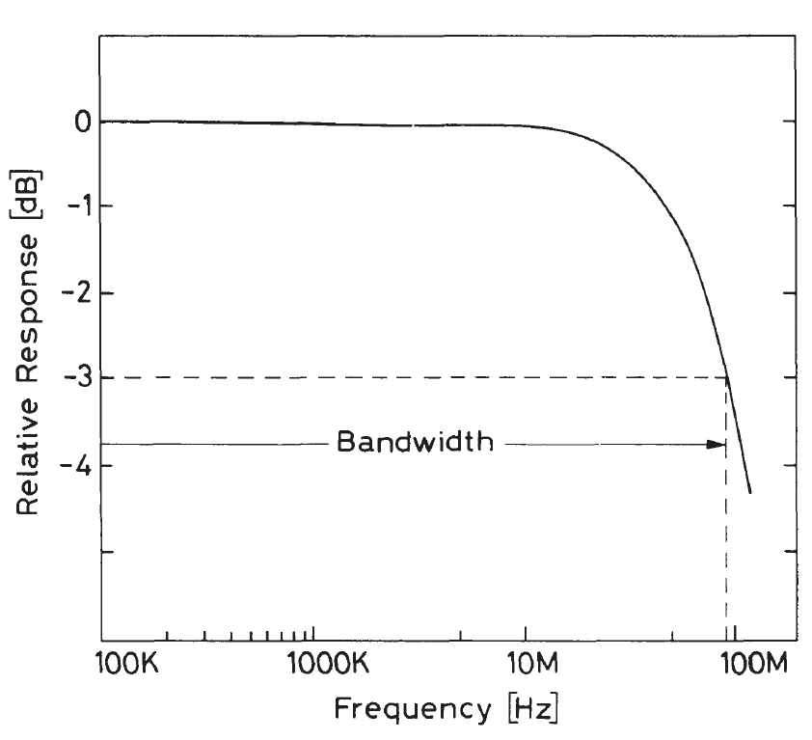
Bandwidth
$Δν>1/T$ for reasonable approximation
For a 10 ns pulse: $Δν≥100$ MHz
3 dB decline in response: bandwidth
Corresponds to ~70% of the original signal

Slide 48
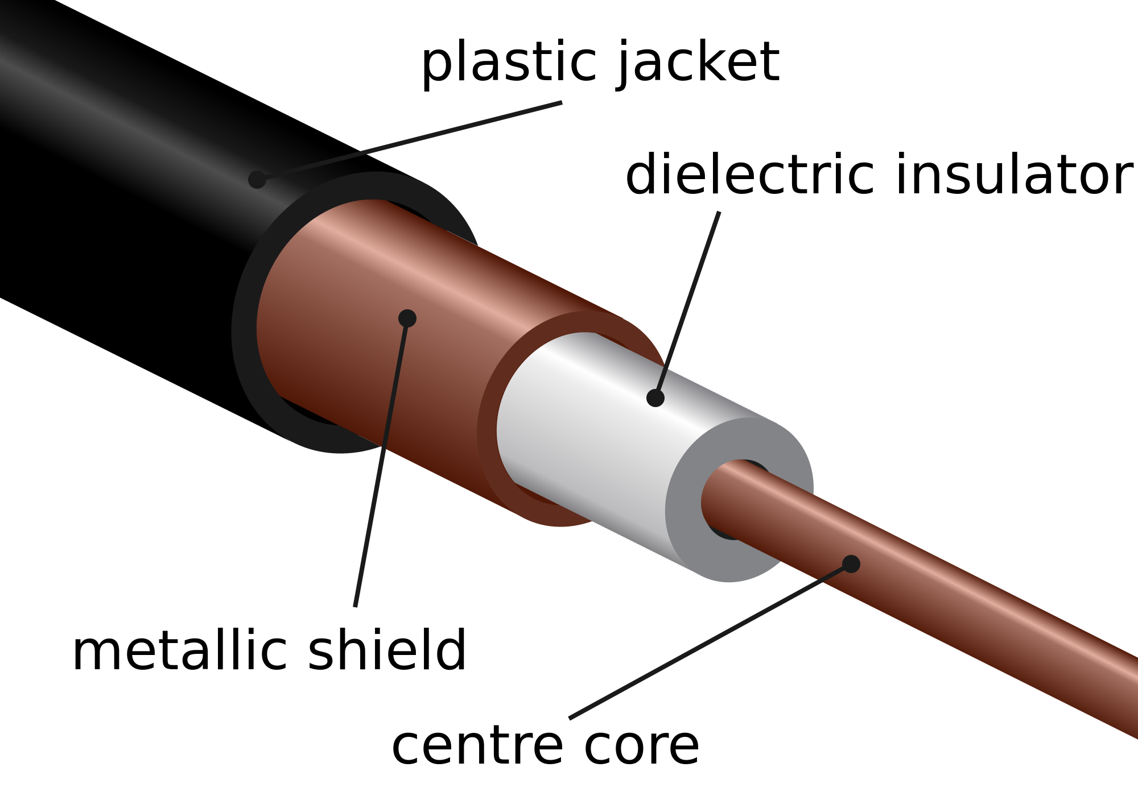
The coaxial cable
Source: Wikimedia commons

Slide 49
The coaxial cable
Minimizes pickup from electric and electromagnetic fields
Shield is normally braided for flexibility
Velocity of propagation $\left(v_{p}\right)$ a function of:
$1/\sqrt{k}$
Separation between inner and outer conductor
$v_{p}\left(\text{polyethelyne}\right)≈0.66c$
Characteristic impedance also a function of:
$k$
Separation between inner and outer conductor
Notes:
K is the dielectric constant of the insulator

Slide 50
Termination
v_{s}
$$R_{t}$$
Cable has characteristic impedance $R$
Imagine a generator creating a step voltage change from 0 to $V_{0}$ at $t=0$
Step travels along at $v_{p}$ drawing $I=\frac{V_{0}}{R}$ until the signal reaches the end of the cable
Notes:
At the end, the cable is charged.

Slide 51
Termination
v_{s}
$$R_{t}$$
Cable has characteristic impedance $R$
Imagine a generator creating a step voltage change from 0 to $V_{0}$ at $t=0$
Step travels along at $v_{p}$ drawing $I=\frac{V_{0}}{R}$ until the signal reaches the end of the cable
Things get interesting at the end
If $R_{t}=R→$ The signal won’t reflect
If $R_{t}=0→$ Inverted signal reflected

Slide 52
Termination
v_{s}
$$R_{t}$$
Cable has characteristic impedance $Z_{0}$
Imagine a generator creating a step voltage change from 0 to $V_{0}$ at $t=0$
Step travels along at $v_{p}$ drawing $I=\frac{V_{0}}{Z_{0}}$ until the signal reaches the end of the cable
Things get interesting at the end
If $R_{t}=Z_{0}→$ The signal won’t reflect
If $R_{t}=0→$ Inverted signal reflected
If $R_{t}=∞→$ Same polarity signal reflected
Notes:
We normally talk about terminating the cable but we’re really terminating the device.
If the input impedance doesn’t match the characteristic impedance of the cable, the input has to be brought down

Slide 53
Termination
v_{s}
$$R_{t}$$
Given a cable with
Characteristic impedance $Z_{0}$
Input waveform with amplitude $A_{0}$
$$R_{t}$$ | Reflected amplitude, A
0 | $$−A_{0}$$
$$0<R_{t}<Z_{0}$$ | $$−A_{0}<A<0$$
$$Z_{0}$$ | 0
$$Z_{0}<R_{t}<∞$$ | $$0>A>A_{0}$$
$$∞$$ | $$A_{0}$$

