Slide 1
Instrumentation Upgrades to TITAN’s Cooler Penning Trap
2016 APS Division of Nuclear Physics Meeting
October 13-16, 2016 – Vancouver, BC
D. Lascar | Postdoctoral Fellow | TRIUMF

Slide 2
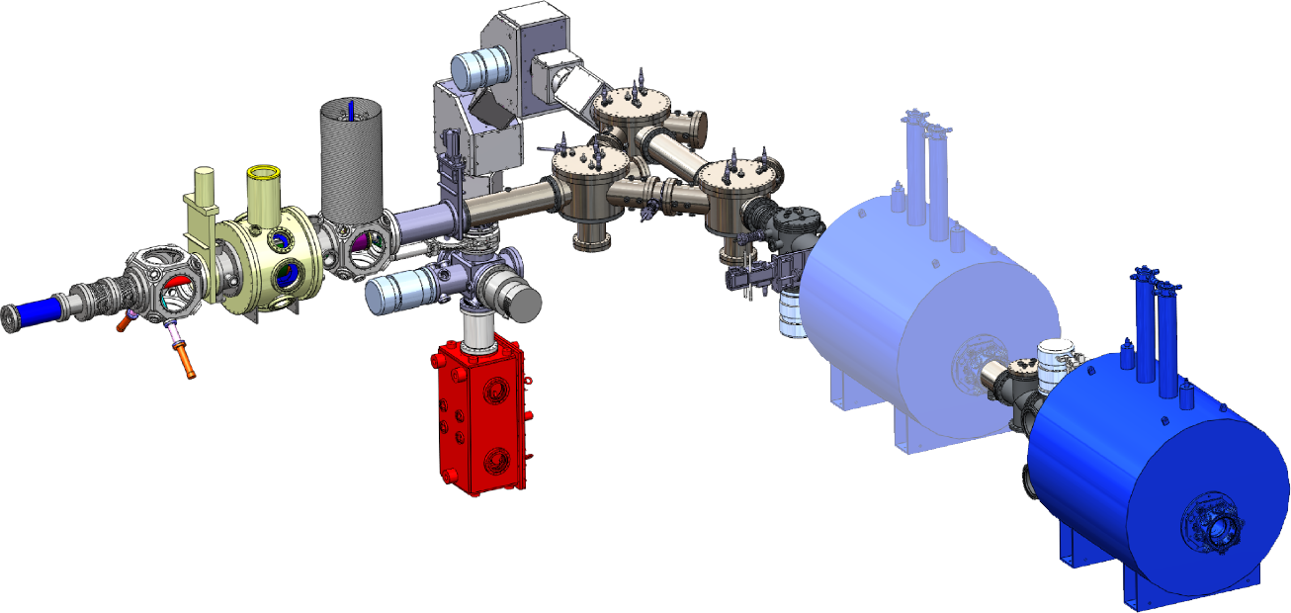
TITAN
Electron Beam Ion Trap
EBIT
Charge breeder
Cooler PEnning Trap
CPET
HCI cooling
SCI
HCI
RadioFrequency Quadruple trap
RFQ
Cooling and bunching
Measurement PEnning Trap
MPET
Precision mass measurement
Rare isotope beam
ISAC
Notes:
Mention that ultimately we need to send ions to MPET for mass measurements

Slide 3
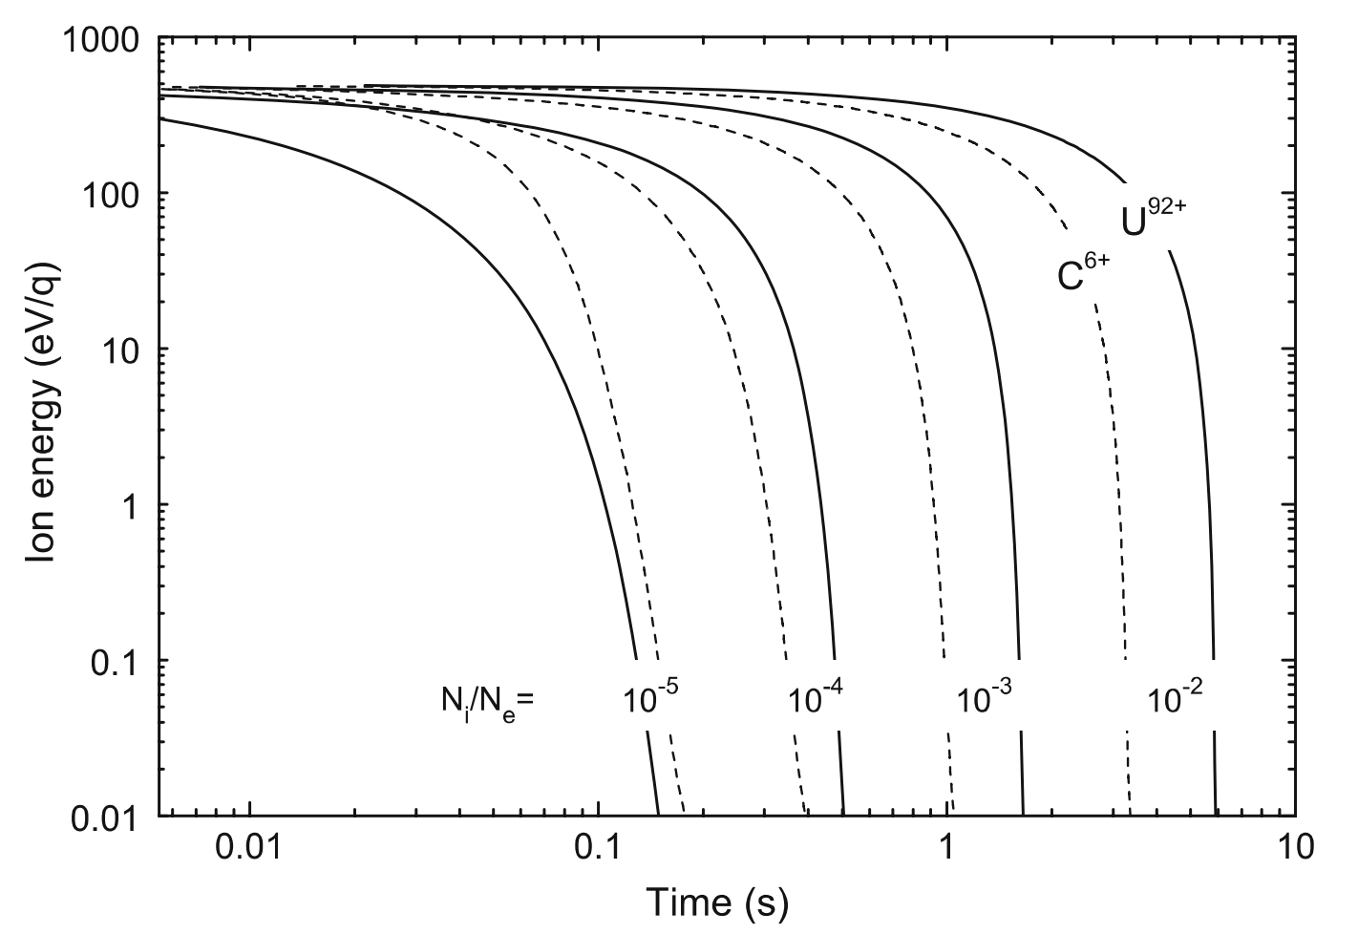
Detecting the plasma
30 eV/q
10⁸-10⁹ electrons detected
1 eV/q
~50ms
Z. Ke et al Hyp. Inter. 173 103 (2007)
U. Chowdhury et al AIP Conf. Proc. 1640 120 (2015)
Notes:
SLOW THE FUCK DOWN
10⁸-10⁹ electrons detected with phosphor screen.
Explain the graph and what the ratio is.
Given 10³ ions, this puts us in the sweet spot for fast cooling

Slide 4
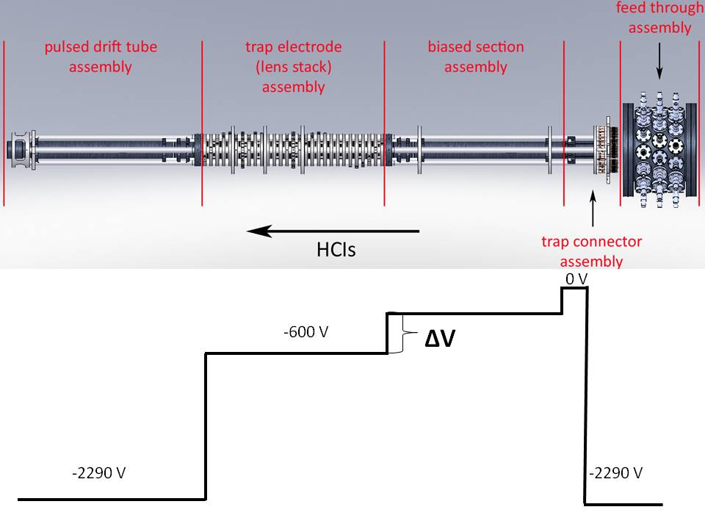
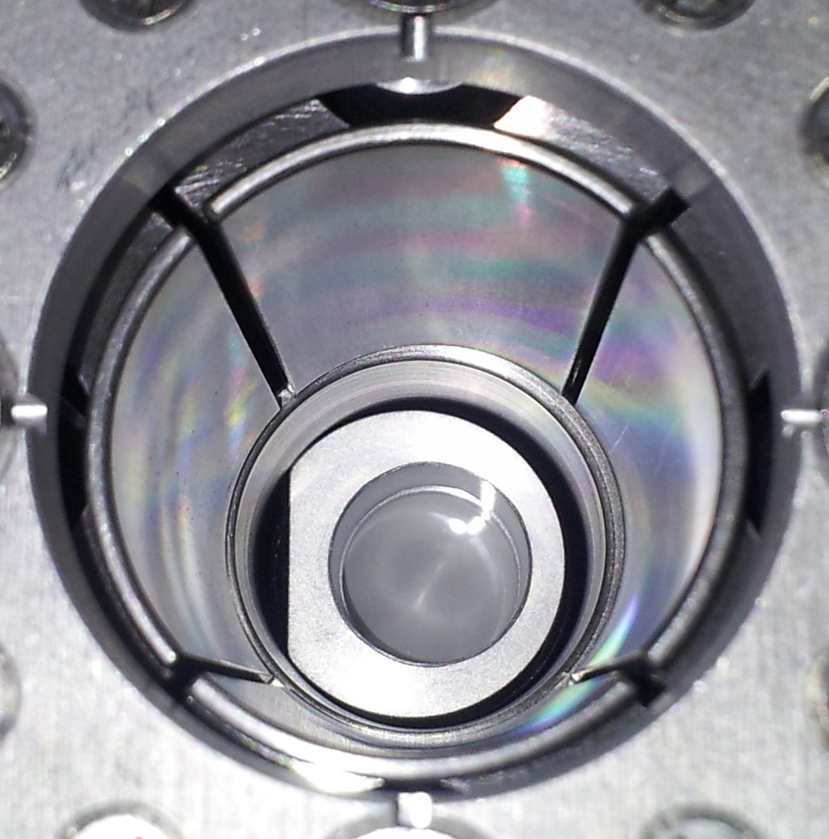
Phosphor screens are not transparent
Ions can’t enter the trap!!

Slide 5
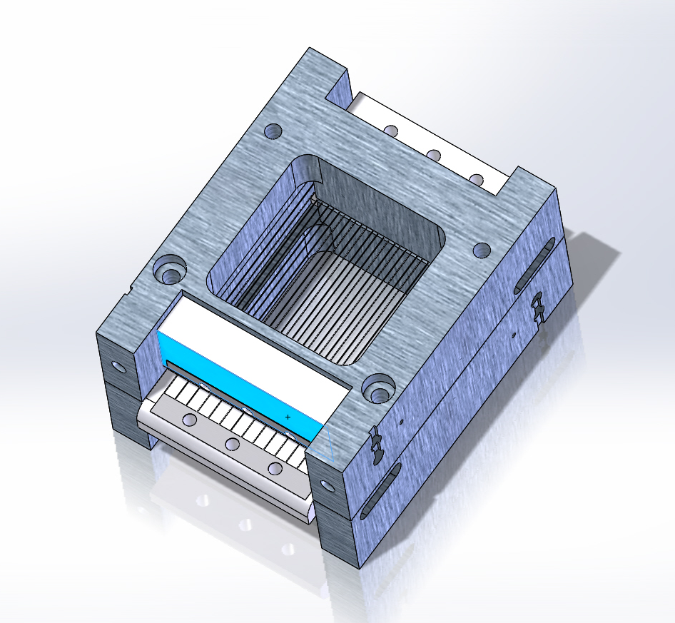
Detection based on Bradbury Nielsen Gate (BNG) concept
2 sets of alternating wires
$V_{\text{drift}}±ΔV$ applied to alternating wires
$$ΔV=0$$
No deflection
$$ΔV≠0$$
Deflection
T. Brunner et al IJMS 309 97 (2012)

Slide 6
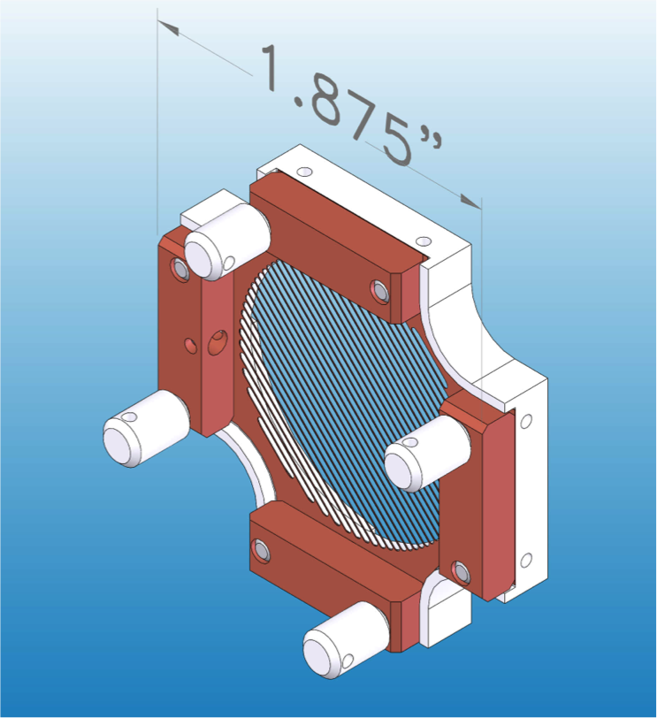
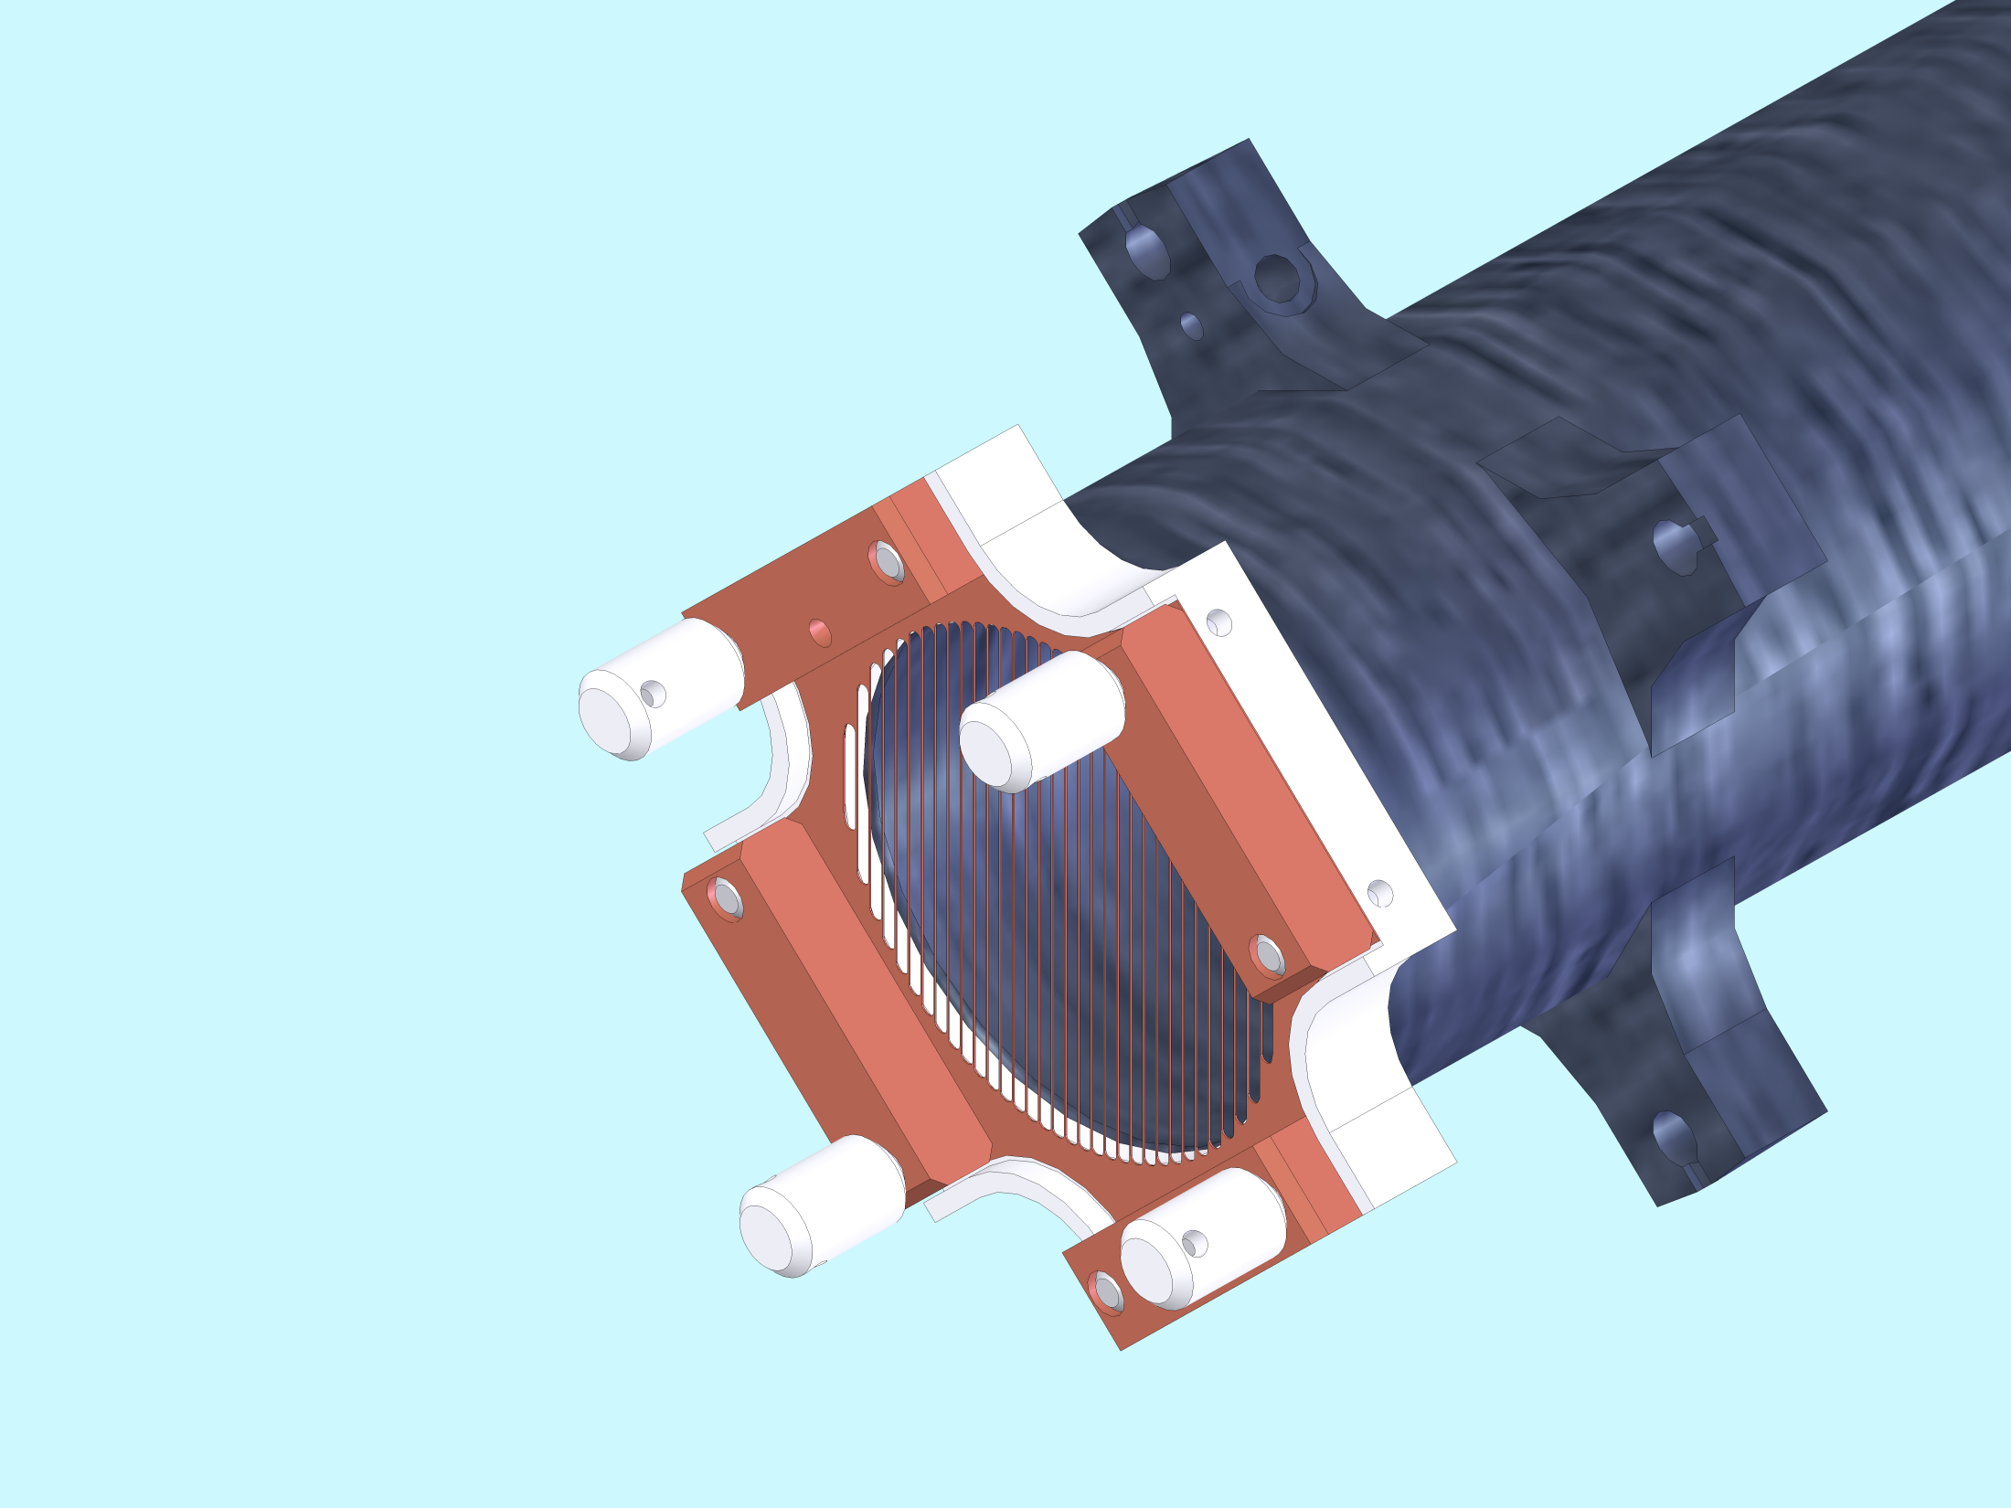
New mesh detector
0.1 mm thick
Charge agnostic
Can be made effectively transparent
Rugged & Customizable
Design translatable to almost any setup
D. Lascar et al. NIMB 376 292 (2016)
D. Lascar et al. NIMA submitted (arXiv:1609.05262)
Notes:
Taken advantage of advances in photochemical machining.

Slide 8
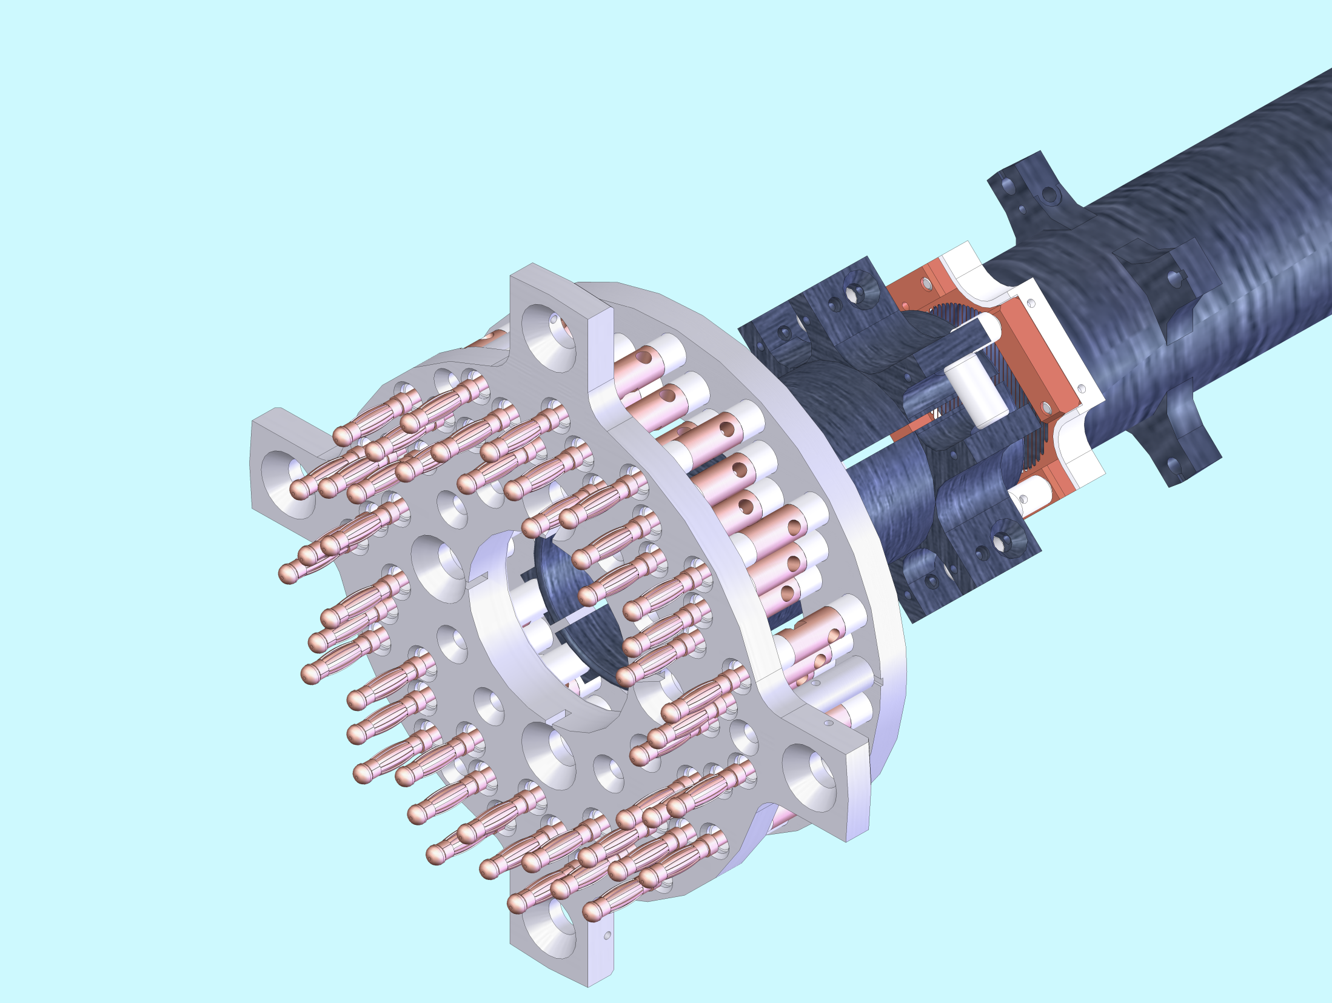

Slide 9
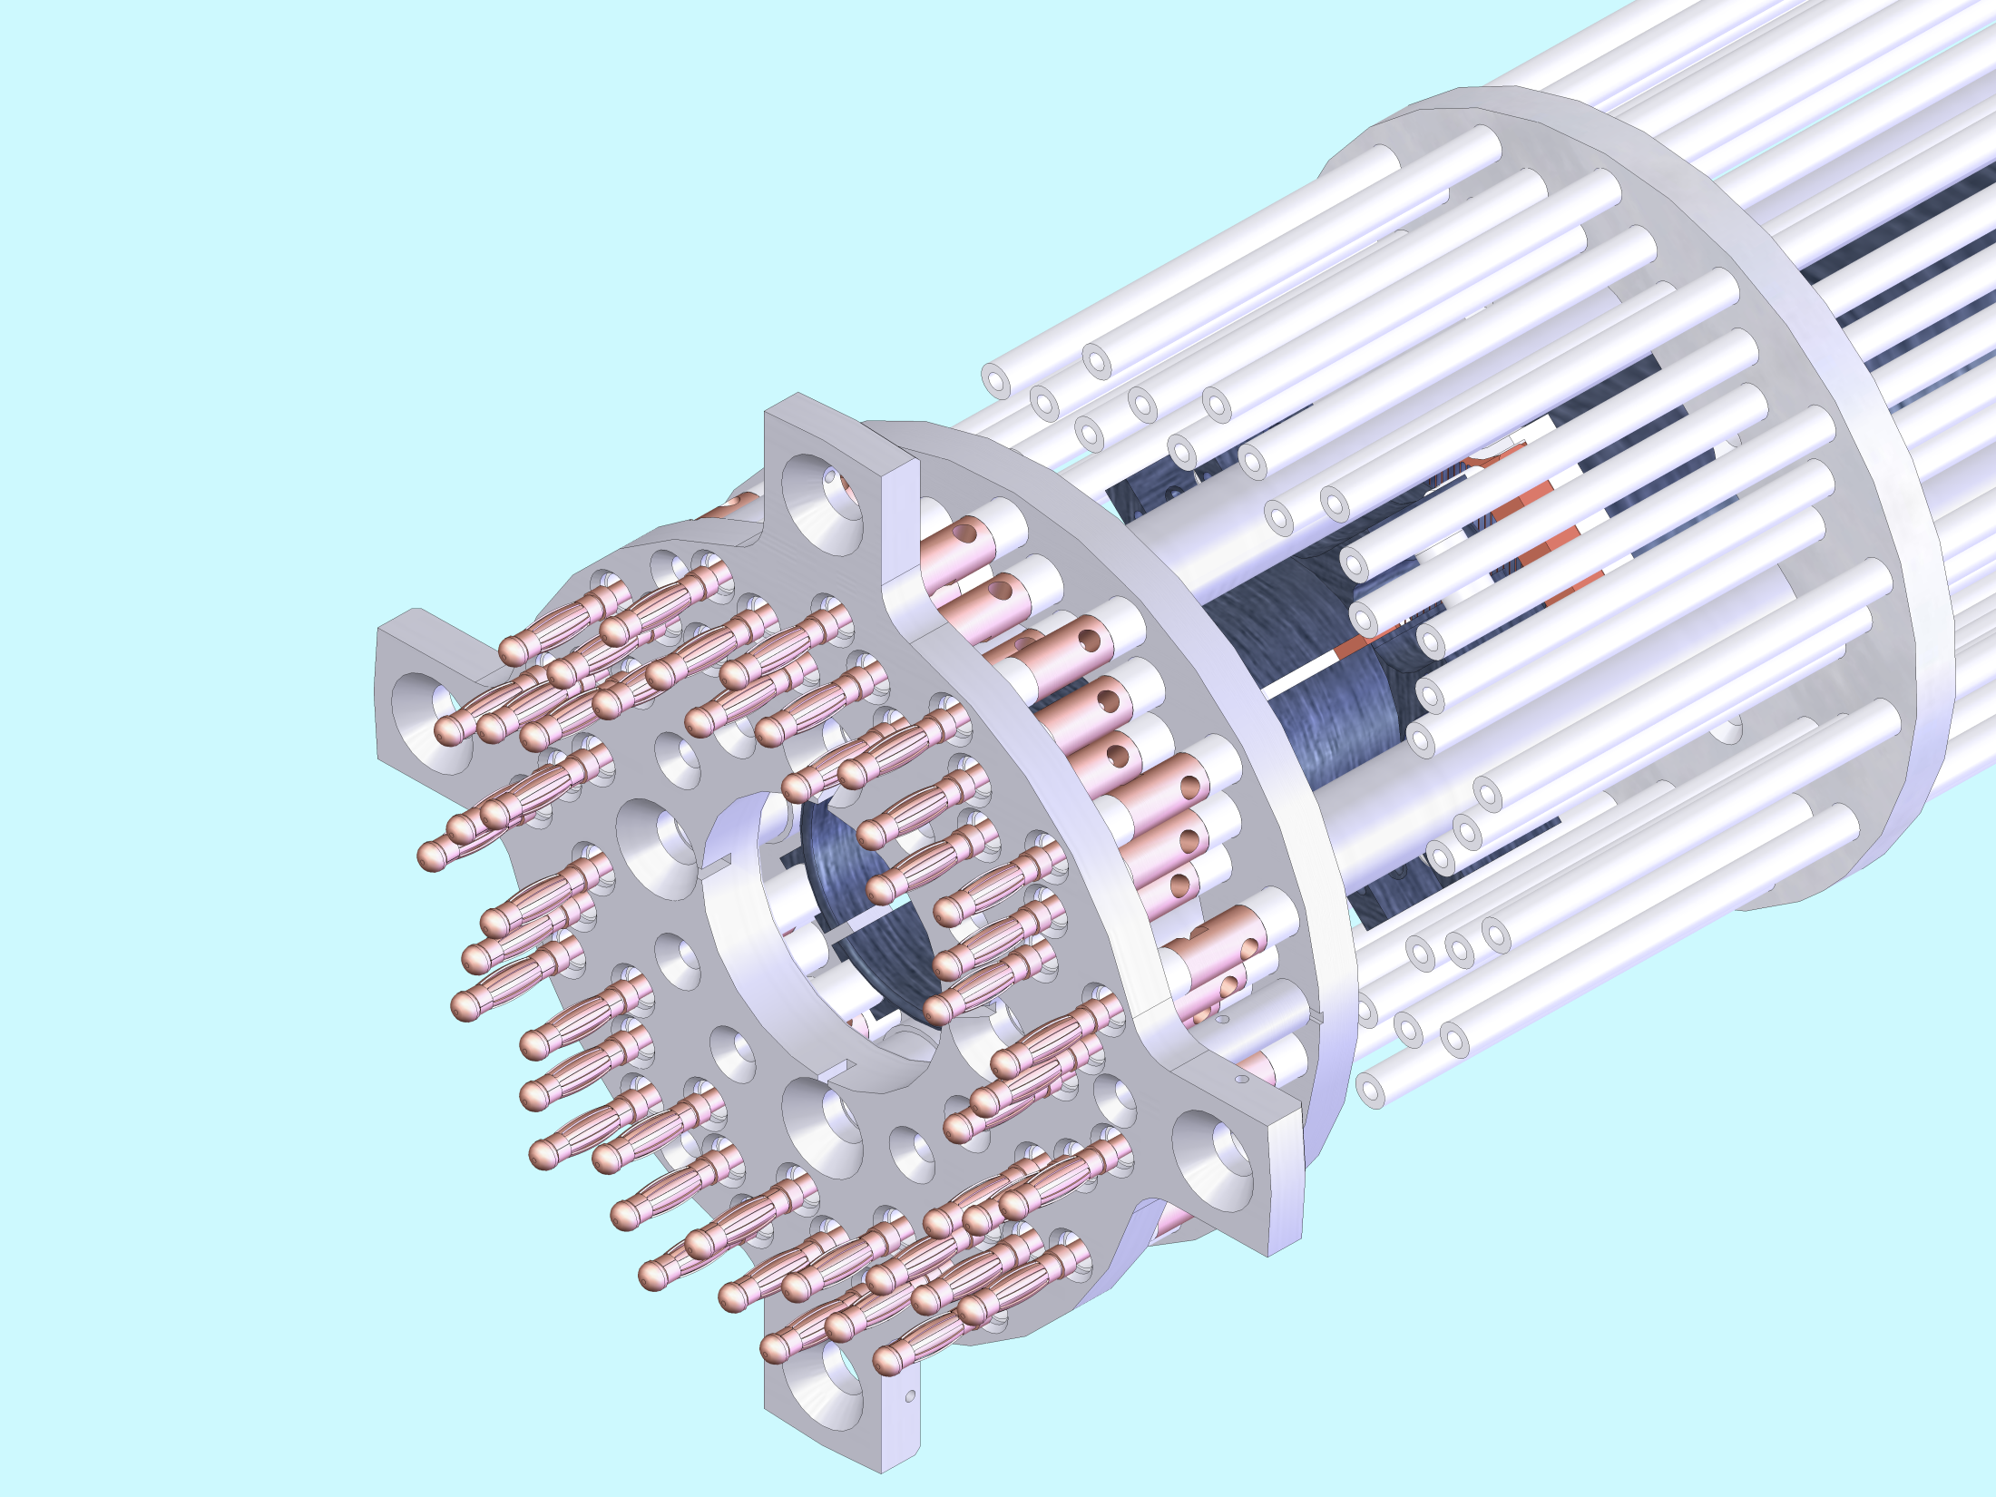
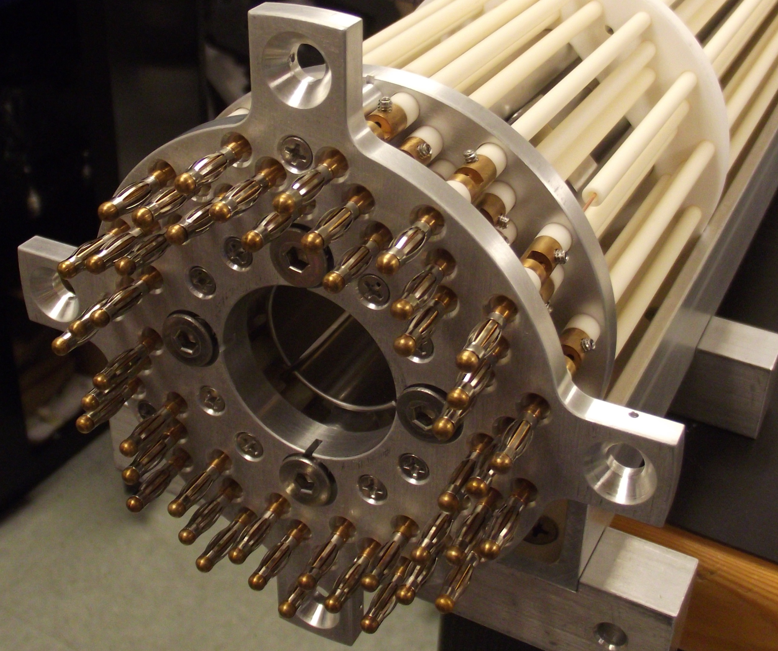

Slide 10
We put the Mesh in the CPET simulation
200 V
Mesh detector position
Notes:
Point out where wire mesh is
Point out where e- begin
Once the graph comes up that’s it for the mesh detector. Then it’s on to the off-axis source.

Slide 11
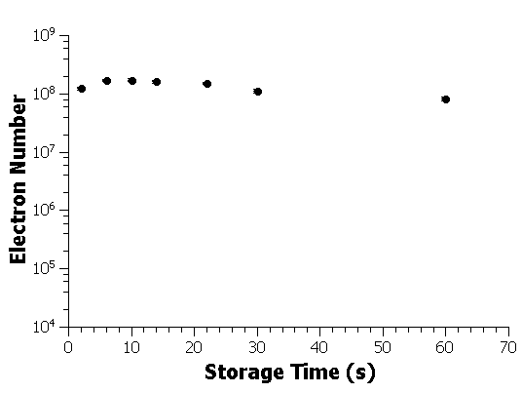
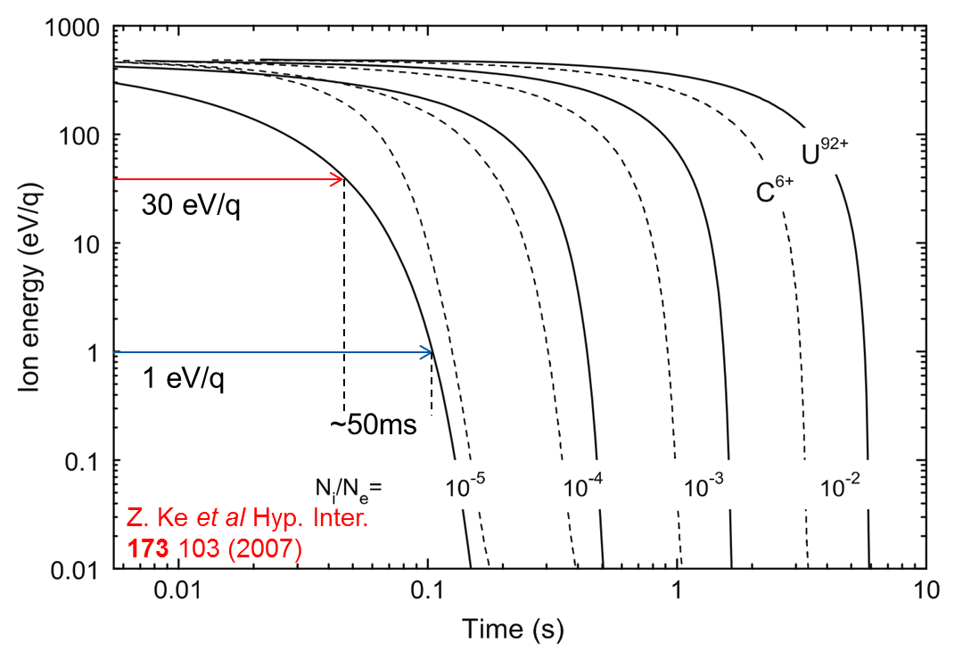
Electron number measurement
Notes:
This is your last slide before transitioning to the off-axis source
This length of trapping time allows us to put in multiple cycles of ions and cool them with the same bunch of trapped electrons.
This is your last slide before transitioning to the off-axis source

Slide 12
Ions can’t exit the trap either

Slide 13
CPET
MPET

Slide 14
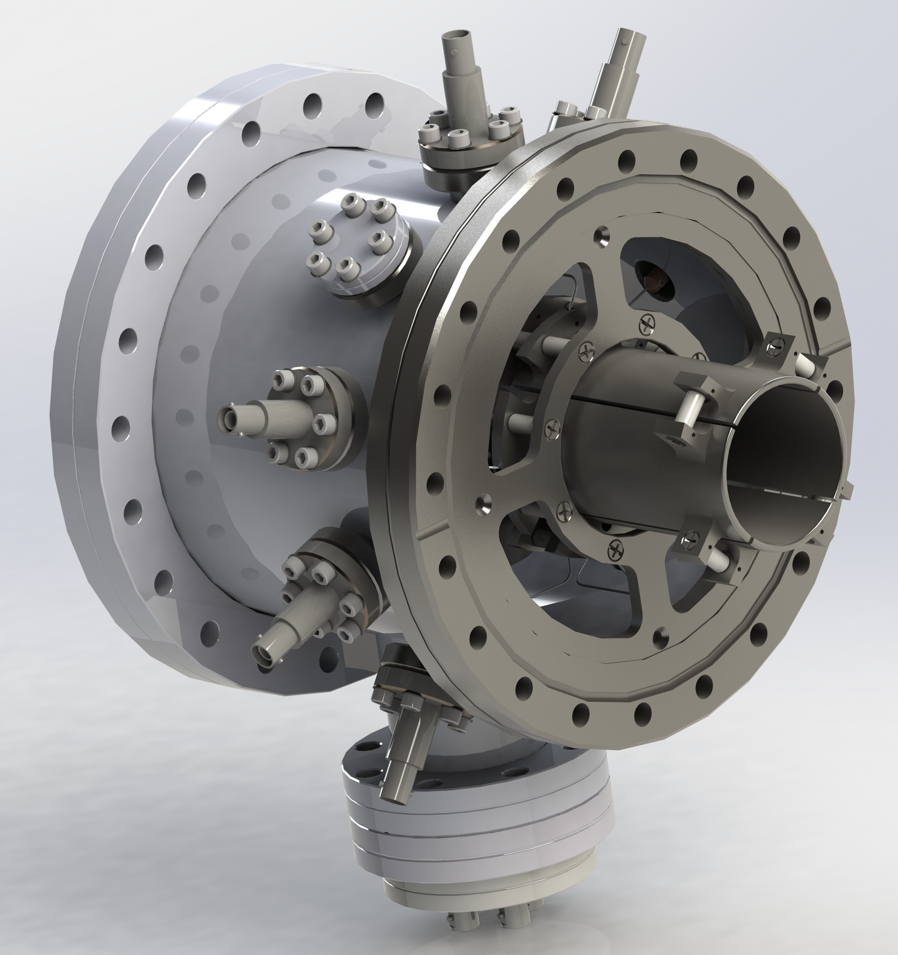
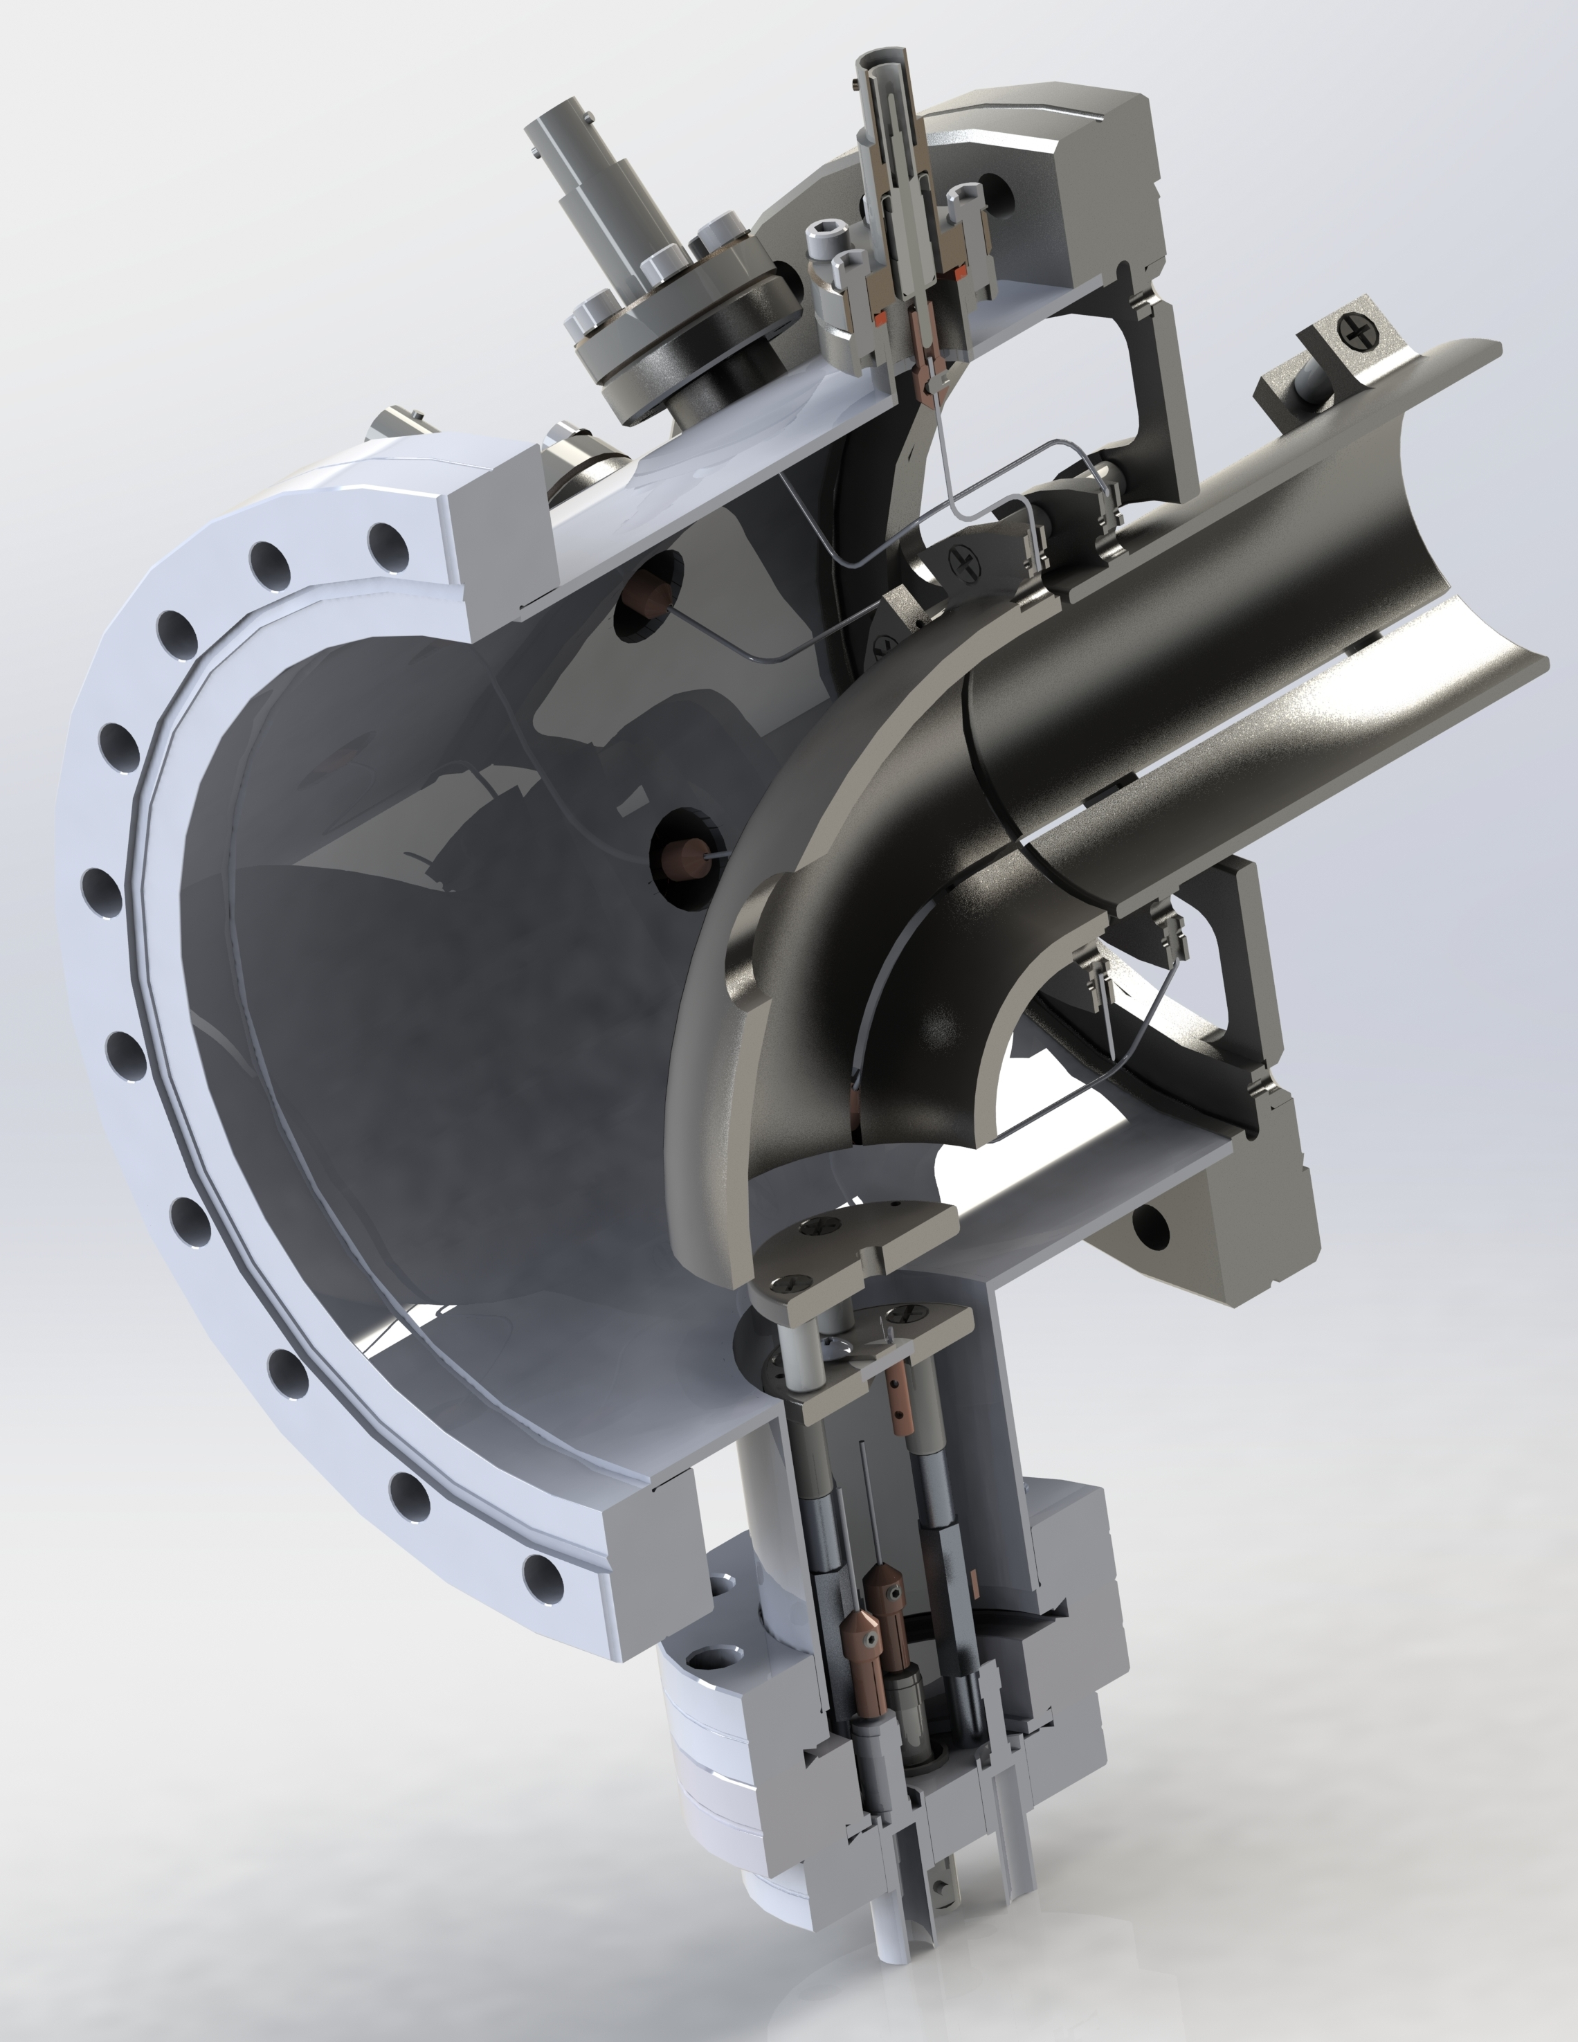
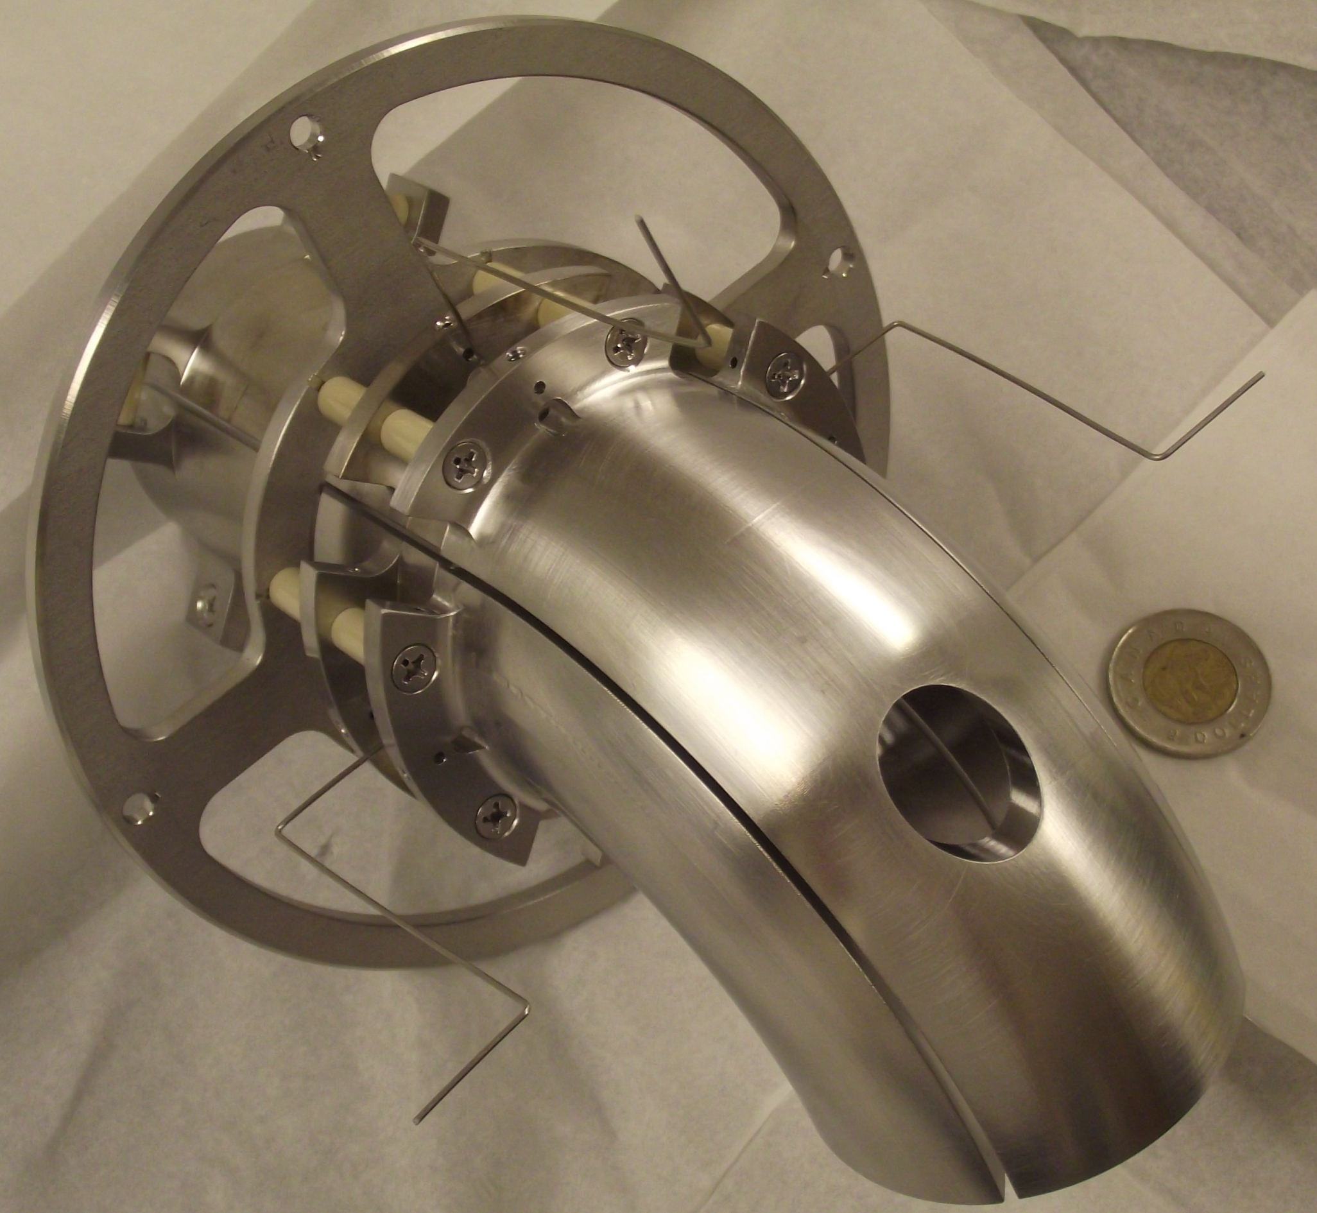
Aperture for ions

Slide 15
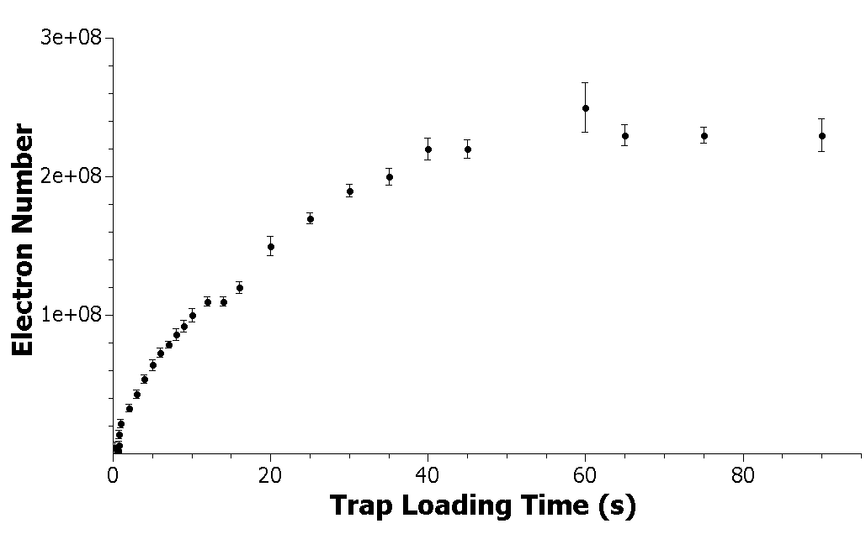
Electron number measurement
Data taken by B. Kootte and S. Paul

Slide 16
Conclusions
New mesh detector functioning well and translatable to many applications
Rugged
Charge agnostic
Transparent
Customizable
Off-axis electron source installed and working
Prepared to begin the simultaneous trapping of electrons and ions See S. Paul’s talk on Sunday morning
Trap Physics Section
Notes:
Spacing, shape configuration and material type can all be selected.
Rugged = High radiation, High B, caustic, corrosive, tight space
Mention Erich’s talk on another way that TITAN is working to improve the precision of Penning trap mass measurements

Slide 17
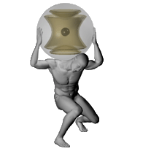
The TITAN collaboration

Slide 19
A wire mesh
A BNG is already in use in the beamline.
It doesn’t physically move.
We can turn it on or off at will.
Why only use it to deflect charged particles away?

