Slide 1
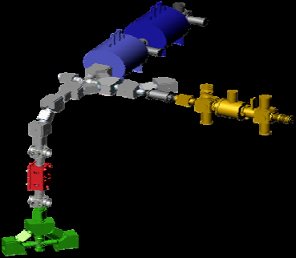
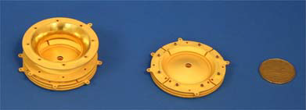
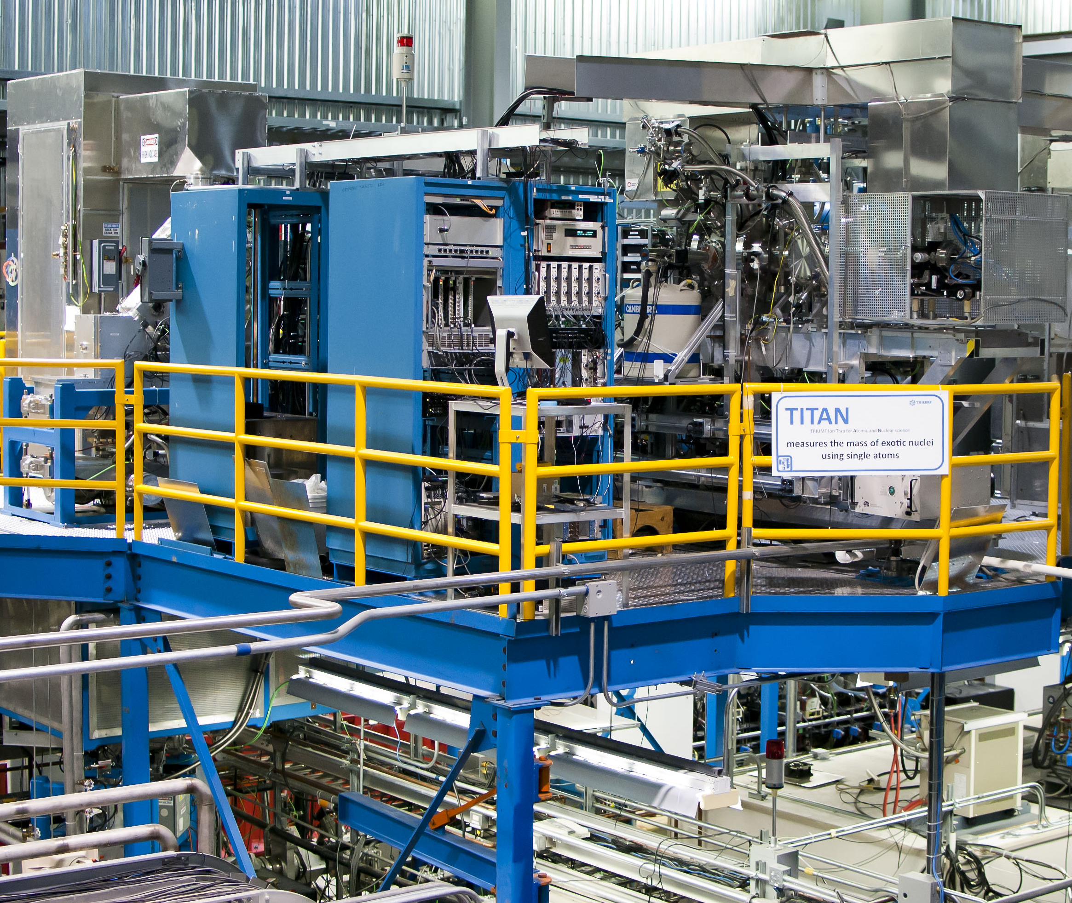
Concurrent Mass Measurement and Laser Spectroscopy for Unambiguous Isomeric State Assignment
2017 Low Energy Community Meeting
October 28, 2017
D. Lascar

Slide 2
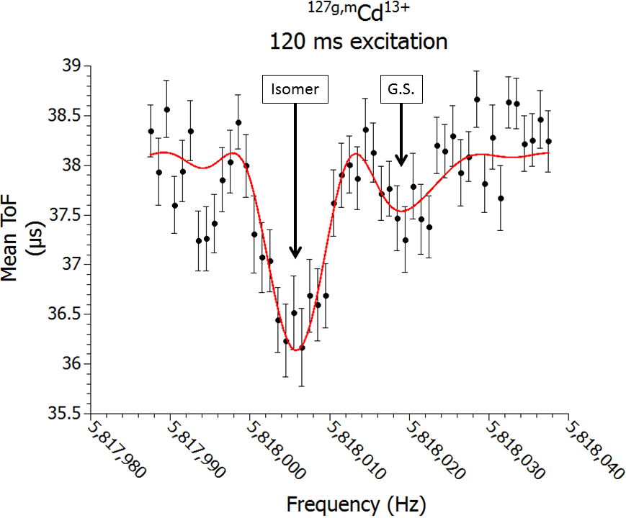
Recent Cd mass measurements at TITAN
Measured the masses of ^{125g,m}Cd, ¹²⁶Cd, and ^{127g,m}Cd
  First ever measurement of ^{127g}Cd
Made possible with EBIT and Highly Charged Ions (HCI)
Paper submitted to PRC – Rapid Comm.
D. Lascar et al., PRC 96 044323 (2017).

Slide 3
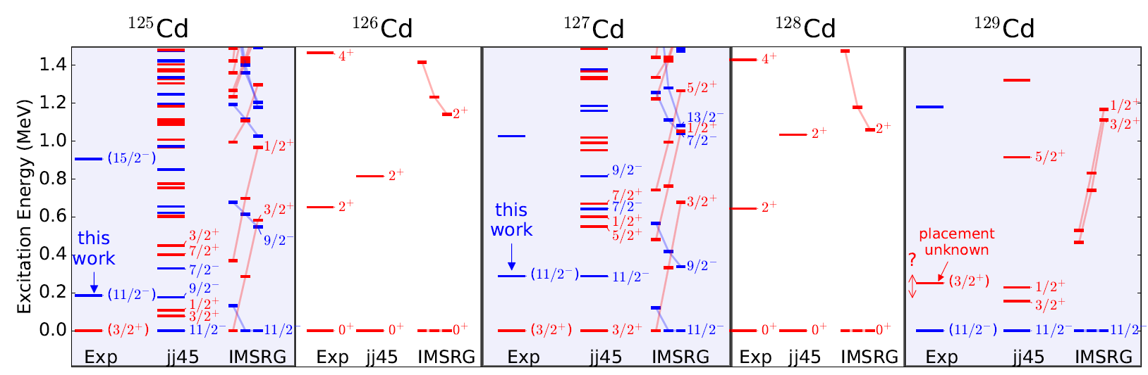
What we found: Nuclear structure is unclear
Systematic arguments dominate state assignments
State of the art calculations show states alternating

Slide 4
We need help
Penning traps :
Give us clear energy measurements
Fail when it comes to assigning spin and parity
Can identify relative production
D. Lascar et al., arXiv:1705.04449
Submitted to PRC – Rapid Communications

Slide 5
We need help
Penning traps :
Give us clear energy measurements
Fail when it comes to assigning spin and parity
Can identify relative production
D. Lascar et al., arXiv:1705.04449
Submitted to PRC – Rapid Communications

Slide 6
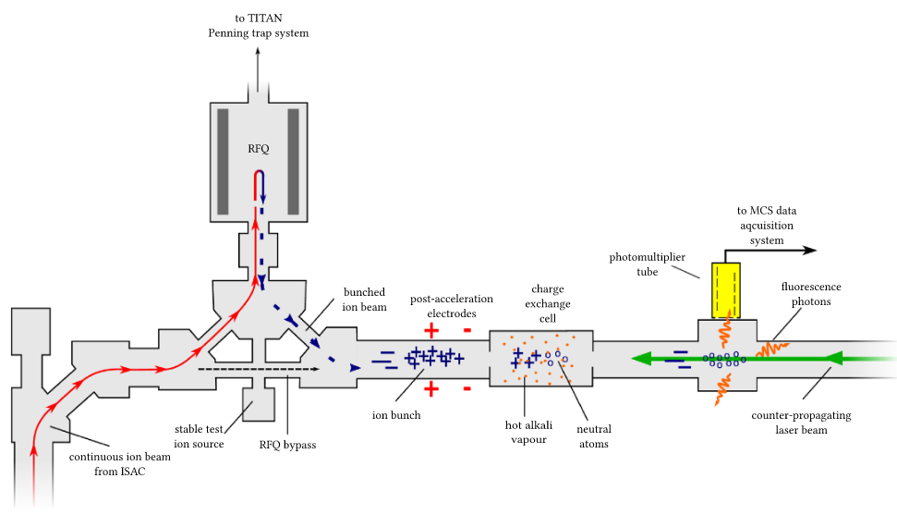
Collinear Laser Spectroscopy at TRIUMF
Slide courtesy of C. Babcock

Slide 7
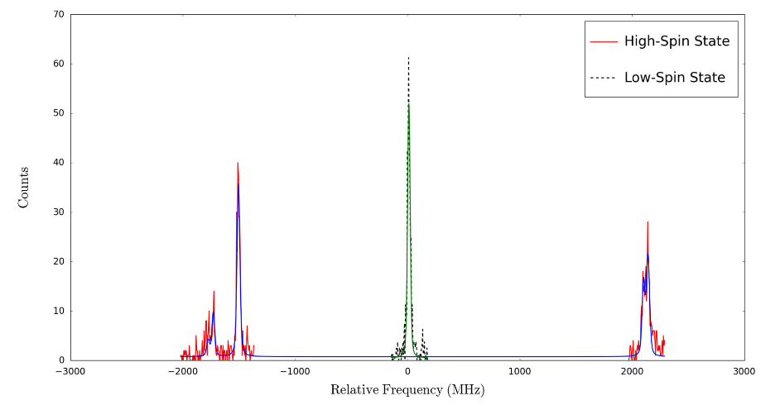
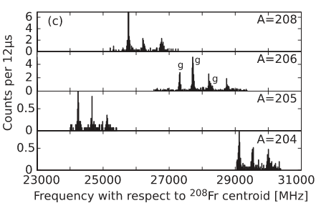
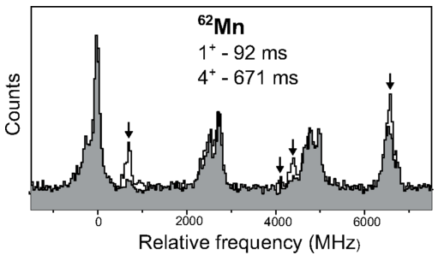
Isomer Identification
⁹⁸Rb
Concurrently produced isomers will show up in the spectrum and can be fitted separately
Slide courtesy of C. Babcock
T. Procter, Eur. Phys. J. A (2015)
Francium
Heylen, Phys. Rev. C (2015)
Voss, Phys. Rev. Lett. (2013)

Slide 8
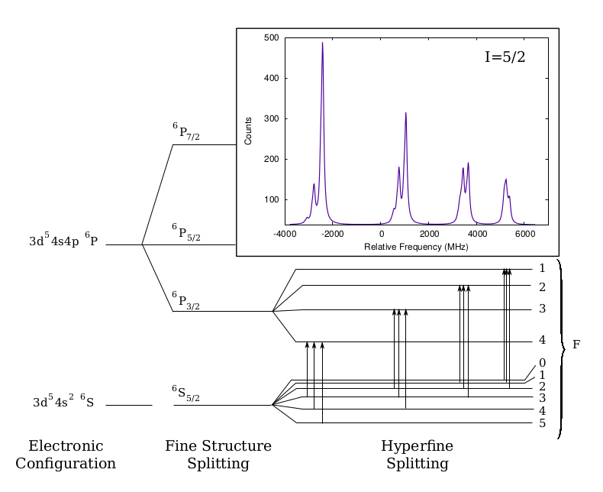
Determination of Spin
Spin can be unambiguously determined using the peaks of the hyperfine structure
Cannot identify ordering of states
Can identify relative production
Slide courtesy of C. Babcock

Slide 9
Determination of Spin
Spin can be unambiguously determined using the peaks of the hyperfine structure
Cannot identify ordering of states
Can identify relative production
Slide courtesy of C. Babcock

Slide 10
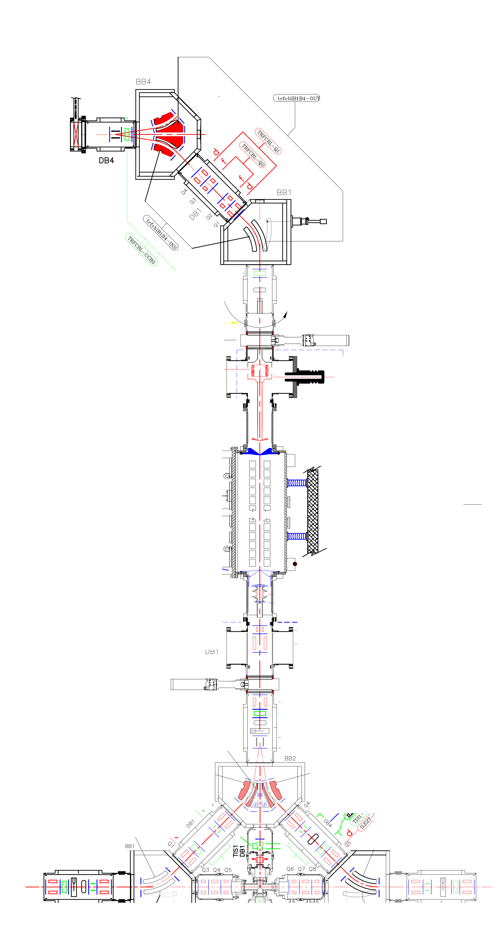
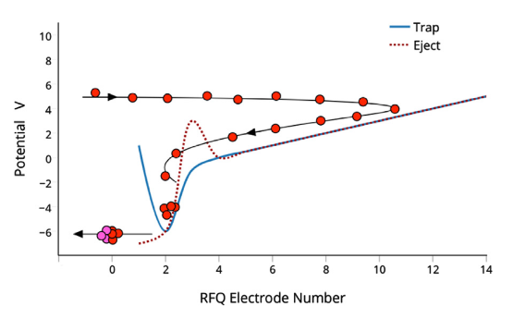
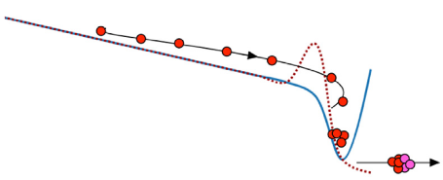
TITAN RFQ for Mass Measurement and Spectroscopy
For CLS
To Penning trap
From
ISAC
To laser spec
For PT
17 18 19 20 21 22 23 24
Slide courtesy of C. Babcock
Notes:
All we need to do it make certain that we can switch the RFQ back and forth quickly.
Nothing is new in terms of individual experiments

Slide 11
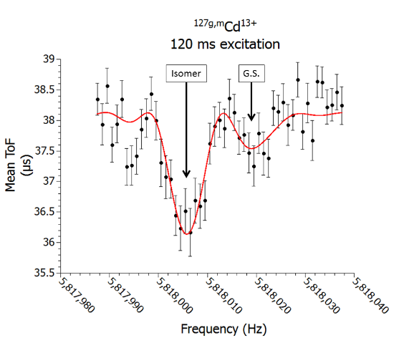
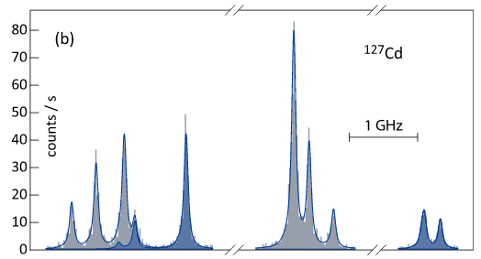
Isomer Identification
11/2-
3/2⁺
Relative abundance links both experiments
High resolution is not needed
Requires ~30/70 split to make unambiguous ID with CLS

Slide 12
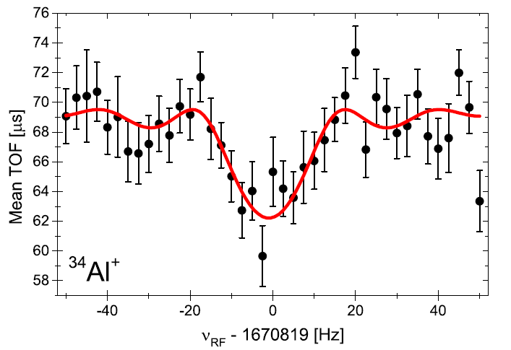
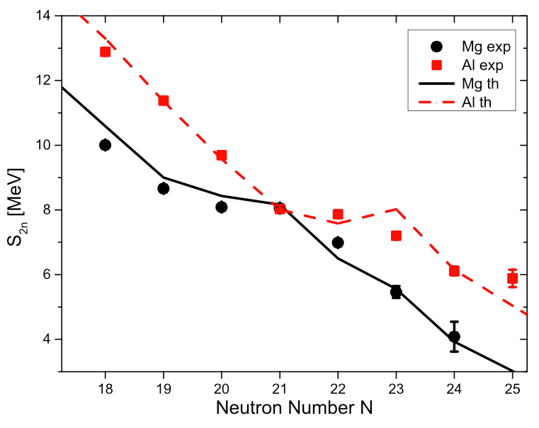
Potential future work
³⁴Al – Placement of intruder state
1⁺ isomer predicted due to intruding structures
Possibility 1⁺ might become g.s.
Would explain inversion in S_{2n} around N=20
Similar inversions possible around N=28
A. A. Kwiatkowski et al., PRC 92 061301R (2015)

Slide 13
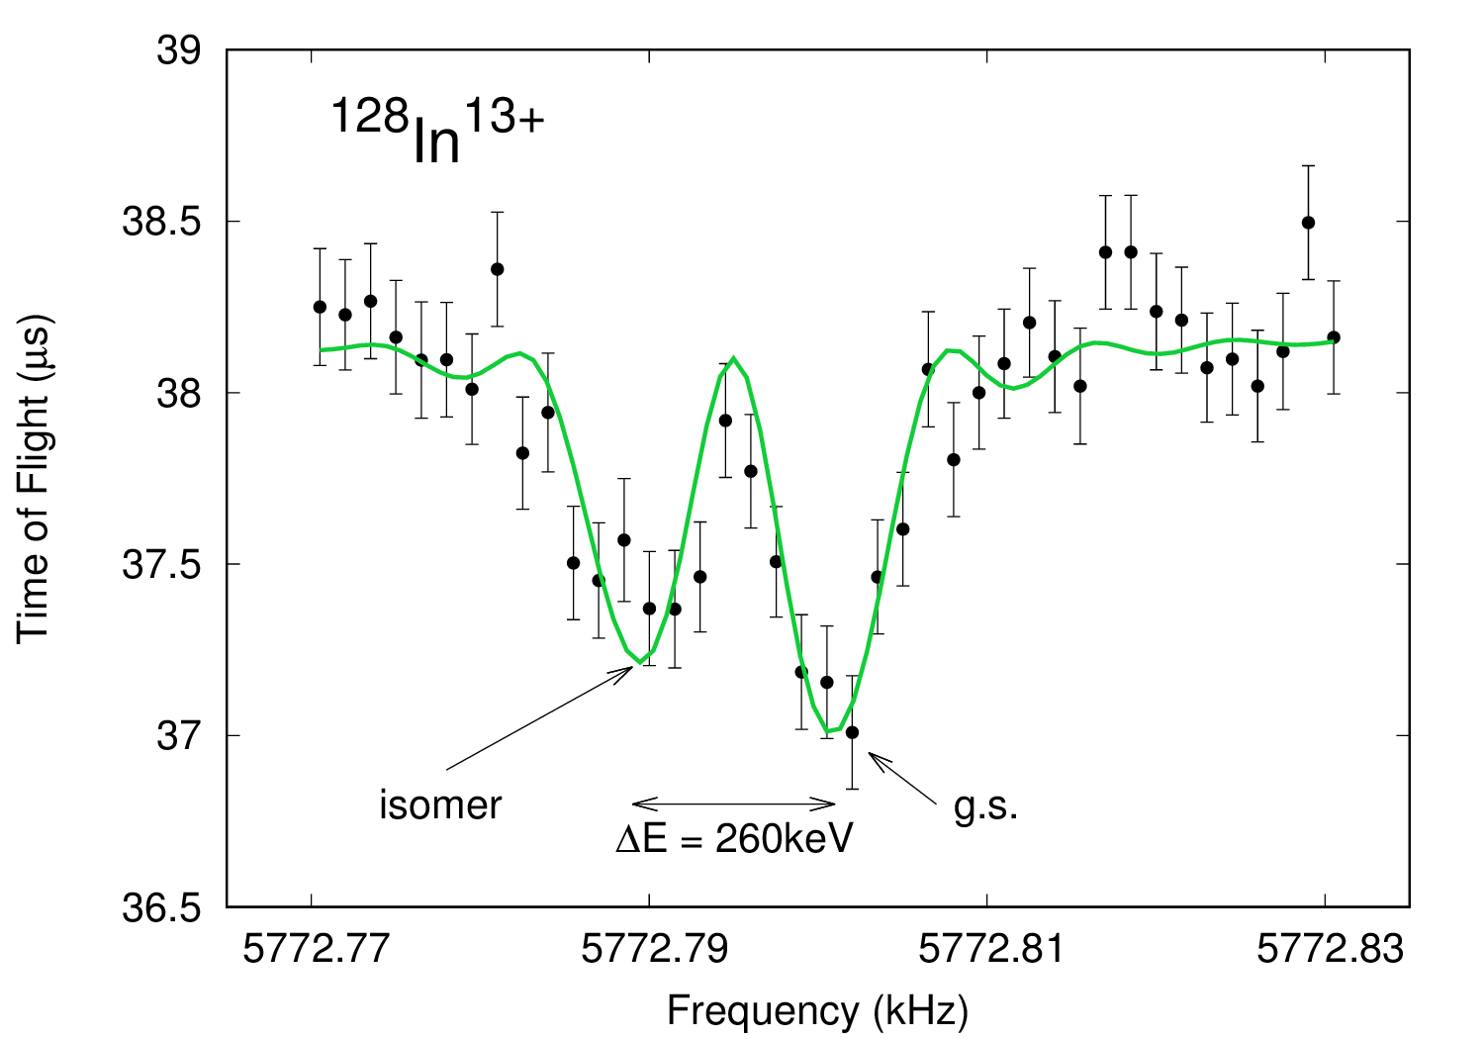
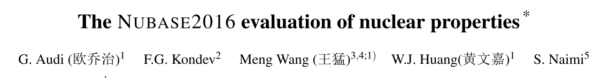
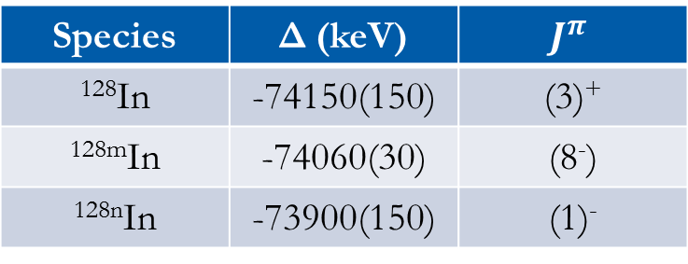
Indium…so much indium
Last year’s run
In this example:
None of the states are unambiguously assigned
It looks like we’ve at least got the n-state for certain
CLS has been performed – laser schemes known
  Nucl. Phys. A464 9 (1987)
This is low hanging fruit
Species | Δ (keV) | $$J^{π}$$
¹²⁸In | -74150(150) | (3)⁺
^{128m}In | -74060(30) | (8⁻)
^{128n}In | -73900(150) | (1)⁻
Notes:
“There are many sets of parenthesis in the $J^{π}$ column in NUBASE”

Slide 14
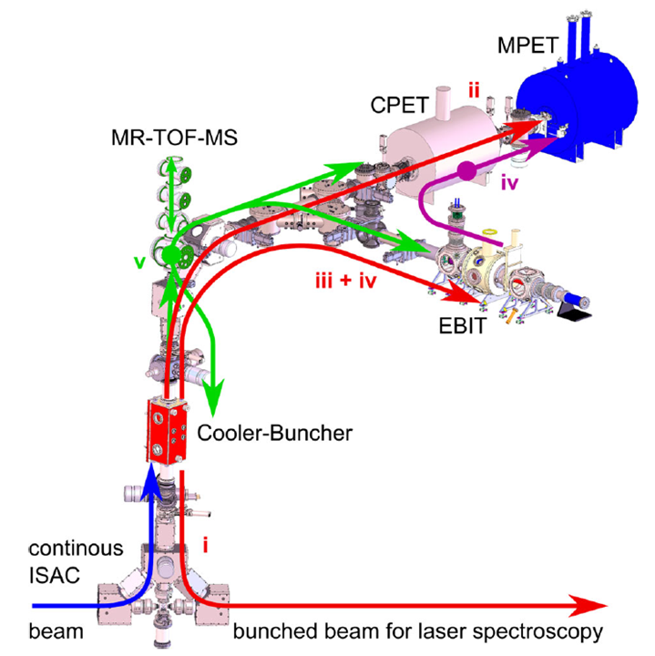
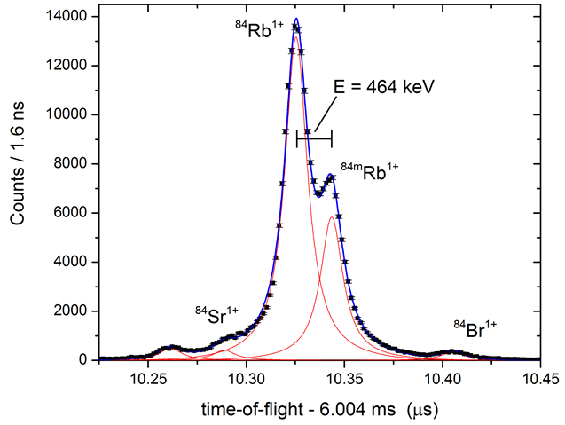
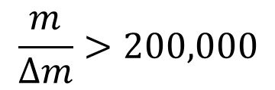
Modifications: MR-ToF
$$\frac{m}{Δm}>200,000$$
Notes:
Mention the successful commissioning
If isomer is more than 3-400 keV then MR-ToF alone is fine.

Slide 15
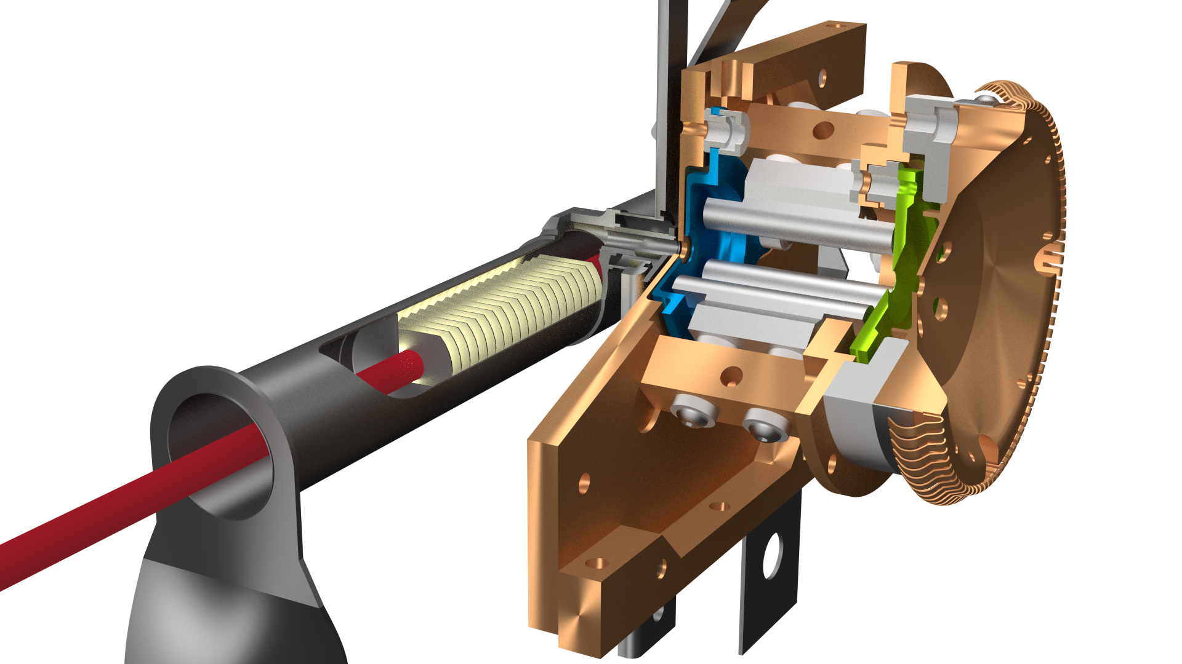
Modification: Selective ionization
Repeller electrode
Potential barrier to suppress ions from target (shifting of target and repeller voltages)
RFQ ion guide for radial confinement of laser ions
500 MeV p+
Heat shield
(water cooled)
Element selective laser ionization in cold environment
Slide courtesy of M. Mostamand
10mm

Slide 16
Beginning of a campaign
Represents a negligible investment
  Broadly applicable
  Involves multiple groups to increase facility utilization
Only N. American location is TRIUMF
  S1754 – 7 days approved for odd-A Cd
  But LEBIT & BECOLA are sufficiently close that a shared RFQ is possible
Possible at TRIUMF, IGISOL, and ISOLDE
  No plans (yet) to pursue combined measurements of this nature…IGISOL proposals due mid-September

Slide 17
Collaborators
D. Lascar – Hire Me
J. Henderson – TRIUMF/Livermore
C. Babcock – TRIUMF
M. Pearson – TRIUMF
THANK YOU

Slide 18
Collaborators
D. Lascar – Hire Me
J. Henderson – TRIUMF/Livermore
C. Babcock – TRIUMF
M. Pearson – TRIUMF
THANK YOU

Slide 19
Short Measurement Times
TITAN specializes in a short measurement cycles.
We masses of some of the shortest lived nuclides ever.
  ³¹Na (t_{1/2} = 17 ms)
  ³²Na (t_{1/2} = 13 ms)
  ¹¹Li (t_{1/2} = 9 ms)
Production is the limit.
³¹Na⁺
T_{1/2} = 17 ms
ν_{c} = qe/m ∙ B/2π
³²Na⁺
T_{1/2} = 13 ms
Notes:
Tests have shown that we can go get to high precision with a 5ms excitation time

Slide 20
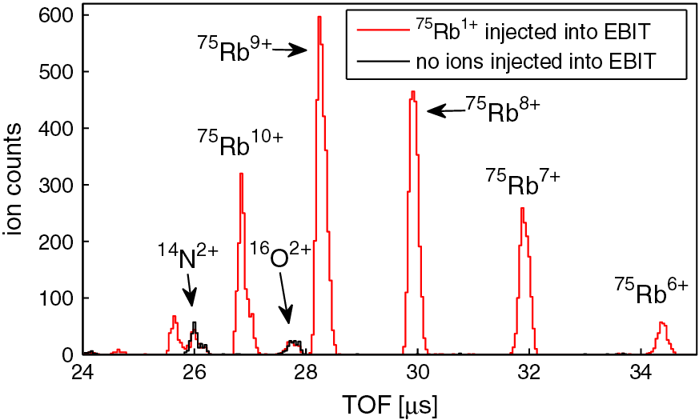
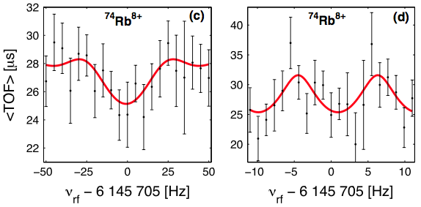
Optimizing PTMS Performance
⁷⁴Rb⁸⁺ T_{1/2} = 64 ms
Heaviest superallowed β emitter
δm m
m q e B T_{RF}
≈
N limited by yield/beam time
T_{RF} limited by T_{1/2}
B limited by δB/B
q up to Z+
Charge breeding can boost precision
or
reduce experimental requirements for the same precision
~1/T_{RF}
S. Ettenauer et al., PRL 107 (2011) 272501

Slide 21
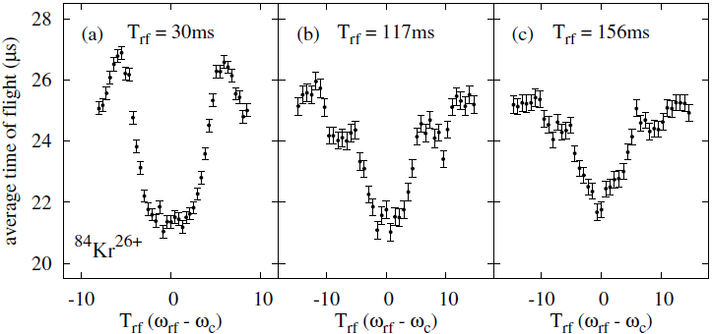
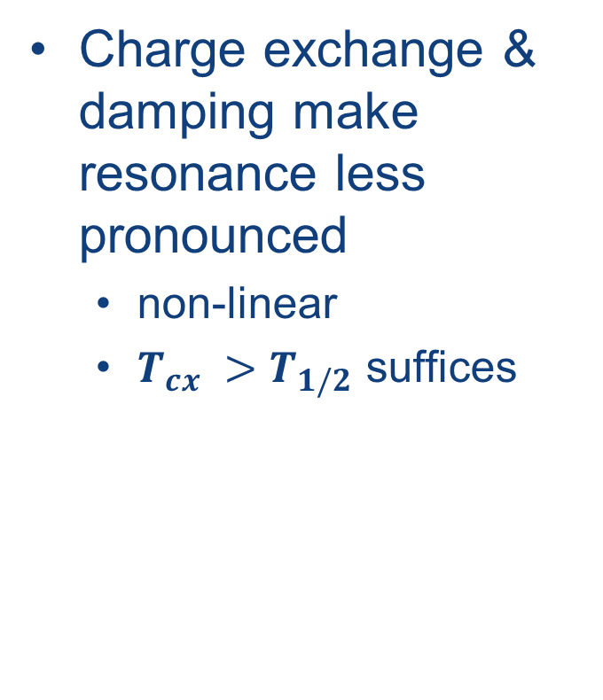
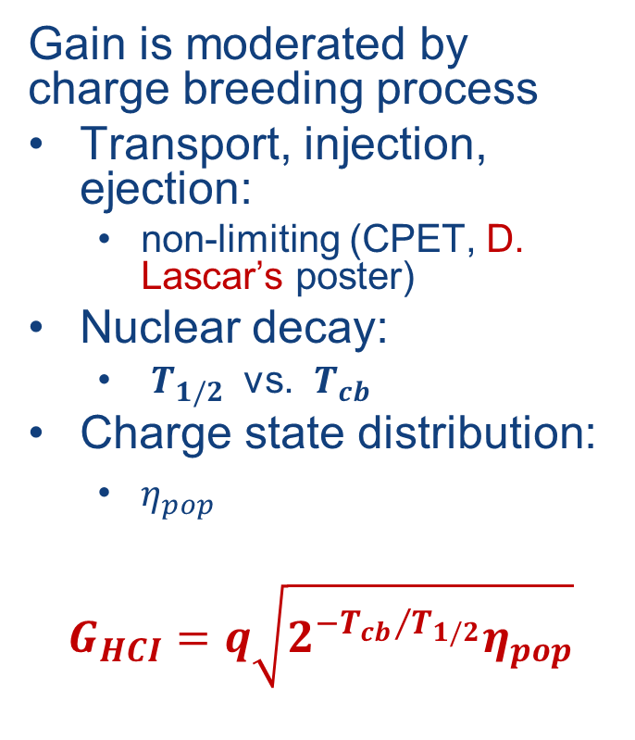
Opportunities & Challenges of HCI
Gain is moderated by charge breeding process
Transport, injection, ejection:
  non-limiting (CPET, D. Lascar’s poster)
Nuclear decay:
  $T_{1/2}$ vs. $T_{cb}$
Charge state distribution:
  $η_{pop}$
$$G_{HCI}=q\sqrt{2^{−{T_{cb}}/{T_{1/2}}}η_{pop}}$$
Charge exchange & damping make resonance less pronounced
  non-linear
  $T_{cx} >T_{1/2}$ suffices
M.C. Simon, et al., Phys. Scrip. T156 (2013) 014098; T.D. Macdonald, Master’s thesis, UBC 2014; R. Klawitter, PhD work

Slide 22
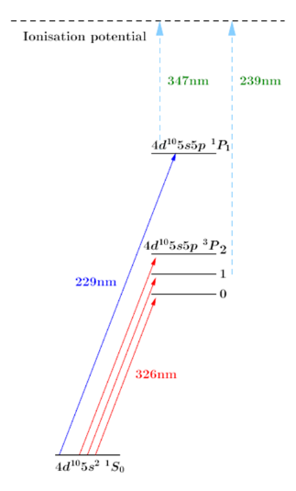
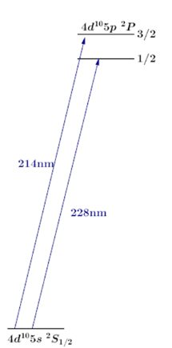
Laser Excitation of Cd
Option 2: Atoms + ionization
Option 3: Metastable state
Option 1: Ions
Slide courtesy of C. Babcock

Slide 23
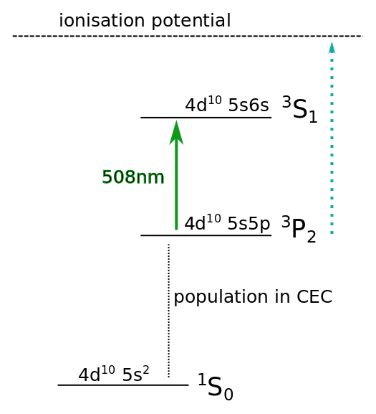
Laser Excitation of Cd
Option 2: Atoms + ionization
Option 3: Metastable state
Option 1: Ions
Slide courtesy of C. Babcock

Slide 24
Indium…so much indium
Last year’s run
In this example:
None of the states are unambiguously assigned
It looks like we’ve at least got the n-state for certain
CLS has been performed – laser schemes known
  Nucl. Phys. A464 9 (1987)
This is low hanging fruit
Species | Δ (keV) | $$J^{π}$$
¹²⁸In | -74150(150) | (3)⁺
^{128m}In | -74060(30) | (8⁻)
^{128n}In | -73900(150) | (1)⁻
Notes:
“There are many sets of parenthesis in the $J^{π}$ column in NUBASE”

Slide 25
Determination of Spin
Spin can be unambiguously determined using the peaks of the hyperfine structure
Cannot identify ordering of states
Can identify relative production
Slide courtesy of C. Babcock

Slide 26
We need help
Penning traps :
Give us clear energy measurements
Fail when it comes to assigning spin and parity
Can identify relative production
D. Lascar et al., arXiv:1705.04449
Submitted to PRC – Rapid Communications

