Slide 1
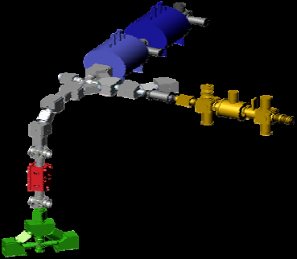
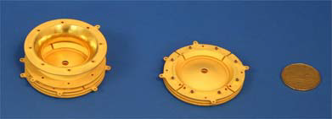
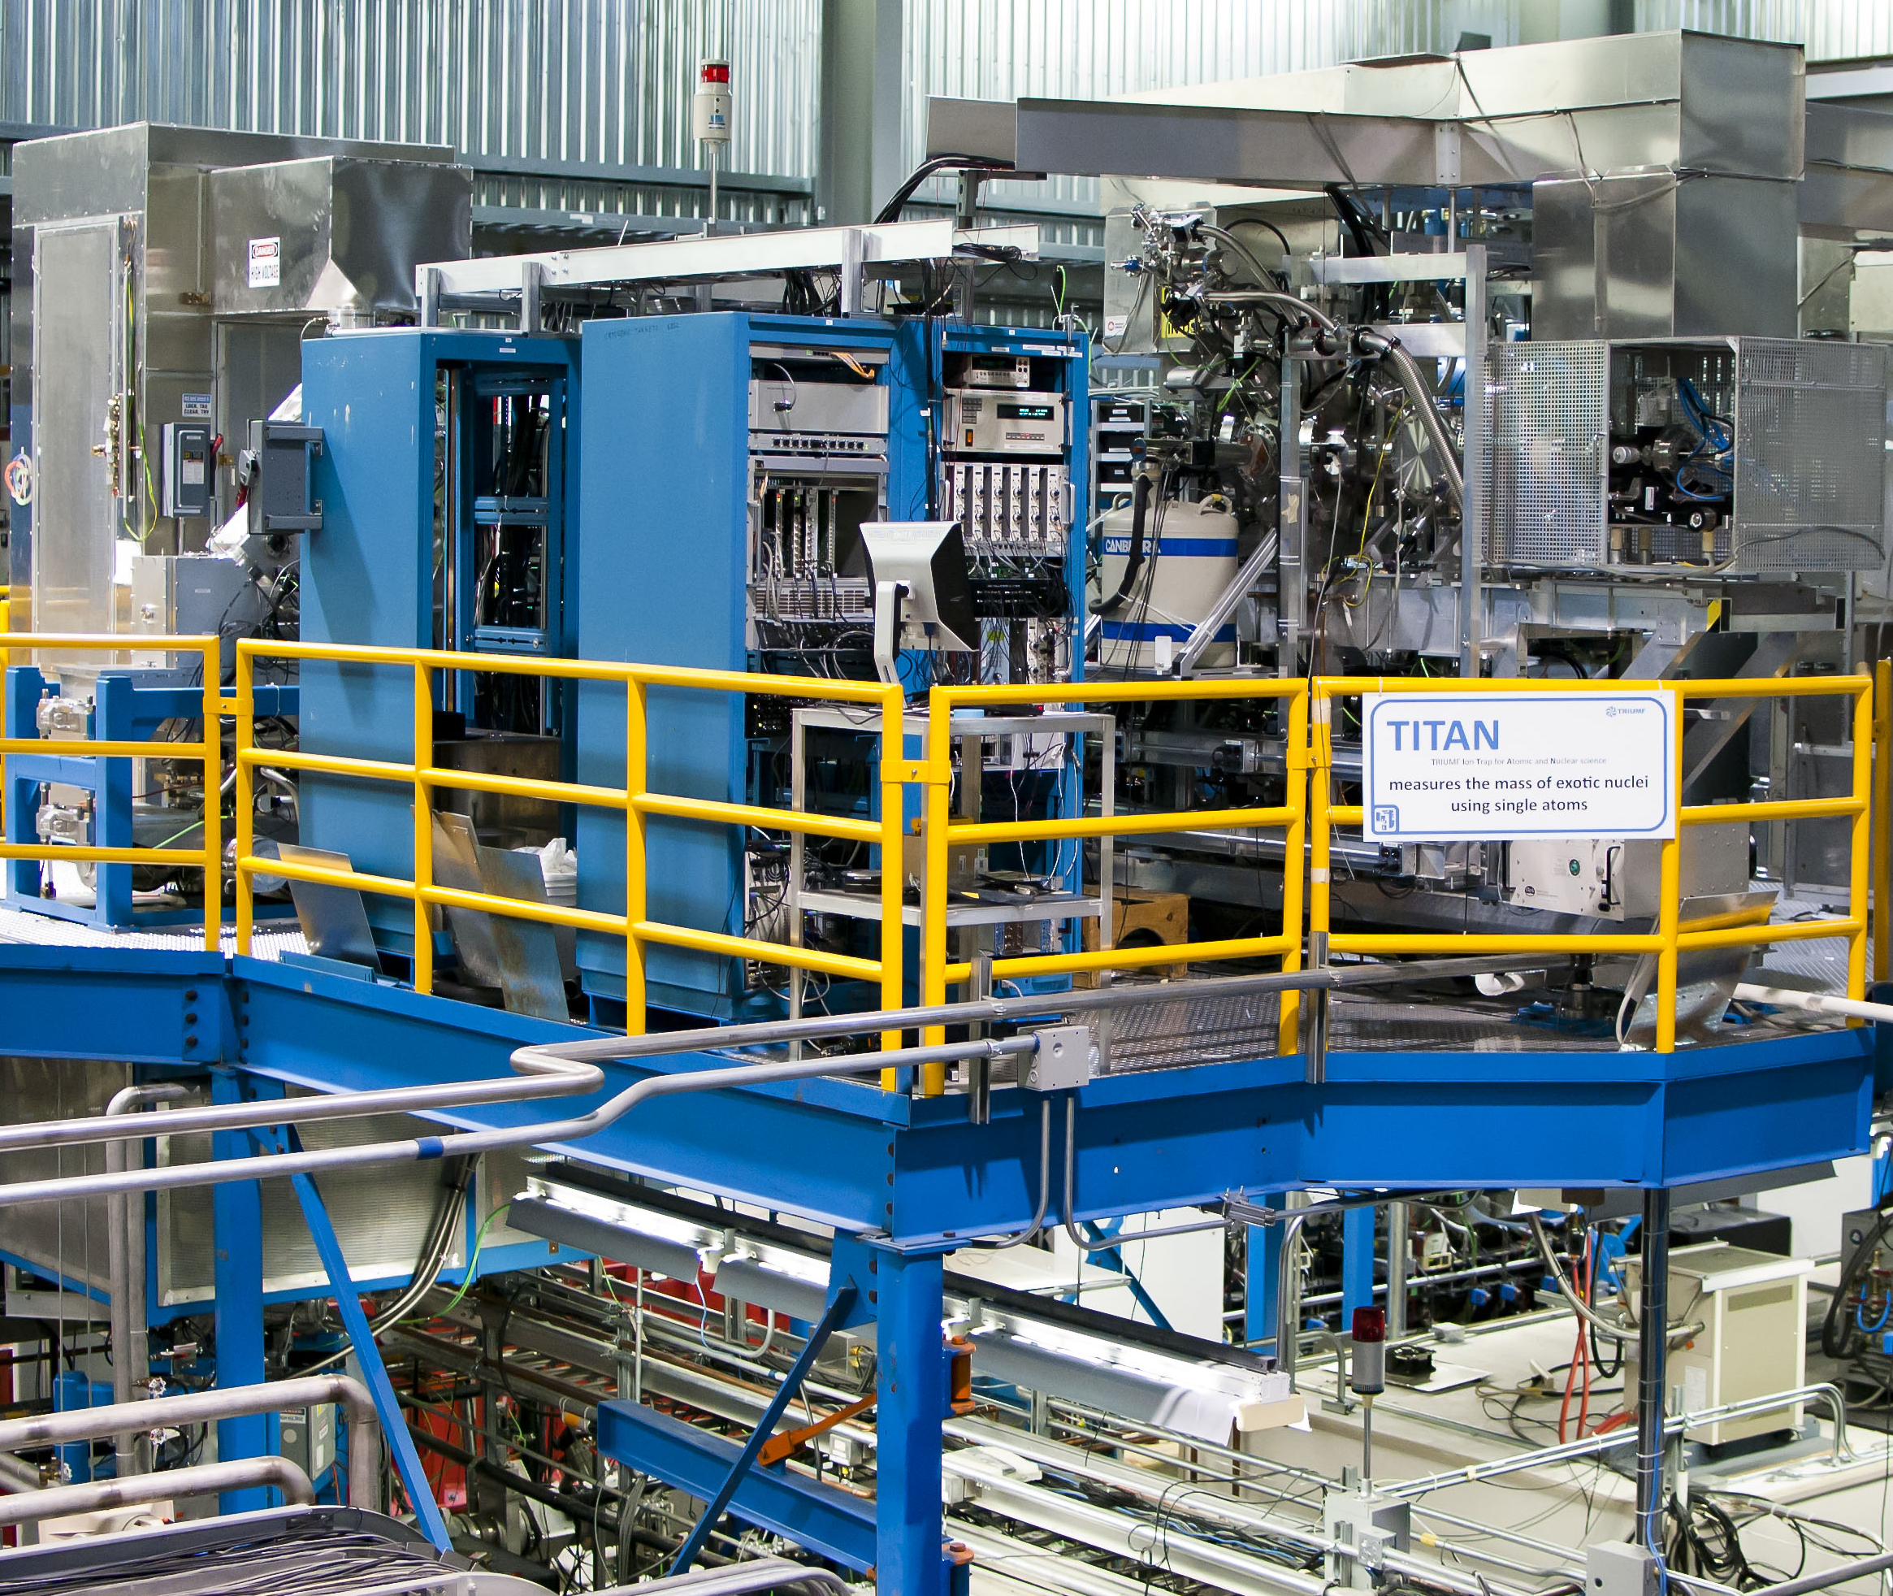
Recent TITAN Measurements and EMMATrap: An Introduction
ISOLDE Physics Seminar
September 7, 2016
D. Lascar | Postdoctoral Fellow | TRIUMF

Slide 2
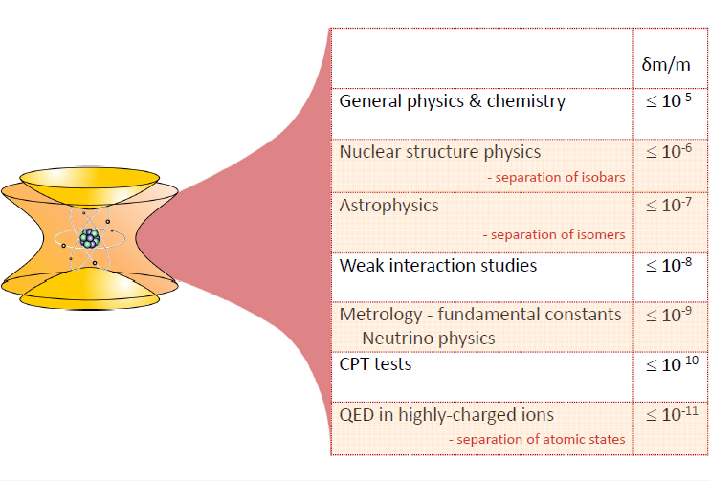
What do masses tell us?
Nuclear Masses of Rare Isotopes:
  Magic numbers of exotic nuclei (new shell closures)
  R-process waiting points
  Inform theory
  CKM matrix
Notes:
Masses used in almost every subfield of physics
Only difference is the precision required
For astrophysics that’s 10 keV/c²
For QED that’s 1eV/c²

Slide 3
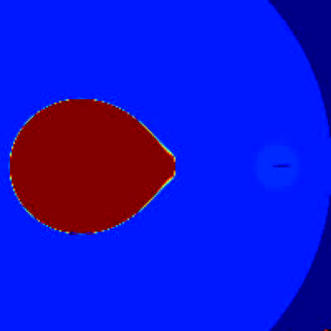
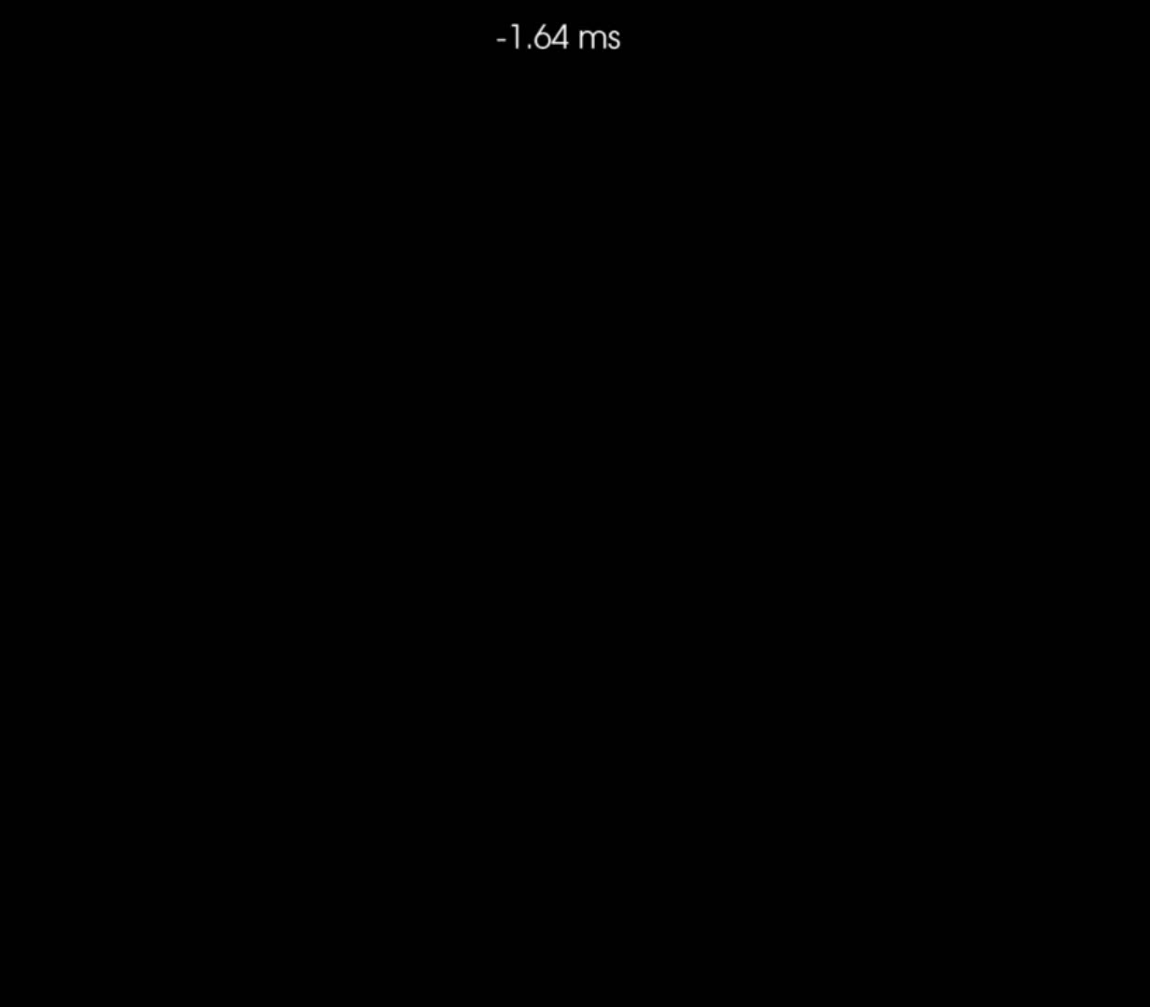
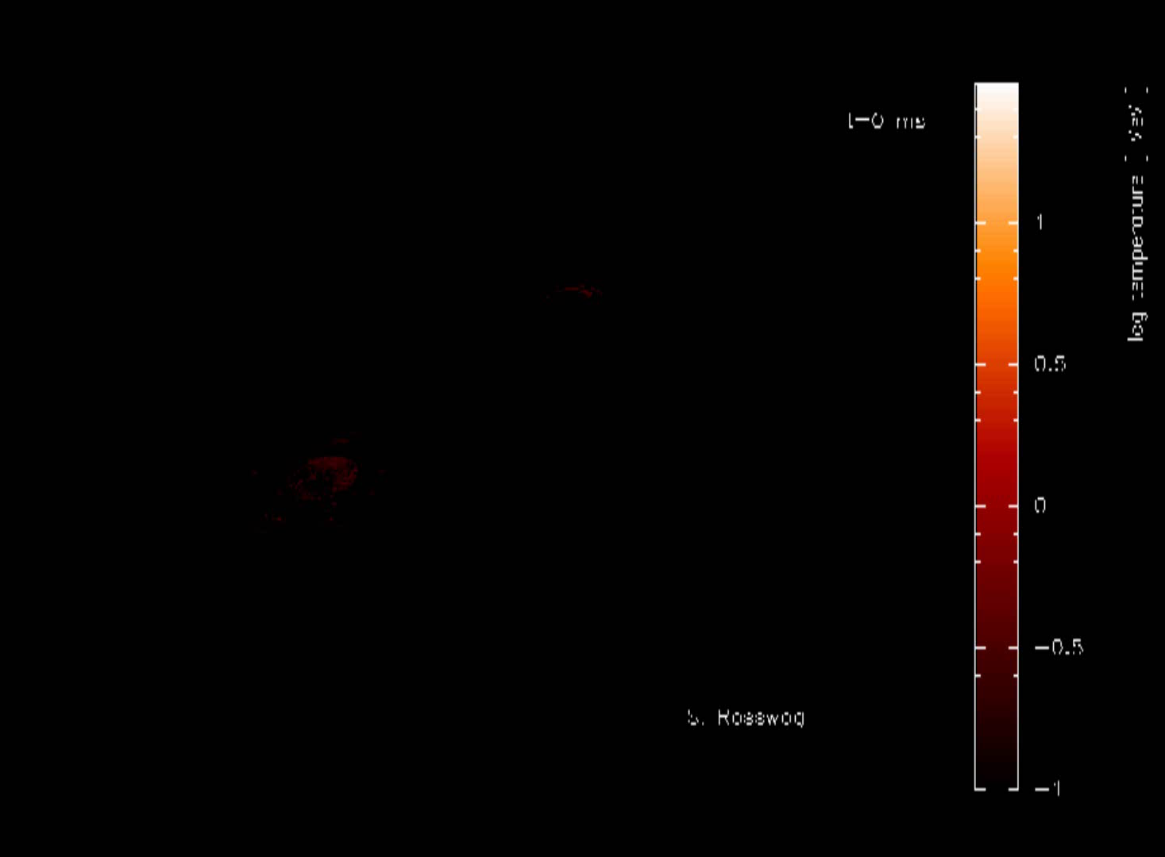
Explosive nucleosynthesis
Type-I X-ray burst
Type-II (CC) SN
Courtesy of J. Blondin NCSU
http://wonka.physics.ncsu.edu/~blondin/AAS/
C. Ott et al ApJ 768, 115 (2013)
Neutron star merger
S. Rosswog et al MNRAS 430 4 (2013)

Slide 4
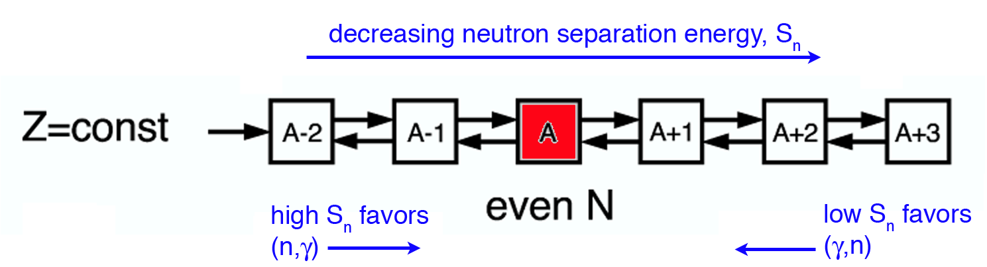
The astrophysical r-process
Temperatures are very high (T~10⁹K)
Neutron densities are very high (n_{n} > 10²⁰ cm⁻³)
(n,γ) rate is high ( < 1 μs/capture )
As region of low neutron separation energy (S_{n}) reached (n,γ) ↔ (γ,n) equilibrium achieved
[A. Champagne, RIA Summer School ‘06]
Notes:
As Sn drops, the number of available photons with enough energy knock out a neutron increase.

Slide 5
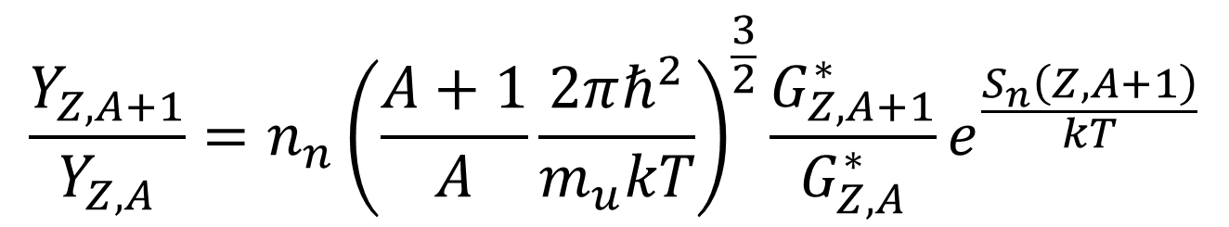
The astrophysical r-process
Temperatures are very high (T~10⁹K)
Neutron densities are very high (n_{n} > 10²⁰ cm⁻³)
(n,γ) rate is high ( < 1 μs/capture )
As region of low neutron separation energy (S_{n}) reached (n,γ) <-> (γ,n) equilibrium achieved
Equilibrium point defined by Saha Equation
Neutron separation energy
$$\frac{Y_{Z,A+1}}{Y_{Z,A}}=n_{n}{\left(\frac{A+1}{A}\frac{2πℏ^{2}}{m_{u}kT}\right)}^{\frac{3}{2}}\frac{G_{Z,A+1}^{∗}}{G_{Z,A}^{∗}}e^{\frac{S_{n}\left(Z,A+1\right)}{kT}}$$
…
Z
Neutron density
Temperature
N
Notes:
The left size is the ratio of relative abundance between two adjacent isotopes.

Slide 6
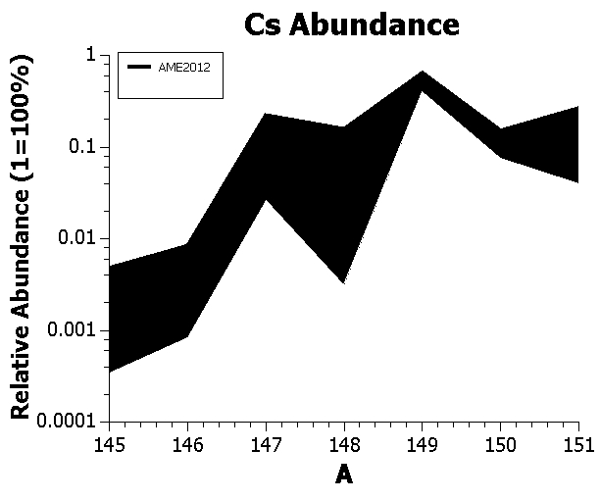
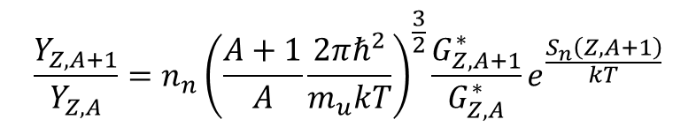
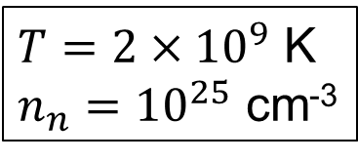
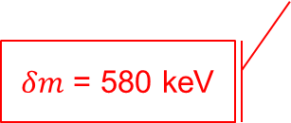
Calculated abundances – AME only
$T=2×{10}^{9}$ K
$n_{n}={10}^{25}$ cm⁻³
Errors and values extrapolated
$δm$ = 580 keV
$$\frac{Y_{Z,A+1}}{Y_{Z,A}}=n_{n}{\left(\frac{A+1}{A}\frac{2πℏ^{2}}{m_{u}kT}\right)}^{\frac{3}{2}}\frac{G_{Z,A+1}^{∗}}{G_{Z,A}^{∗}}e^{\frac{S_{n}\left(Z,A+1\right)}{kT}}$$
Notes:
An order of magnitude difference is seen in A=148
The others would be larger if the value in the AME was actually based on a real measurement.

Slide 7
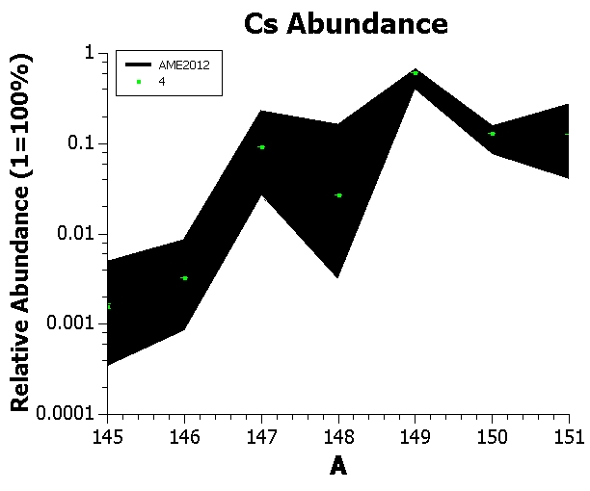
Calculated abundances – AME only
$T=2×{10}^{9}$ K
$n_{n}={10}^{25}$ cm⁻³
Notes:
Here is what happens to the calculated abundance variation when there is only a 10keV variation in mass.

Slide 8
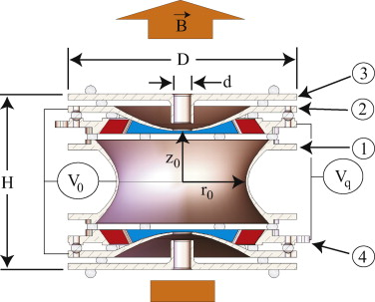
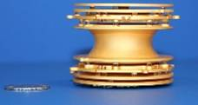
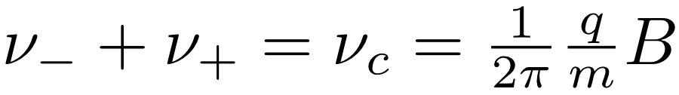
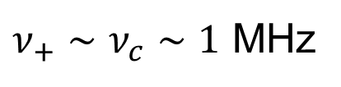
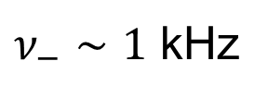
Penning trap
Cyclotron frequency:
Superposition of
strong magnetic field
weak electrostatic quadrupole field
Motion of ions well understood:
Three Eigenmotions can be coupled using RF
Allows us to manipulate motion:
transfer from one motion into the other
$ν_{−}∼1$ kHz
$ν_{+}∼ν_{c}∼1$ MHz
Notes:
Time is the physical quantity we can measure most precisely.
Talk about decoupling of eigenmotions
$ν_{−}$ weakly mass dependent
$ν_{+}$ strongly mass dependent

Slide 9
Energy Conversion
TOF
Detection
Linear
Energy
Magnetic field lines outside the Penning trap
Orbital
Energy
ω_{c} Excitation
Ions from the Penning trap
Notes:
We measure the energy by measuring the time of flight from the PT to a channeltron detector above the trap and outside of the magnetic field.
We need to know how much energy we’ve put into the system so we need to convert the orbital energy to linear energy.

Slide 10
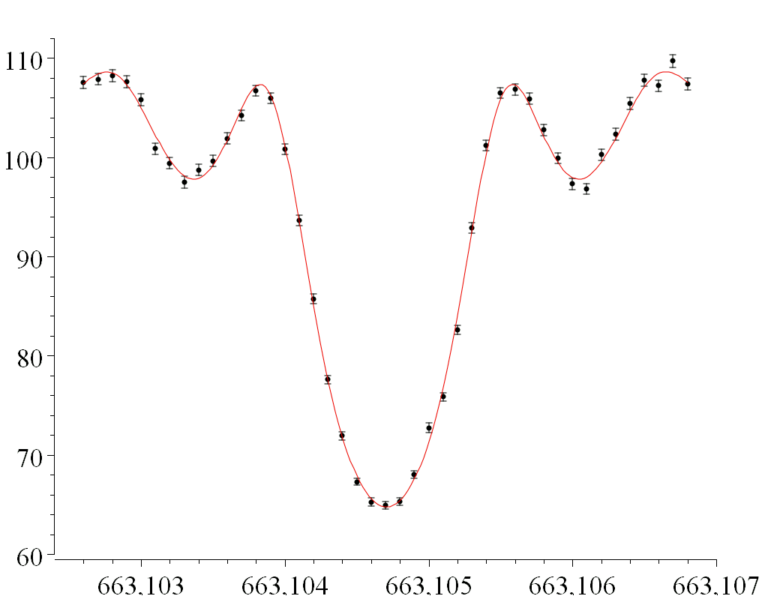
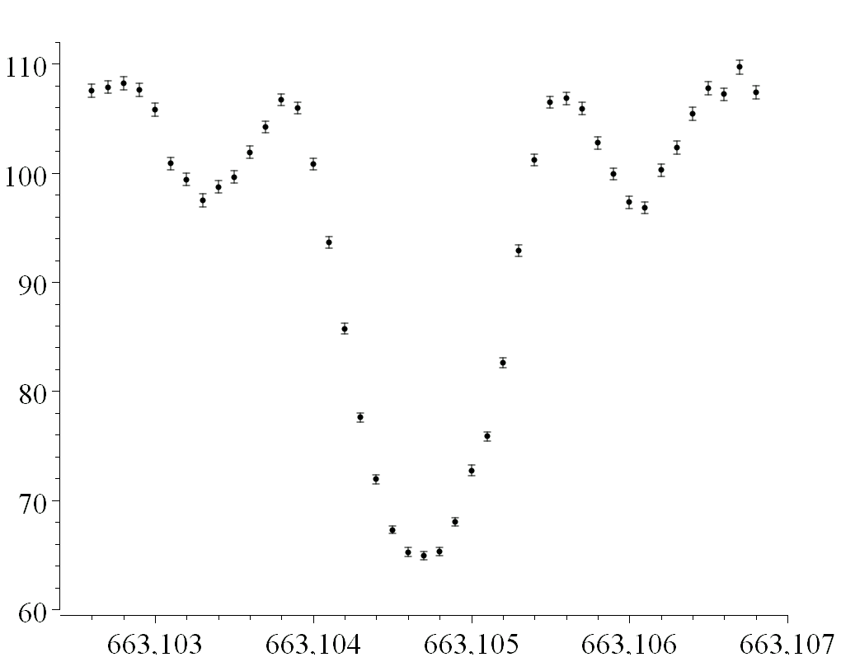
Sample ToF spectrum
¹³³Cs
Time of Flight (arb units)
Unknown:
f_{c}=663,104.706(3) Hz (560 eV/c²)
Frequency (kHz)
Slide courtesy of J. Van Schelt
Notes:
133Cs was chosen because it is close in mass to what we were measuring and because it’s precision is dm/m = 1.7 E-10.
Click early: trf is the amount of time that the excitation has been applied for

Slide 11
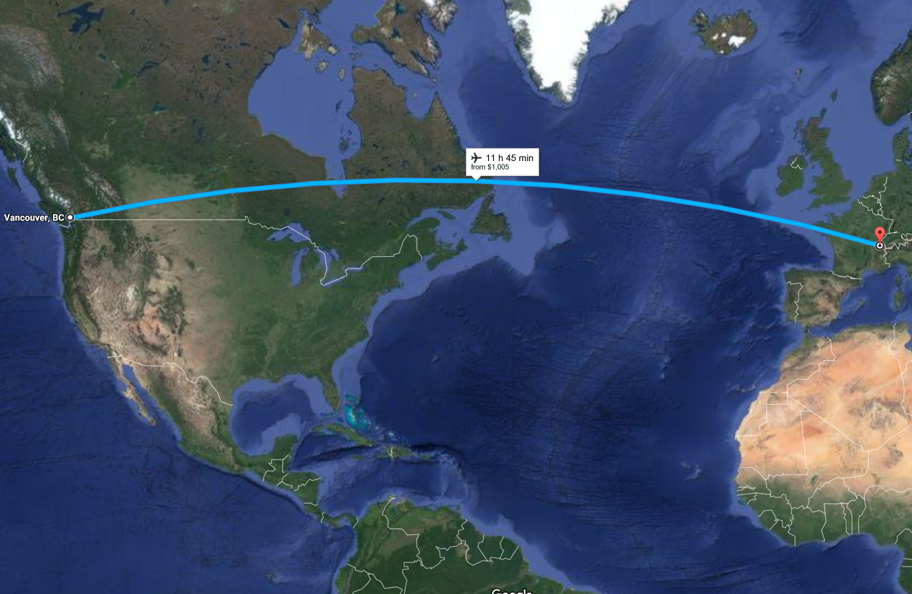

Slide 12
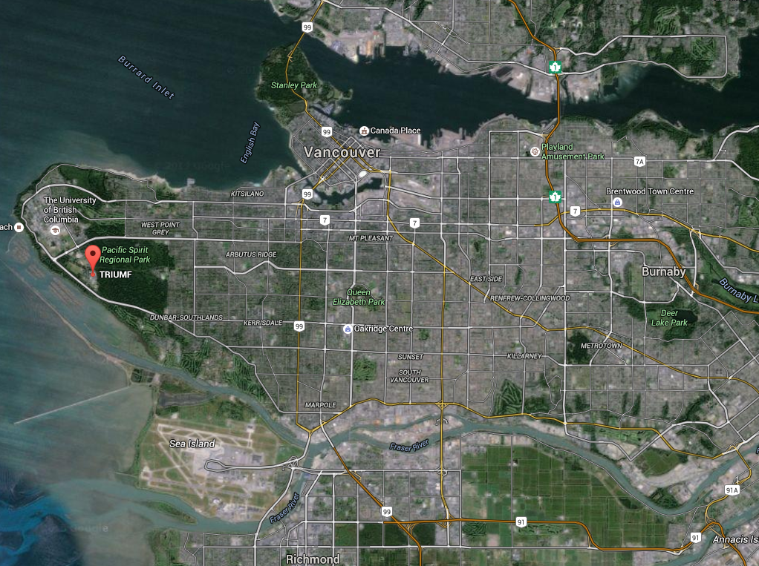

Slide 13
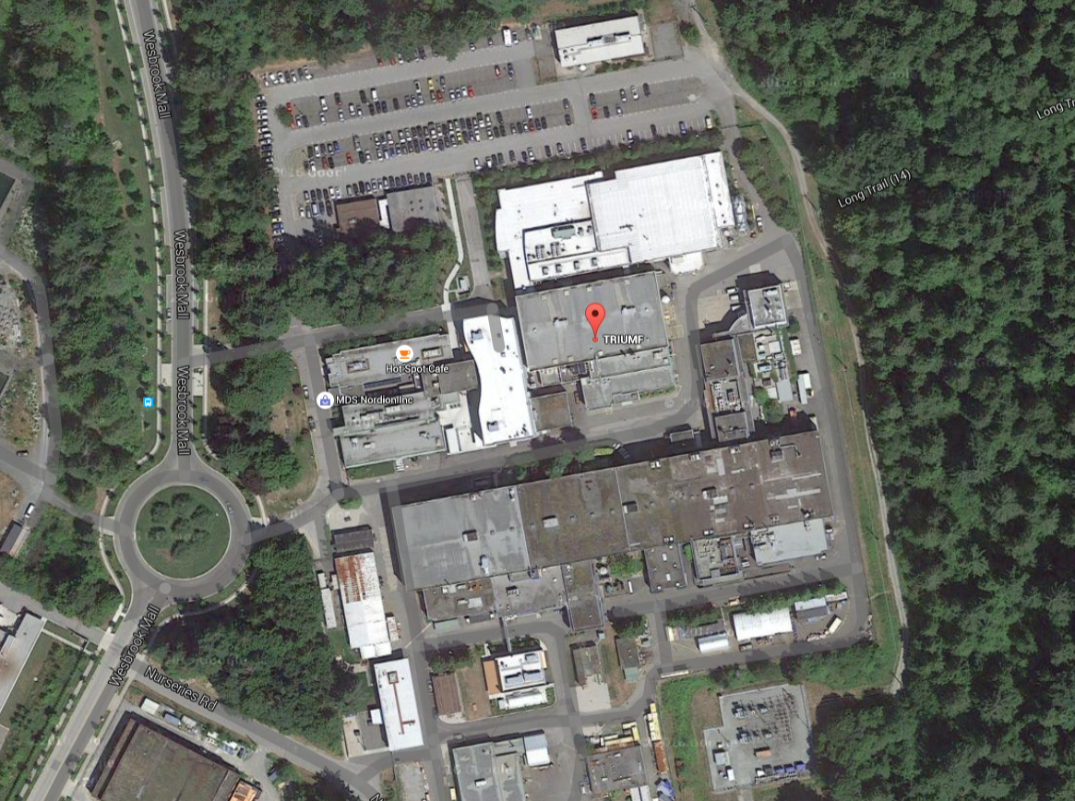
ISAC-II
ISAC-I
Cyclotron

Slide 14
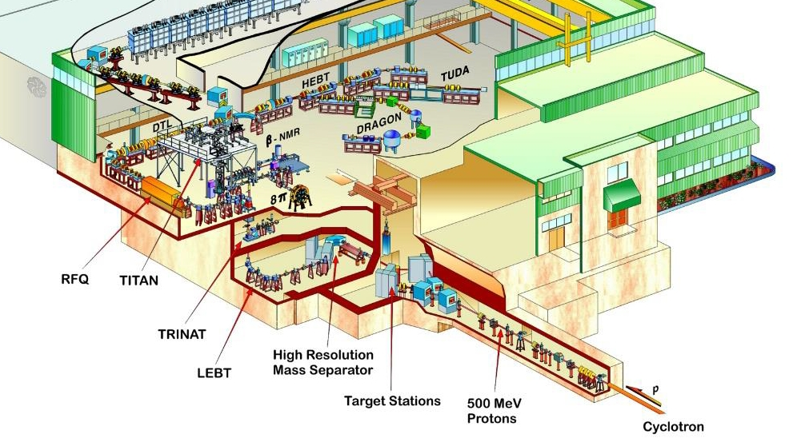
ISAC-I
TITAN

Slide 15
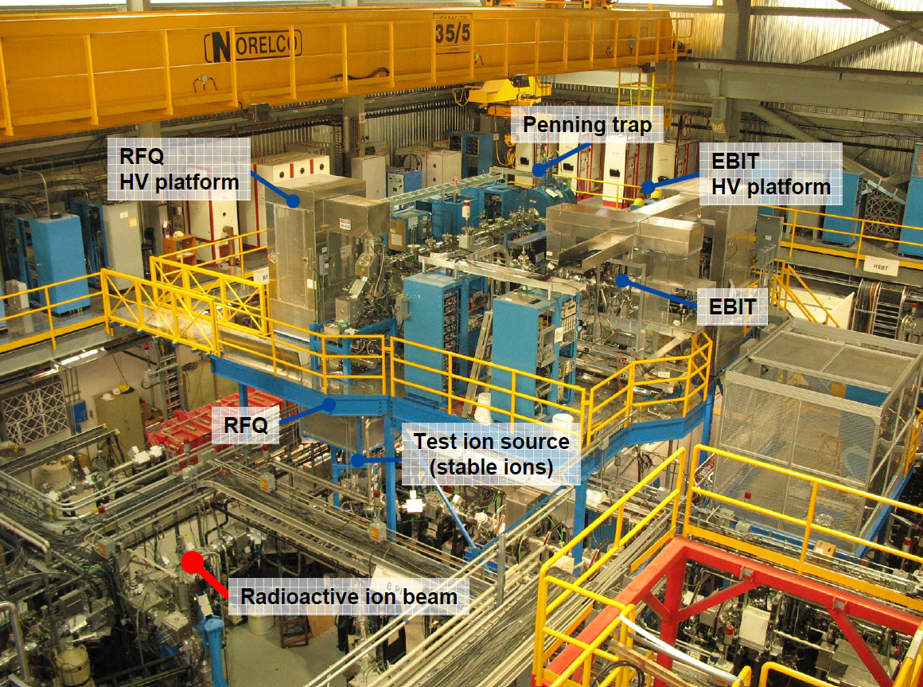

Slide 16
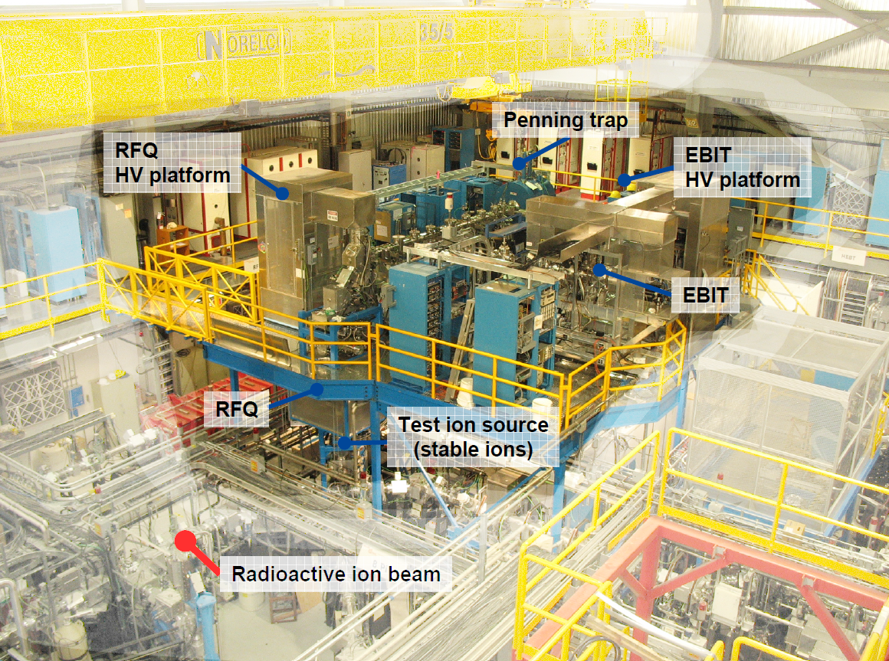

Slide 17
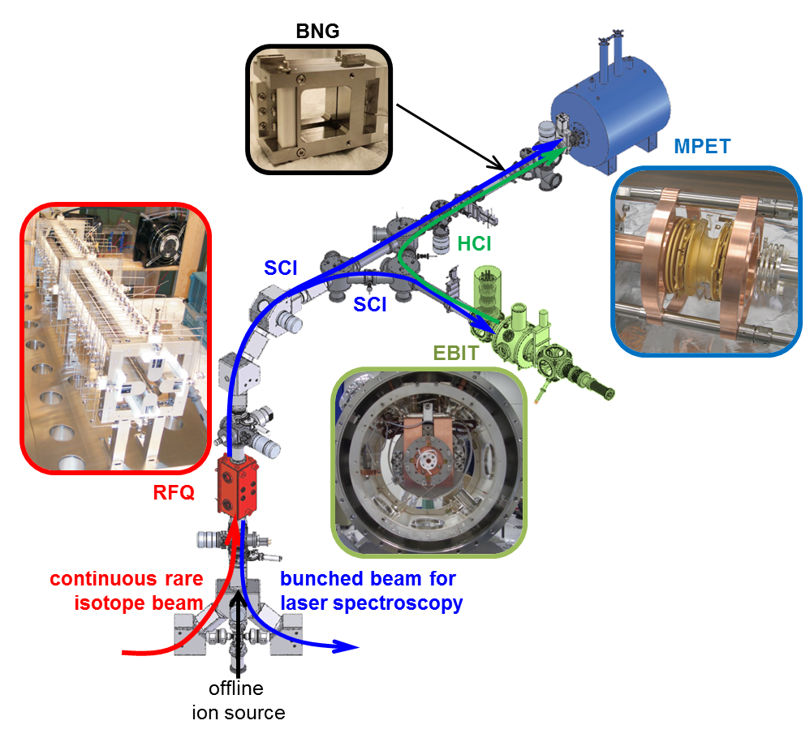

The TITAN facility
BNG: fast m/q selection
MPET: mass measurement via cyclotron frequency determination
RFQ: Accumulation, cooling, and bunching
EBIT: ms charge breeding
$$\frac{δm}{m}∝\frac{m}{t_{\text{rf}}qB\sqrt{N}}$$
Notes:
Going to a higher charge state is particularly important for TITAN because of…next slide

Slide 18
Short Measurement Times
TITAN specializes in short measurement cycles.
Measure masses of some of the shortest lived nuclides ever.
  ³¹Na (t_{1/2} = 17 ms)
  ³²Na (t_{1/2} = 13 ms)
  ¹¹Li (t_{1/2} = 9 ms)
³¹Na⁺
T_{1/2} = 17 ms
ν_{c} = qe/m ∙ B/2π
³²Na⁺
T_{1/2} = 13 ms
Notes:
Tests have shown that we can go get to high precision with a 5ms excitation time
$δ_{\text{Na}}=30$ keV. $δ_{\text{Li}}=64$ keV

Slide 19
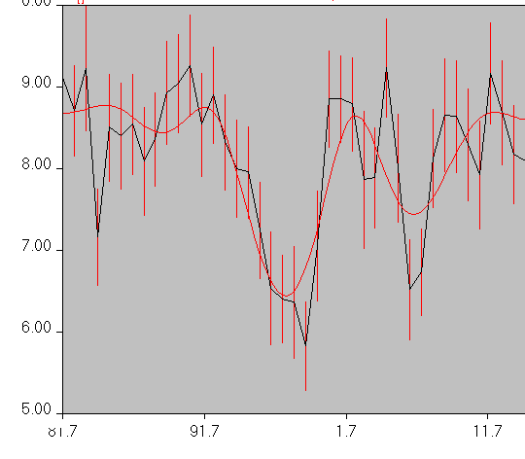
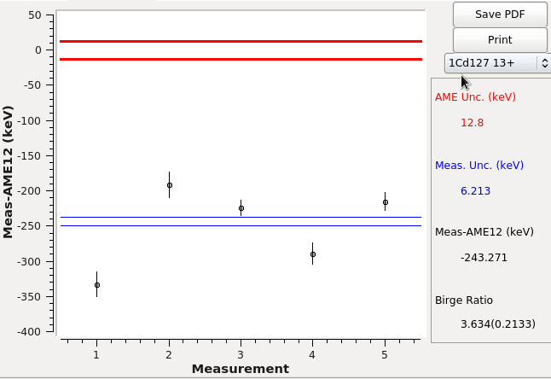
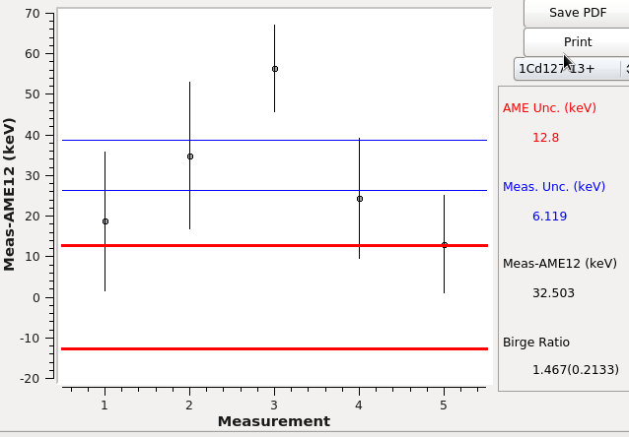
July 2016: S1466 & S1502
10 days
Some of the cleanest beam from IGLIS
Measured masses of 18 states:
  ^{125,125m,126,127,127m}Cd
  ^{125,125m,126,126m,127,127m}In ^{128,128m,129,129m}In ^{130,130m1,130m2}In
Will yield 2 pubs. min.
^{127,m}Cd
¹²⁷Cd
^{127m}Cd
Preliminary
Preliminary
Notes:
In all cases where we observed isomers, we observed the g.s. in the same spectrum

Slide 20
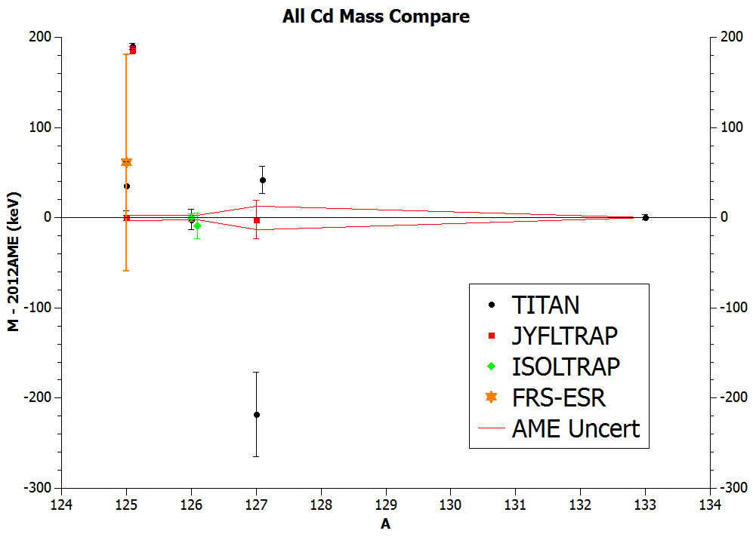
July 2016: S1466 & S1502
10 days
Some of the cleanest beam from IGLIS
Measured masses of 18 states:
  ^{125,125m,126,127,127m}Cd
  ^{125,125m,126,126m,127,127m}In ^{128,128m,129,129m}In ^{130,130m1,130m2}In
Will yield 2 pubs. min.
Misidentified isomer
Preliminary
Notes:
Good agreement in most cases. It looks like JYFLTRAP misidentified the g.s. and measured the isomer so the isomer is what is listed in the AME

Slide 21
Mass Measurements
Analysis of July Cd and In data is ongoing
  Values will be included in the 2016AME
  Cutoff is the end of this month
Able to resolve more isomers than ever before
Still can’t resolve the 50 keV isomer at ¹³⁰In
  Would like to try at ISOLTRAP – Third time’s the charm

Slide 22
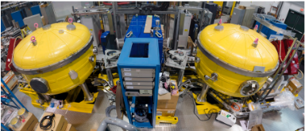
EMMA
In TRIUM’s ISAC-II Area
  Up to 6.5 MeV/u
A mass spectrometer that disperses reaction products according to their A/q ratio.
Recoils are then focused onto detectors installed at the focal plane which measure the x-y position (and hence mass dispersion) of incoming ions.
Slide courtesy of M. Williams
Notes:
EMMA=ElectroMagnetic Mass Analyzer

Slide 23
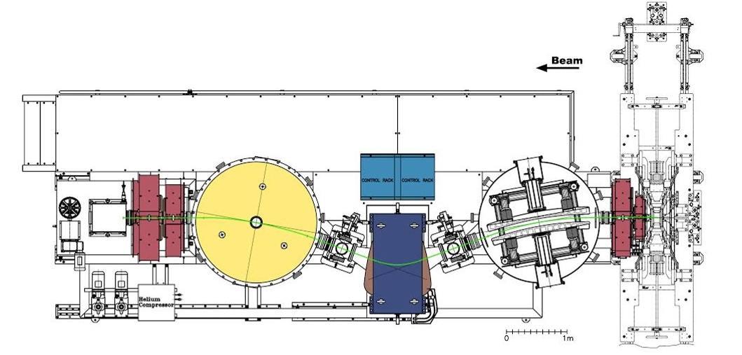
Ion Optical Layout
Based on EME design similar to the FMA.
Key differences in the design allows for greater angular acceptance. (±3.7°Average)
Maximum magnetic and electric rigidities of 1 Tm and 20 MV respectively. Calculate with NuTEMMA: (davids24.triumf.ca/~oliver/NUTEMMA/home.html)
Slide courtesy of M. Williams

Slide 24
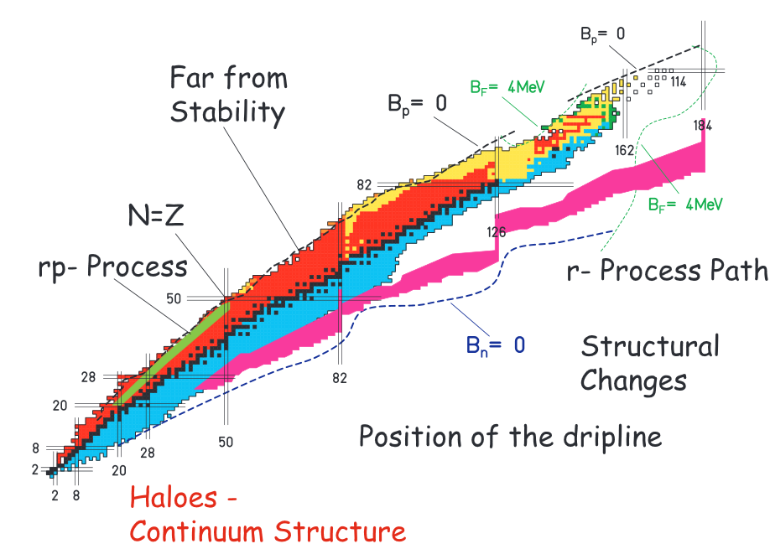
Exotic nuclei at EMMA
Physics Motivation
Nuclear astrophysics
N=Z studies
Investigation of nuclear shell structure
Far from Stability
N=Z
rp-process
r-process path
Structural Changes
Position of the dripline
Haloes –
Continuum Structure

Slide 25
Advantages of EMMATrap
Contamination reduction of ~10⁵
Access to exotic nuclei
Not limited by ISAC target chemistry
N=Z
rp-process
r-process path
Structural Changes
Position of the dripline
Haloes –
Continuum Structure

Slide 26
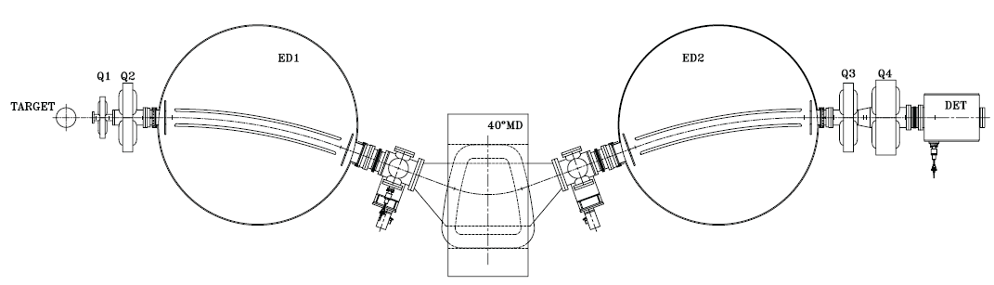
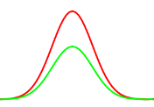
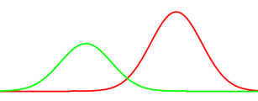
EMMA without trap
Slide courtesy of T. Brunner
Primary
beam
Stopper
gas cell
Laser
ionization
Tagging of reaction products
Stopping of ions in He gas cell
Possibility of laser-ionization (optional)
Cooling and bunching of ions
Separation from contamination in TOF spectrometer
High-precision m/q measurement in Penning trap
Mounted on a platform
Off-line test of setup
Interchangeable with focal plane detector of EMMA
Quadrupole stopper and buncher
Multi-reflection TOF
m/q separation
Notes:
We would need to build either a removable stopper cell or stopper cell/RFQ combo

Slide 27
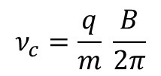
EMMATrap
Slide courtesy of T. Brunner
Particle tagging
Primary
beam
Stopper
gas cell
Laser
ionization
Tagging of reaction products
Stopping of ions in He gas cell
Possibility of laser-ionization (optional)
Cooling and bunching of ions
Separation from contamination in TOF spectrometer
High-precision m/q measurement in Penning trap
Quadrupole stopper and buncher (LPT)
Multi-reflection TOF
m/q separation
Mass measurement
Penning trap
$$ν_{c}=\frac{q}{m} \frac{B}{2π}$$

Slide 28
Commissioning of EMMA & EMMATrap Planning
EMMA scheduled to accept first beam December 2016.
  Α-source commissioning tests before & after in-beam commissioning.
  Will measure Acceptances and R of spectrometer
EMMATrap allows measurement of very exotic isotopes that are inaccessible through ISAC
Undergoing Gate 0 review and preparing for Gate 1 review.

Slide 29
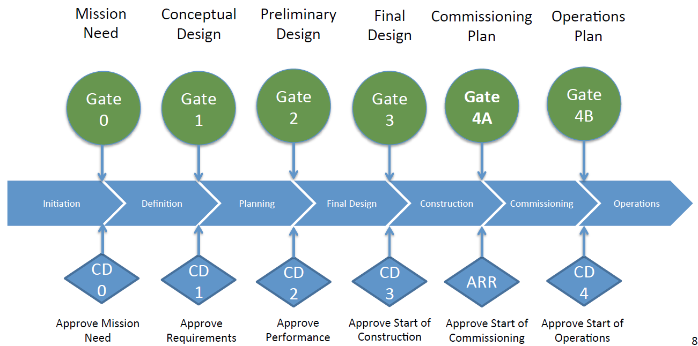
We’re…

Slide 30
Commissioning of EMMA & EMMATrap Planning
EMMA scheduled to accept first beam December 2016.
  Α-source commissioning tests before & after in-beam commissioning.
  Will measure Acceptances and R of spectrometer
EMMATrap allows measurement of very exotic isotopes that are inaccessible through ISAC
Undergoing Gate 0 review and preparing for Gate 1 review.
Looking for collaborators

Slide 31

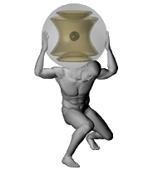
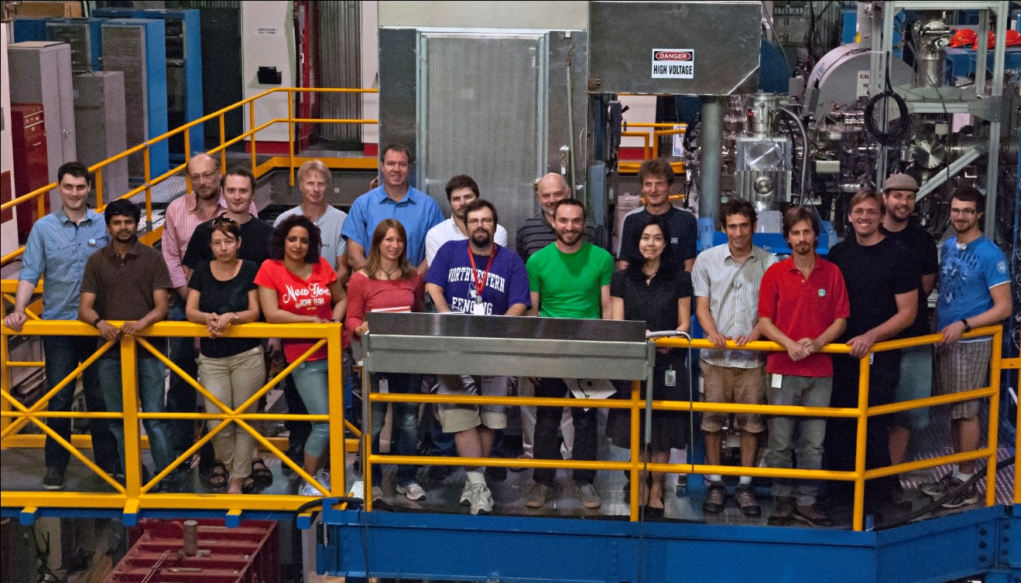
Thank you!
Merci!
Giessen
C. Andreoiu, J.C. Bale, B.R. Barquest, T. Brunner, U. Chowdhury, A. Finlay, D. Frekers, A.T. Gallant, G. Gwinner, R. Klawitter, B. Kootte, A.A. Kwiatkowski, D. Lascar, K.G. Leach, A. Lennarz, E. Leistenschneider, D.A. Short, J. Dilling (C. Babcock, P. Reiter & Y. Lan not pictured) and the TITAN Collaboration

