Slide 1
Detector Physics
Support Electronics
D. Lascar | Postdoctoral Fellow | TRIUMF

Slide 2
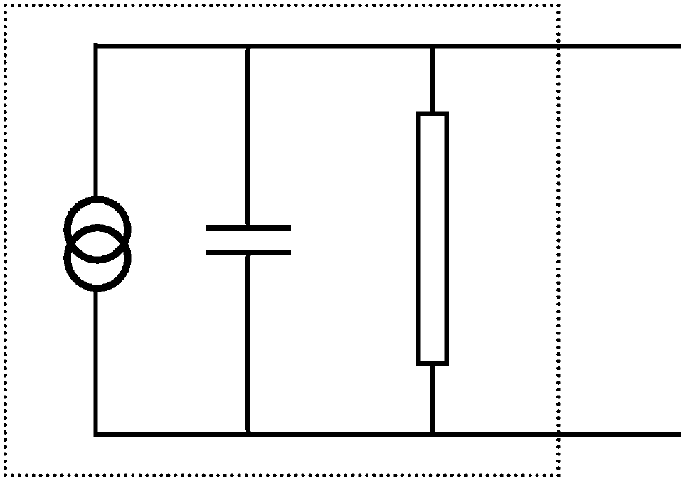
Outline
Signal Basics
Processing electronics
Analysis Electronics
Crate standards
  NIM
  CAMAC
  VME
Transmission and Noise Reduction
Notes:
Much of nuclear electronics has been standardized to the point where you don’t actually need to know what is in the circuit.
All you need to know is the logic of how given devices/module works.
How many of you can use and ADC? How many can build an ADC?
From an electronics perspective, a detector is a current source with a large internal resistance and small capacitance

Slide 3
Signals are small…(for the most part)
You are (almost) always trying to extract an electrical signal from your detector
  Phosphor screens are a notable exception
Gaseous detectors and photomultiplier tubes can make life easier with charge multiplication but semiconductors normally don’t multiply
Electronics can…
  Sort
  Amplify
  Determine timing/coincidence
  Measure pulse height
Notes:
Ask for class thoughts before revealing

Slide 4
Two different ways for measuring signals
Pulse Mode
Current mode
Most common
Observe and count individual pulses
Timing preserved
Amplitude (Energy) is measured
Rate limited.
Not uncommon
All charge is measured via integration
Rate independent
  Pileup is ok
Timing information lost
Amplitude is lost

Slide 5
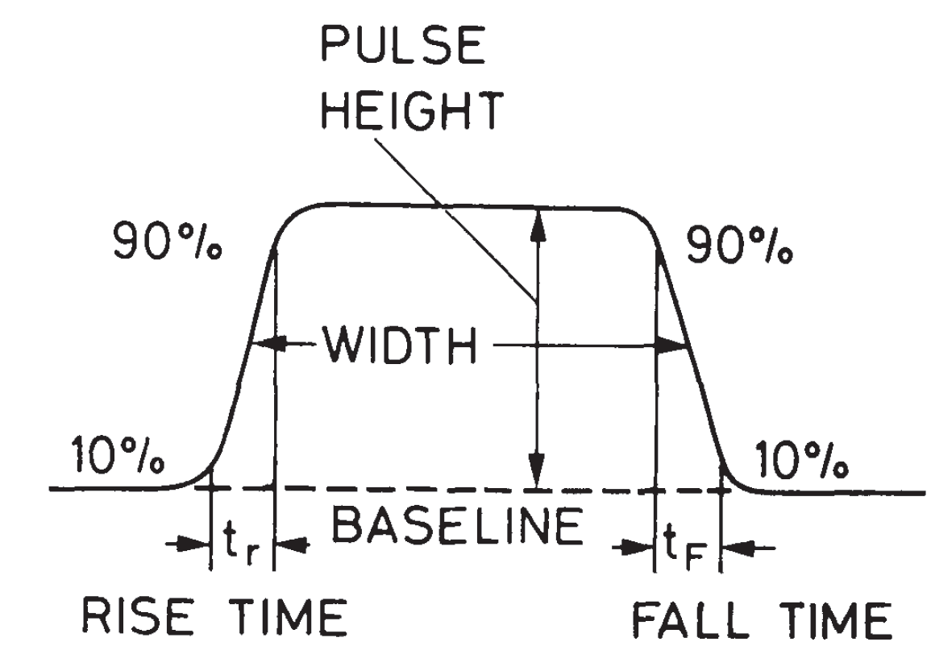
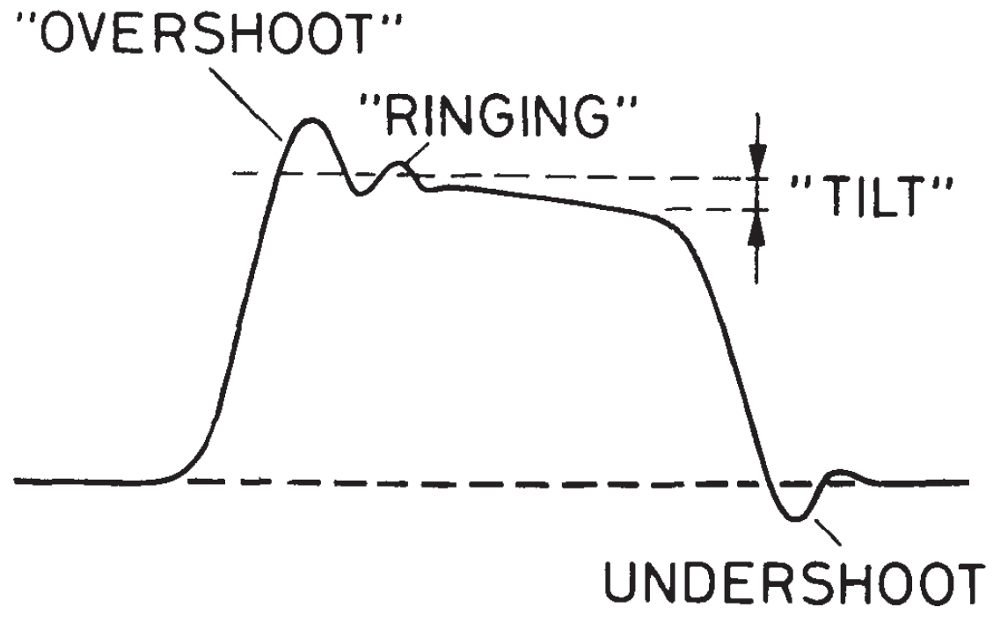
Analog pulse signals
Brief surges of current or voltage
We measure
  Existence
  Polarity
  Shape
  Amplitude
  Width (FWHM)
  Timing
Notes:
Ask about the Existence attribute
Baseline. The voltage or current level to which the pulse decays.
Pulse Height or Amplitude. The amplitude is the height of the pulse as measured from its maximum value to the instantaneous baseline below this peak.
Signal Width. The full width of the signal usually taken at the half-maximum of the signal (FWHM).
Leading Edge. The leading edge is that flank of the signal which comes first in time.
Falling Edge. The falling edge or tail is that flank which is last in time.
Rise Time. This is the time it takes for the pulse to rise from 10 to 90% of its full amplitude. The rise time essentially determines the rapidity of the signal and is extremely important for timing applications.
Fall Time. In analogy with rise time, the fall time is the time it takes for the signal to fall from 90 to 10% of its full amplitude.

Slide 6
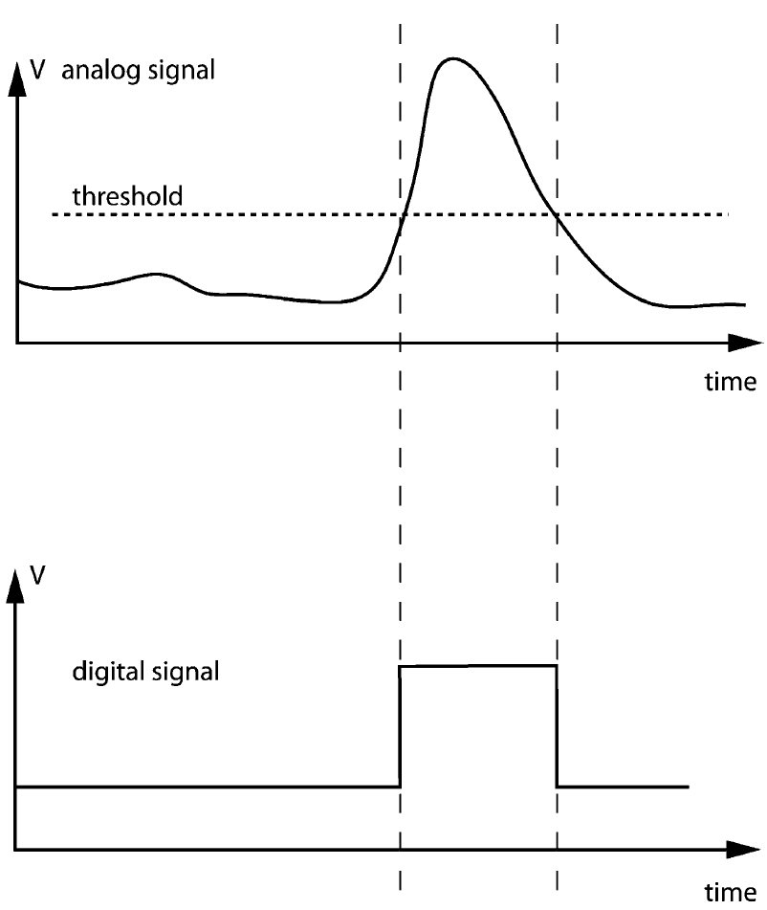
The discriminator – measuring existence
The input signal is always on.
A reference voltage is set by the user – threshold
When the voltage on the input goes higher than the threshold:
Output = 1
  1 and 0 set by user/device
Notes:
This is a digital signal generated from an analog signal. Only timing information and minimum energy survives

Slide 7
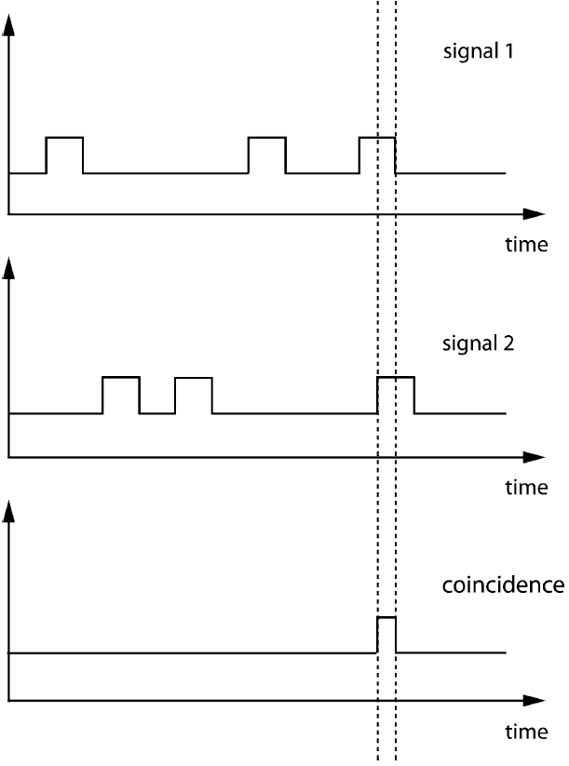
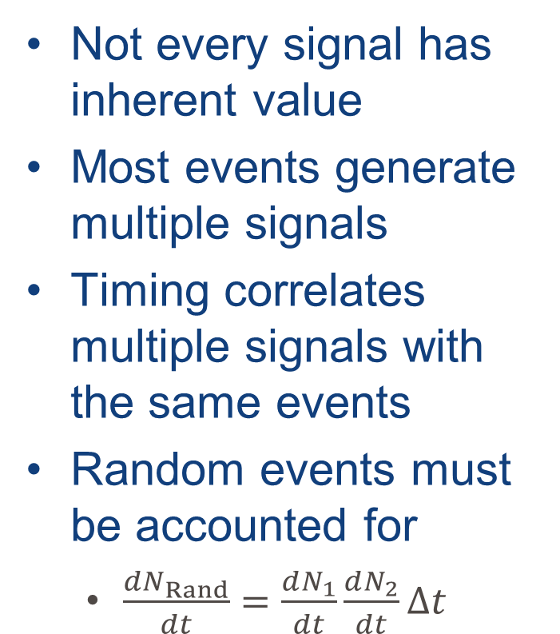

Coincidence measure
Not every signal has inherent value
Most events generate multiple signals
Timing correlates multiple signals with the same events
Random events must be accounted for
  $\frac{{dN}_{Rand}}{dt}=\frac{dN_{1}}{dt}\frac{dN_{2}}{dt}Δt$
$$Δt$$

Slide 8
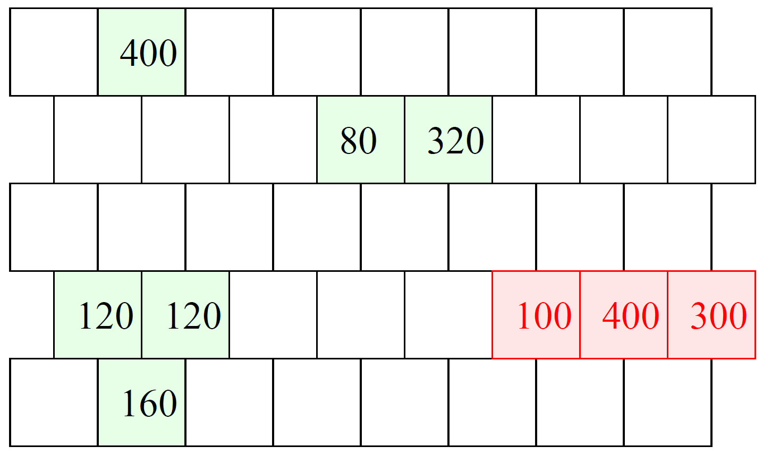
Photon calorimeter
Consider a segmented calorimeter designed to measure γ’s from 300 MeV to 2000 MeV.
  γ can deposit energy in groups of one or more cells.
A charged pion might pass through the detector and leave energy that should be rejected.
Slide courtesy of M. Fortner, N. Illinois University

Slide 9
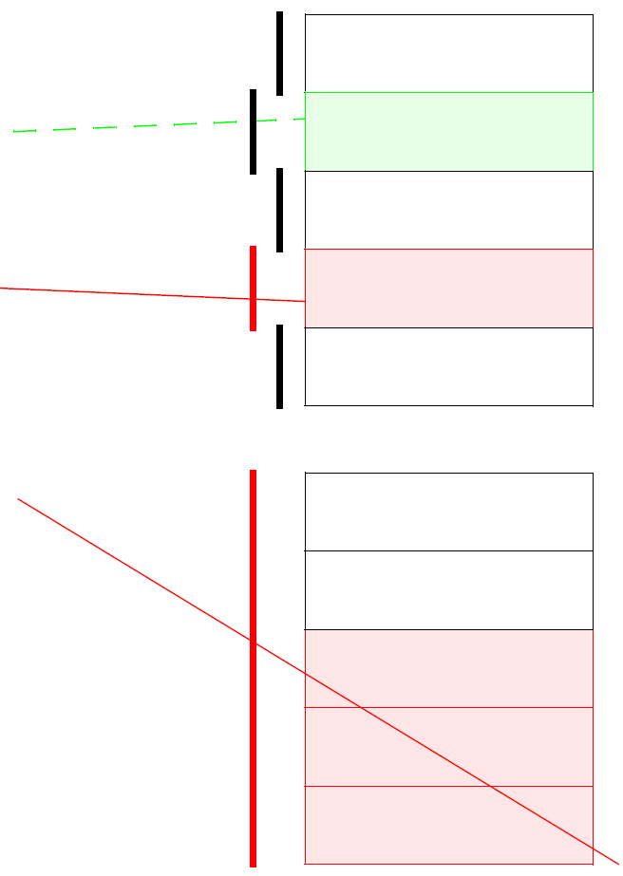
Veto Detector
Set of scintillators placed in front of a calorimeter to act as simple counters.
A charged particle will create a signal in the scintillator, but a photon will not.
Side view
Top view
Slide courtesy of M. Fortner, N. Illinois University

Slide 10
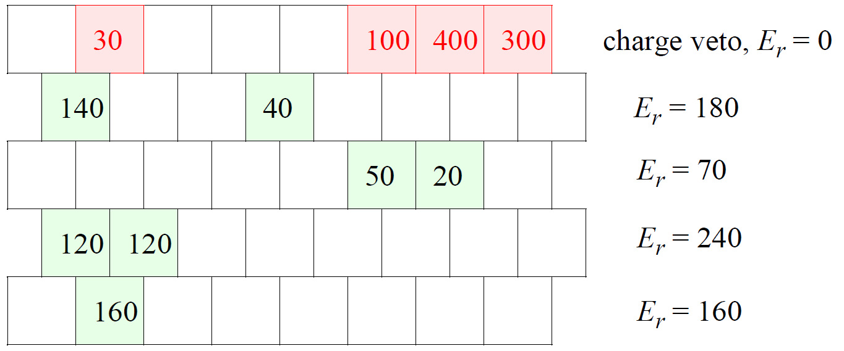

Neutral rows
Simple trigger solution: Sum all the energy in a row when not vetoed by the scintillator.
  If any row exceeds 300 MeV it’s a good event.
Trigger will exclude $π$’s & soft-$γ$ spray.
Trigger inefficient when a good $γ$ spreads energy between two rows
Slide courtesy of M. Fortner, N. Illinois University

Slide 11
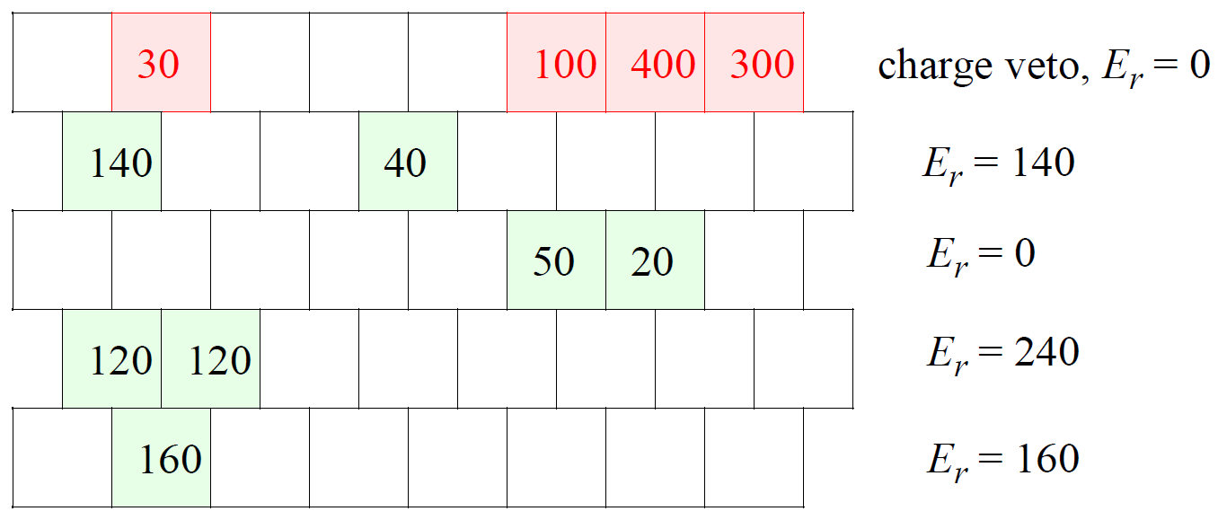

Selected Sum
Better trigger sums all blocks not vetoed, but insist that each cell exceed a 75 MeV threshold
Excludes $π$’s and soft-$γ$ spray
Better at finding 2-row $γ$’s
Slide courtesy of M. Fortner, N. Illinois University

Slide 12
Logic gates
A gate is a circuit element that operates on a binary signal
Logic operations typically have three methods of description:
  Equation symbol
  Truth table
  Circuit symbol
When levels refer to Boolean expressions they are referred to as True and False.
  Logic levels are T=True & F=False
  Binary levels are 1=True & 0=False
When levels refer to electronic voltage levels they are called High and Low
  Logic H=High & L=Low
  Binary levels are 1=High & 0=Low

Slide 13

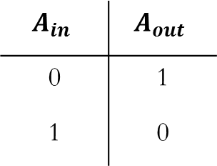



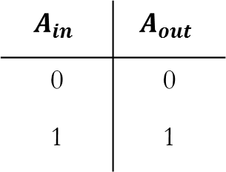
Unary operators – 1 input
The identity operator leaves the value unchanged
The inverse operation reverses the value and is called NOT.
$$A_{in}$$ | $$A_{out}$$
0 | 0
1 | 1
$$A$$
$$A$$
$$A_{in}$$ | $$A_{out}$$
0 | 1
1 | 0
$$A$$
$$\overline{A}$$
Slide courtesy of M. Fortner, N. Illinois University

Slide 14





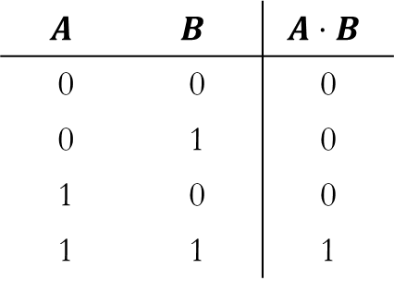

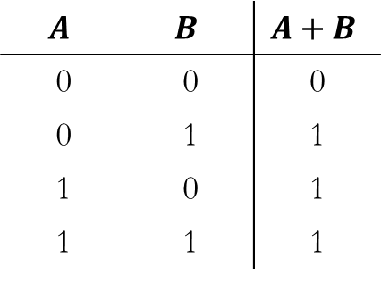
Binary operators – 2 inputs
AND operator acts like multiplication
OR operator acts like addition
$$A$$ | $$B$$ | $$A⋅B$$
0 | 0 | 0
0 | 1 | 0
1 | 0 | 0
1 | 1 | 1
$$A$$
$$A⋅B$$
$$B$$
$$A$$ | $$B$$ | $$A+B$$
0 | 0 | 0
0 | 1 | 1
1 | 0 | 1
1 | 1 | 1
$$A$$
$$A+B$$
$$B$$
Slide courtesy of M. Fortner, N. Illinois University

Slide 15

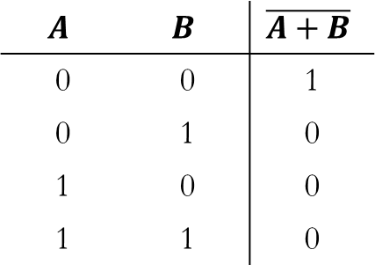

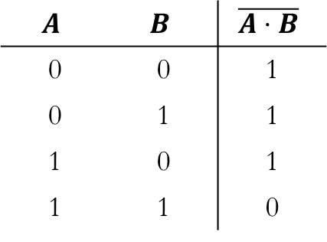




Compound operations
Combination of NOT & AND is NAND
Combination of NOT & OR is NOR
$$A$$ | $$B$$ | $$\overline{A⋅B}$$
0 | 0 | 1
0 | 1 | 1
1 | 0 | 1
1 | 1 | 0
$$A$$
$$\overline{A⋅B}$$
$$B$$
$$A$$ | $$B$$ | $$\overline{A+B}$$
0 | 0 | 1
0 | 1 | 0
1 | 0 | 0
1 | 1 | 0
$$A$$
$$\overline{A+B}$$
$$B$$
Slide courtesy of M. Fortner, N. Illinois University

Slide 16


Compound operations
Combination of NOT & AND is NAND
Combination of NOT & OR is NOR
Either NAND or NOR gates can be used to create other logic gates
$$A$$
$$\overline{A⋅B}$$
$$B$$
$$\overline{\left(\overline{A⋅B}\right)⋅(\overline{A⋅B})}=A⋅B$$
$$\overline{\left(\overline{A+A}\right)+(\overline{B+B})}=A⋅B$$
Slide courtesy of M. Fortner, N. Illinois University

Slide 17
Many many many many many more
Exclusive OR
Flip-Flops
Clocks
Counters
Multistage dividers
A plethora of amplifiers
  Summation
  Difference
  Multipliers

Slide 18
Analog to digital conversion
Signal attributes are most easily processed when converted to a digital signal

Slide 19
Analog to digital conversion
Signal attributes are most easily processed when converted to a digital signal

Slide 20
Analog to digital conversion
Signal attributes are most easily processed when converted to a digital signal

Slide 21
Analog to digital conversion
Signal attributes are most easily processed when converted to a digital signal

Slide 22
Analog to digital conversion
Signal attributes are most easily processed when converted to a digital signal

Slide 23
Digital signals make logic easy/possible
Electronics that analyze systems to be when measuring quantized pieces of information.
Improving the sampling rate allows for finer “level-splitting” but most electronics only have two states: 0 and 1 – Logic signals
Logic carries less information more reliably
  Don’t have to worry about maintaining the full waveform

Slide 24
Digital signals make logic easy/possible
Electronics that analyze systems to be when measuring quantized pieces of information.
Improving the sampling rate allows for finer “level-splitting” but most electronics only have two states: 0 and 1 – Logic signals
Logic carries less information more reliably
  Don’t have to worry about maintaining the full waveform
It would be easier to define a standard
  Or 5 standards, it doesn’t really matter as long as we know what we’re dealing with

Slide 25
The Nuclear Instrument Module (NIM) standard
Slow positive logic
Fast negative logic (NIM logic)
Slow rise time
  ≥ 100 ns
Positive polarity
Designed for high input impedance (≥ 1000 Ω)
  Low current
  Can’t be transmitted over long cable
Not used so often
Fast rise time
  ~1 ns
Negative polarity
Current based standard & low impedance
  Current into 50 Ω
    Logic 0: 0 V
    Logic 1: -0.8 V
 | Output must deliver | Input must accept
Logic 0 | -2 to +1 V | -2 to +1.5 V
Logic 1 | +4 to +12 V | +3 to +12 V
 | Output must deliver | Input must accept
Logic 0 | -1 to +1 mA | -4 to +20 mA
Logic 1 | -14 to -18 mA | -12 to -36 mA

Slide 26
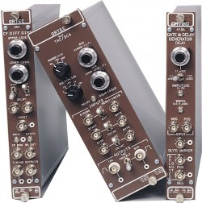
But wait…there’s more
NIM is also a standard for electronics modules.
  Can be single-wide, double-wide or triple-wide

Slide 27
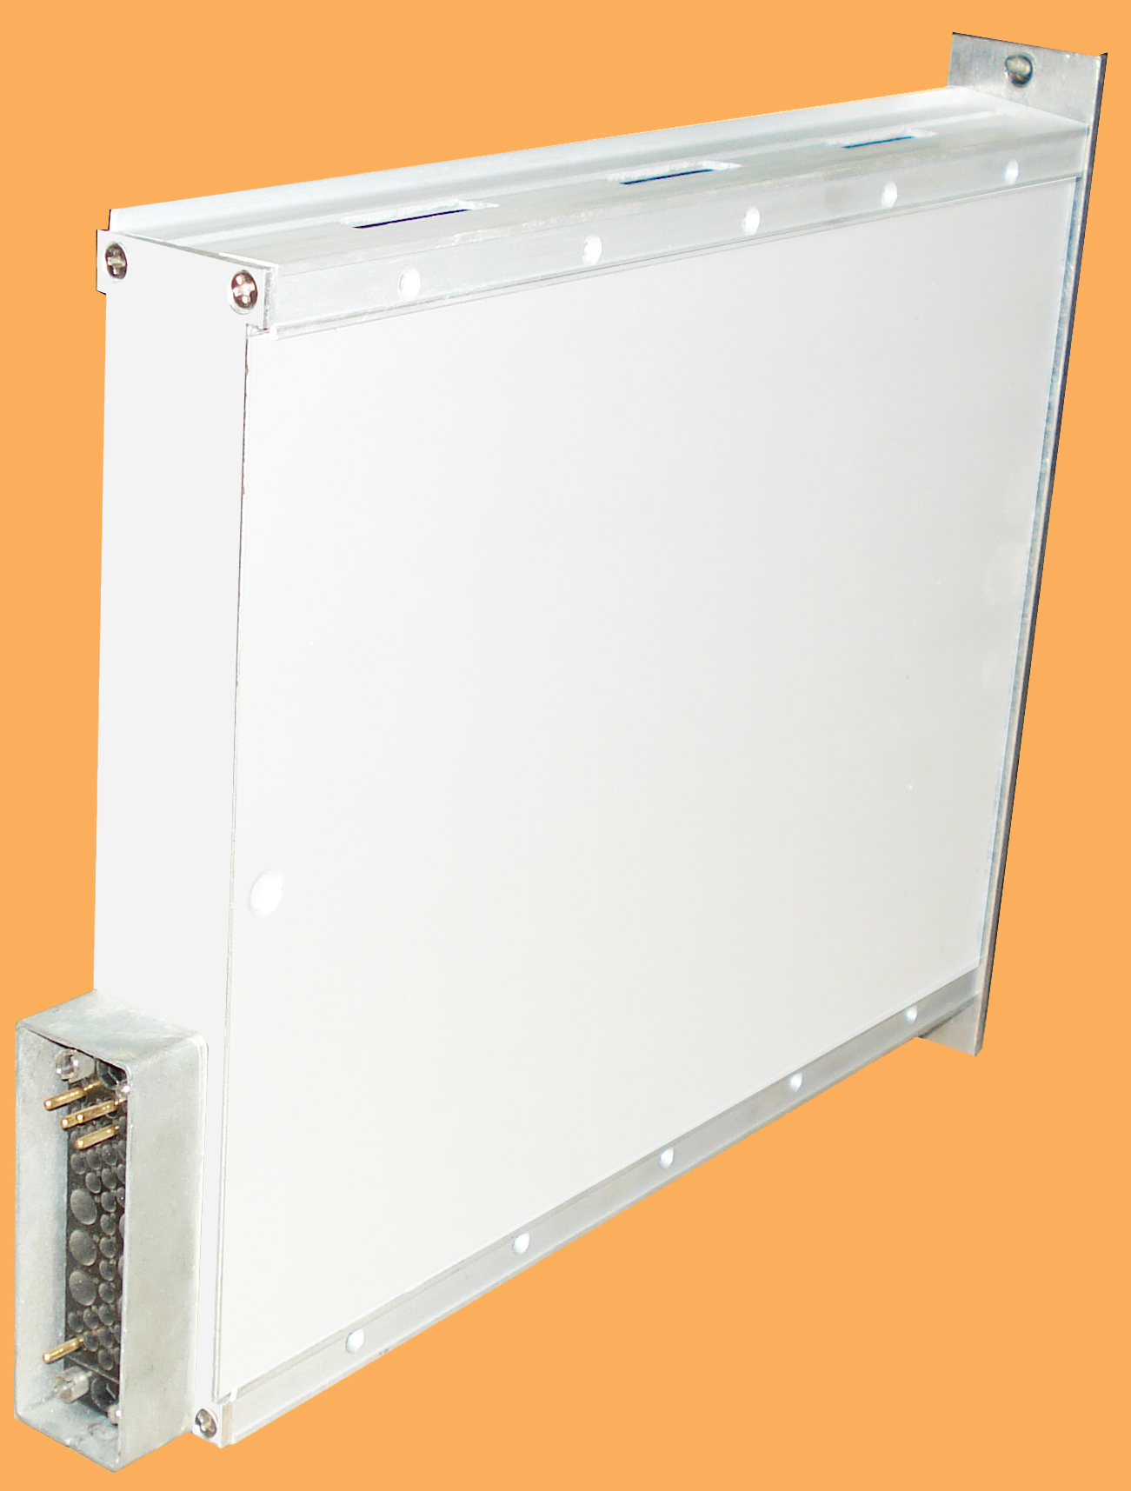
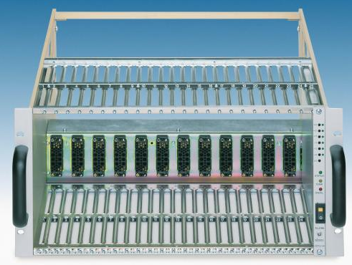
But wait…there’s more
NIM is also a standard for electronics modules.
Modules are designed to mate with a crate

Slide 28
But wait…there’s more
NIM is also a standard for electronics modules.
Modules are designed to mate with a crate
Crate provides
  ±6V
  ±12V
  ±24V
All pins bussed
No communication between modules
Modules can be quickly added for different experimental needs
Many labs have pools of NIM modules

Slide 29
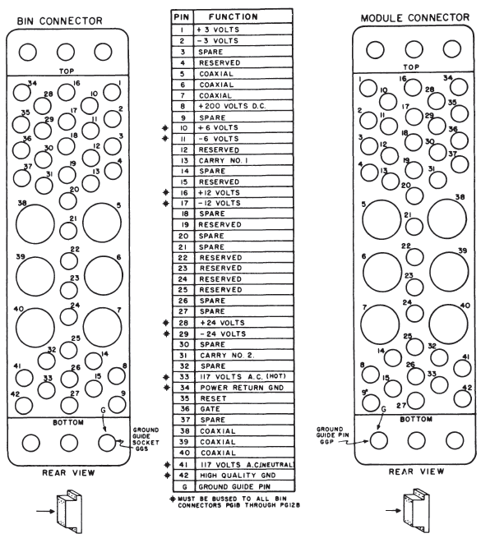

Slide 30
Common off-standard logic
NIM signals can be counterintuitive or limiting so other signal standards are often included
Transistor-Transistor Logic (TTL)
  Positive going logic
Emitter Coupled Logic (ECL)
  Faster & easier to use than fast negative NIM
 | TTL | ECL
Logic 0 | +0 to +0.8 V | -1.75 V
Logic 1 | +2 to +5 V | -0.90 V
Note the smaller jump

Slide 31
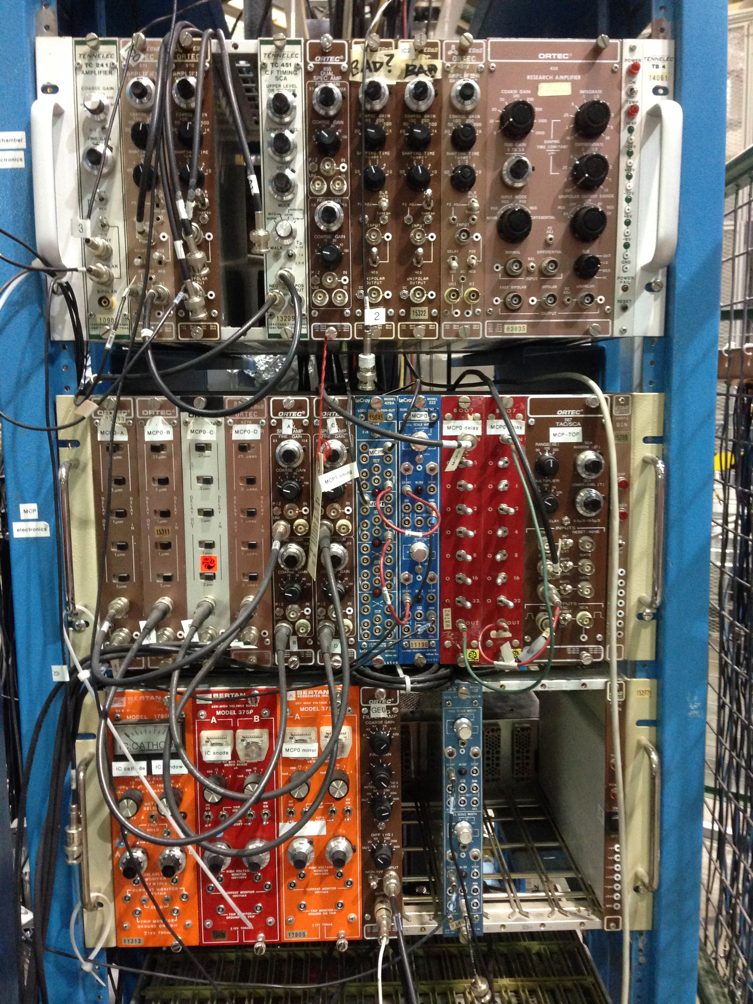

Slide 32
CAMAC: Time to make life more complicated…interesting
The NIM standard:
  Doesn’t handle large amounts of digital data easily
  Interface with a computer is done on a module by module basis
  Modules are normally wider than they need to be if no readout meter is required.
A new standard to:
  Make the modules thinner
  Include a common dataway for communication
  Still fit in a standard 19” rack

Slide 33
The Computer Automated Measurement And Control (CAMAC) Standard
Introduced in 1969 and adopted in 1972
25 module stations 17.2 mm wide
  Double- and triple-wide modules are allowed
Modules normally made of a single PCB with an edge connector of 86 contacts.
Every station has:
  ±6V
  ±12V (not required by standard but normally there)
  ±24V
  Separate read and write lines (24 pairs in total)
Notes:
Double wide modules are important for large components like relays.

Slide 34
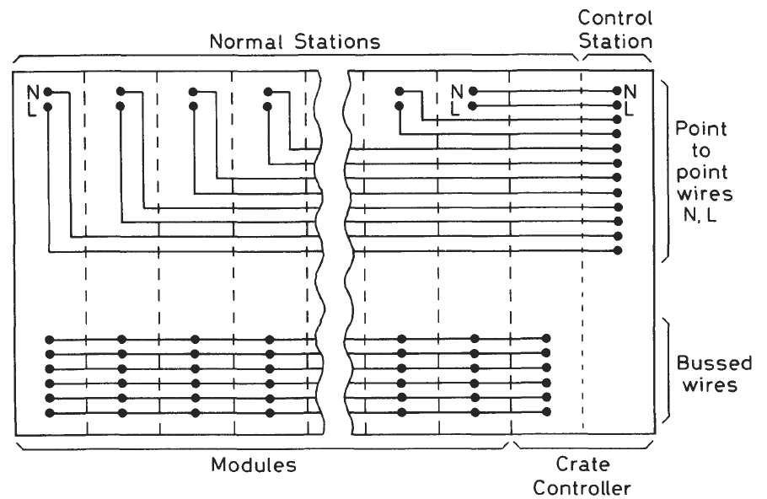
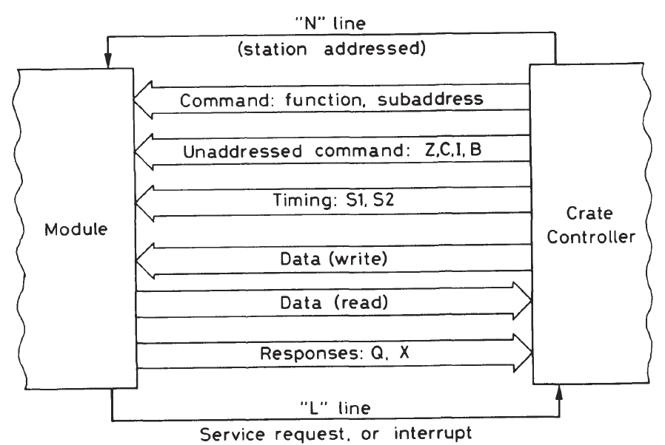
The CAMAC dataway

Slide 35
The CAMAC controller
The extreme right station is the control station
  All read and write lines connect.
A special crate controller module must go in the last station
  System won’t function without a controller
Controller
  Transfers data to/from control PC
  Communicates with all modules
  Mediates communication between modules
Communication designed for FORTRAN but by now there’s translators for every language

Slide 37
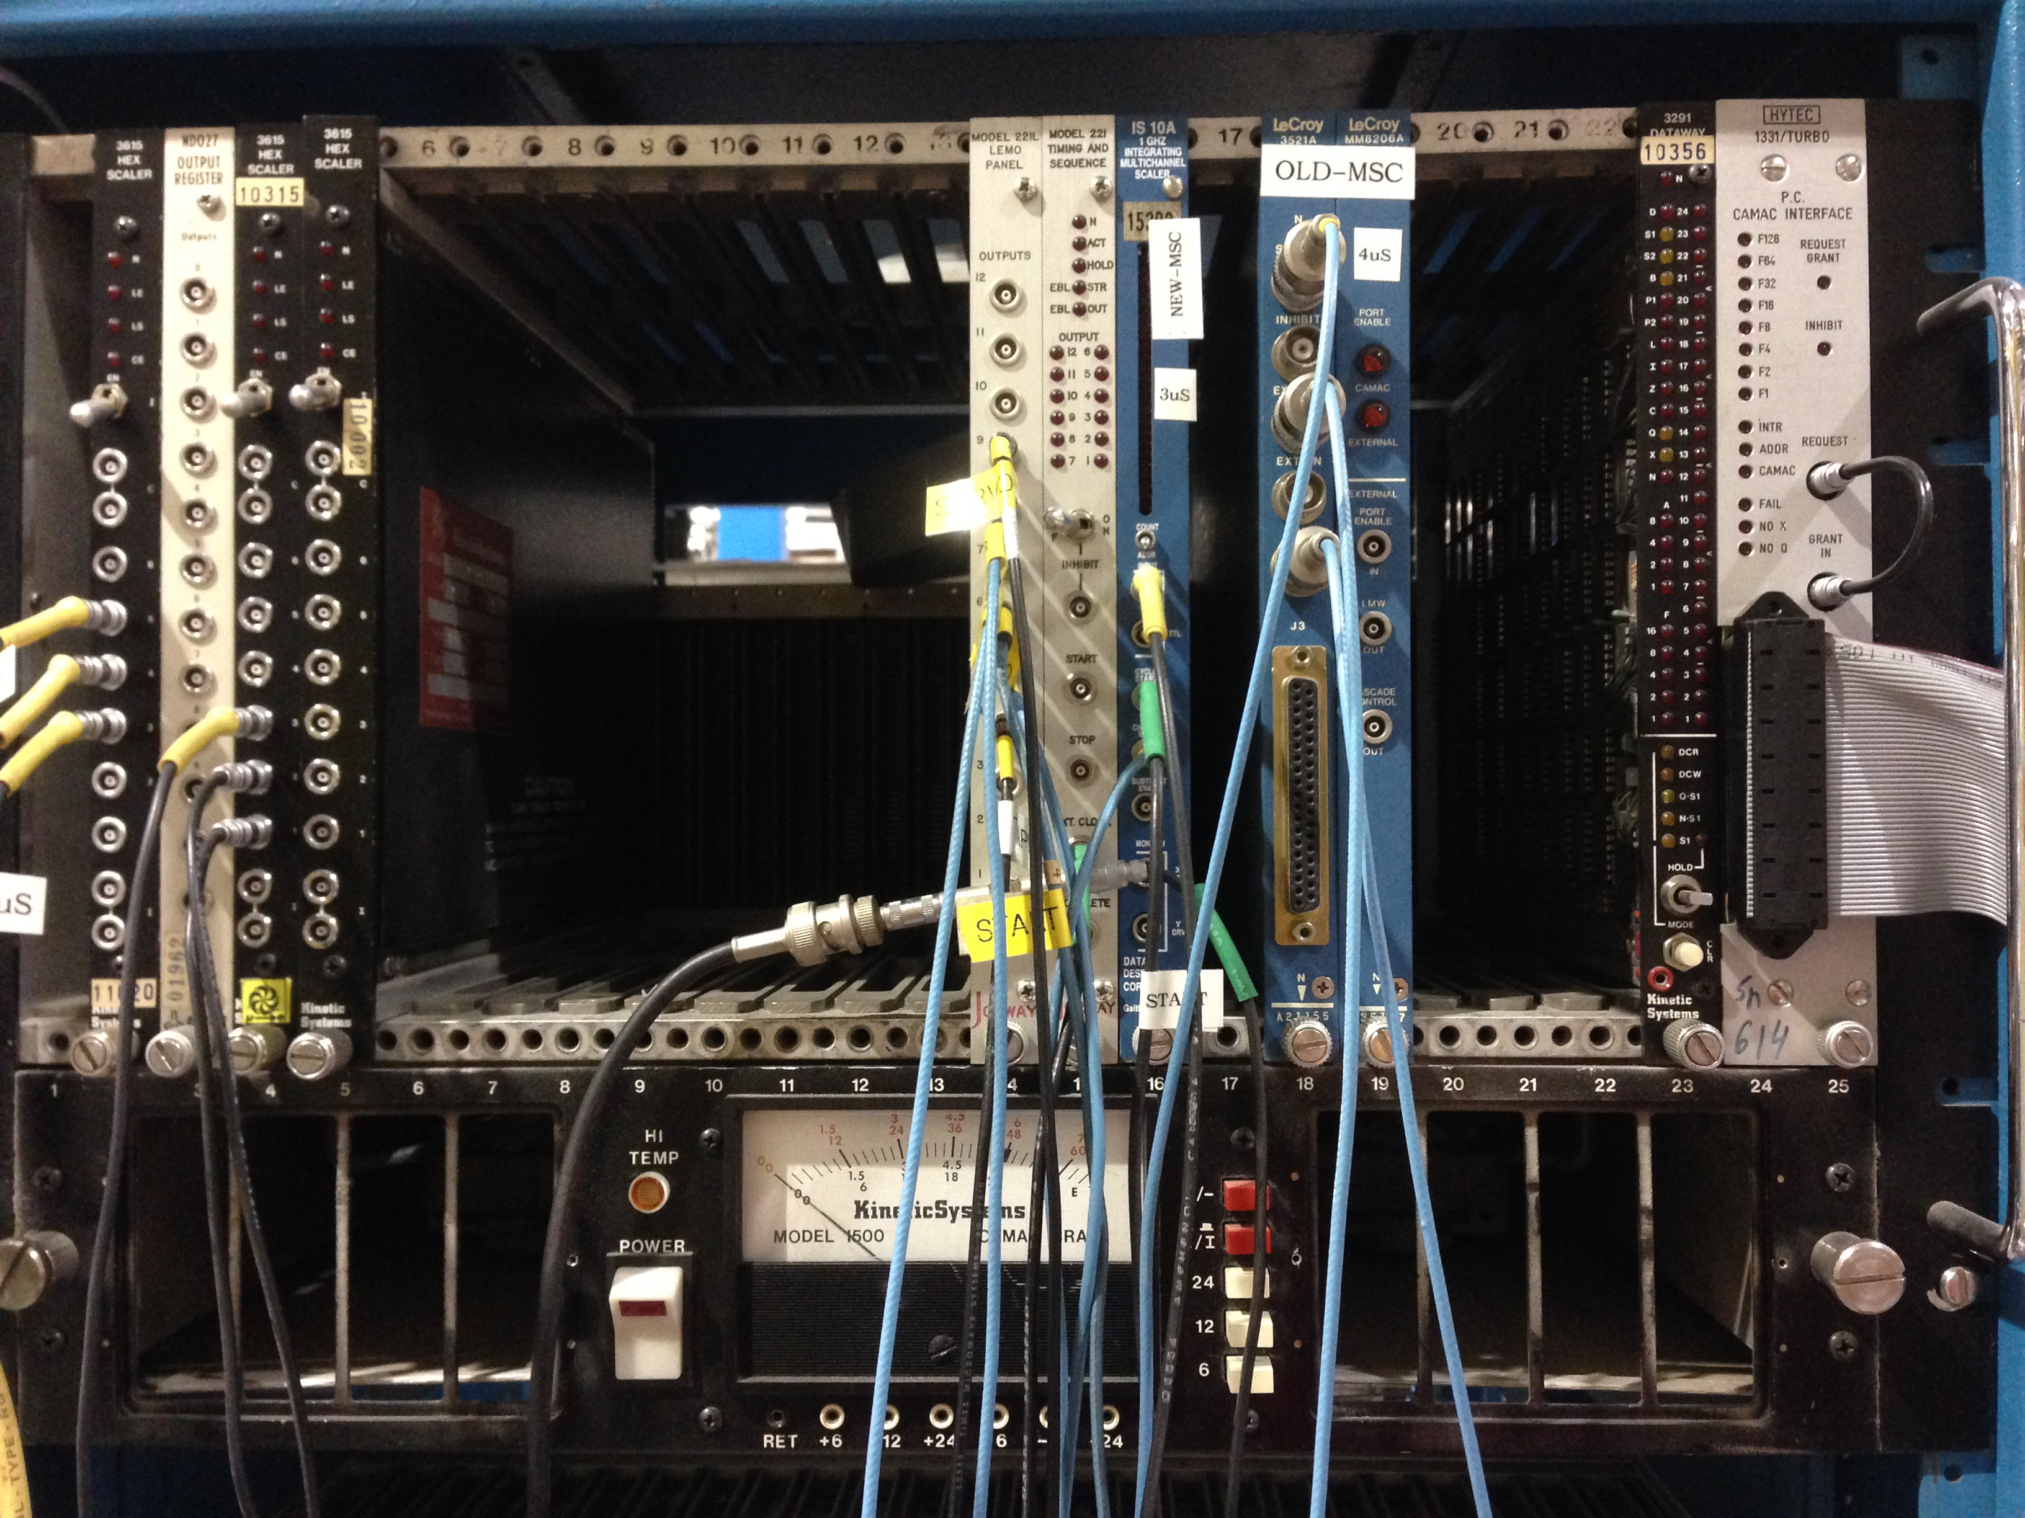

Slide 38
For more on CAMAC
Entire classes could be given on the CAMAC standard and communication
Leo Chapter 18 is a great start
  http://link.springer.com/book/10.1007%2F978-3-642-57920-2
Fermilab’s Introduction to CAMAC
  http://cdorg.fnal.gov/ese/prep/introCamac.php
CAMAC Tutorial Issue, IEEE Trans. Nucl. Sci. NS-20 2 (1973)
  http://ieeexplore.ieee.org/xpl/tocresult.jsp?isnumber=4327008&punumber=23

Slide 39
From CAMAC to VME
As experiments grew larger, the CAMAC data busses couldn’t keep up and latency increased
  Dead time = Bad
Modules expensive
Not hot-swappable
VME designed to accommodate fast microprocessor control
Made with industry standard parts so cheaper

Slide 40
From CAMAC to VME
VME crate requires a controller
  Performs bus arbitration
  Provides and maintains timeout errors
  System clock
  Other system utilities
Modules can send messages directly to each other
  Controller only opens and closes access to dataway
Communication is asynchronous and can proceed as fast as the slowest communicator
VMEbus modules tend to be set via software only
Notes:
All data transfers occur in terms of direct memory access
In CAMAC, all messages were passed through and processed by the controller, in VME, the controller simply grants access to the dataway to both sides for the duration of the communication.
For PC interface, Controller just grants access to the module. You communicate directly to the module.

Slide 41
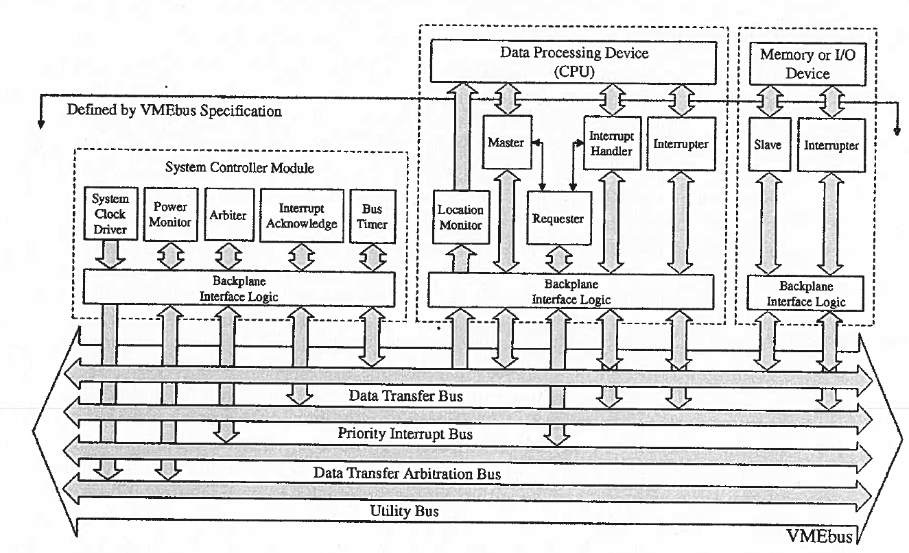
For more on VME
W. D. Peterson, The VMEbus Handbook, VITA, Scottsdale, Az 1997.
American National Standard for VME64 Extensions for Physics and Other Applications
  https://ph-dep-ese.web.cern.ch/ph-dep-ese/crates/standards/Av23.pdf

Slide 42
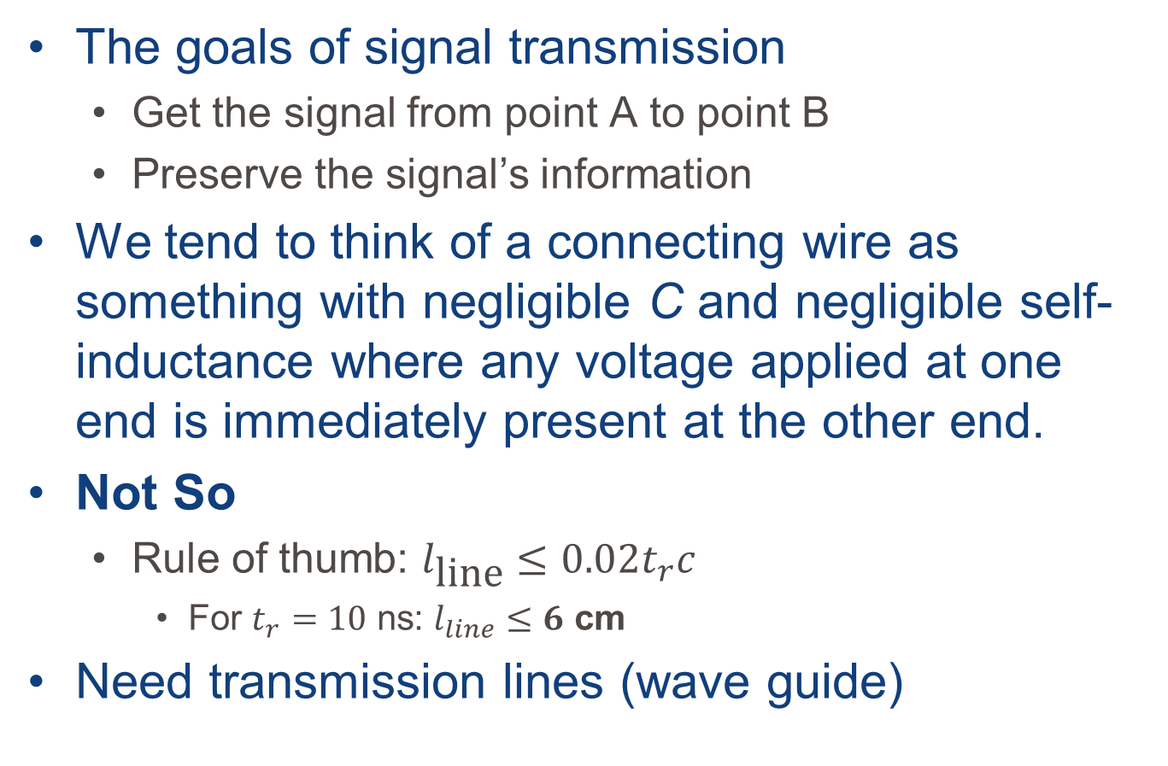
Transmission lines
The goals of signal transmission
  Get the signal from point A to point B
  Preserve the signal’s information
We tend to think of a connecting wire as something with negligible C and negligible self-inductance where any voltage applied at one end is immediately present at the other end.
Not So
  Rule of thumb: $l_{\text{line}}≤0.02t_{r}c$
    For $t_{r}=10$ ns: $l_{line}≤6$ cm
Need transmission lines (wave guide)

Slide 43
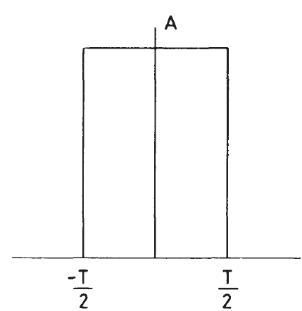


Transmission lines
Transmission lines carry rf signals efficiently
But a pulse isn’t rf.
What gives?
$$V$$
$$t$$

Slide 44
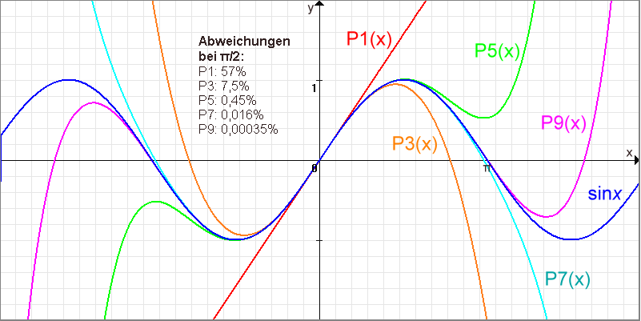

Digression: Taylor series
Represent any function as an infinite sum of polynomials and that function’s derivatives
$$\sum_{n=0}^{∞}{\frac{f^{\left(n\right)}(a)}{n!}{\left(x−a\right)}^{n}}$$

Slide 45
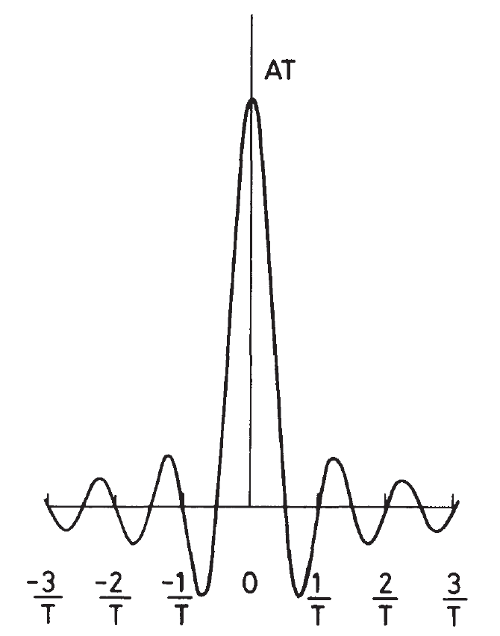


Fourier Analysis
Any pulse can be decomposed into a superposition of many pure sinusoidal frequencies
$$V$$
$$VT$$
$$t$$
$$ν=ω/2π$$
Notes:
When we perform a Fourier transform on the pulse we can see that the pulse contains a continuous spectrum of frequency components from 0 to $∞$.
As long as the bandwidth is sufficient, you can transmit anything over a transmission line.

Slide 46
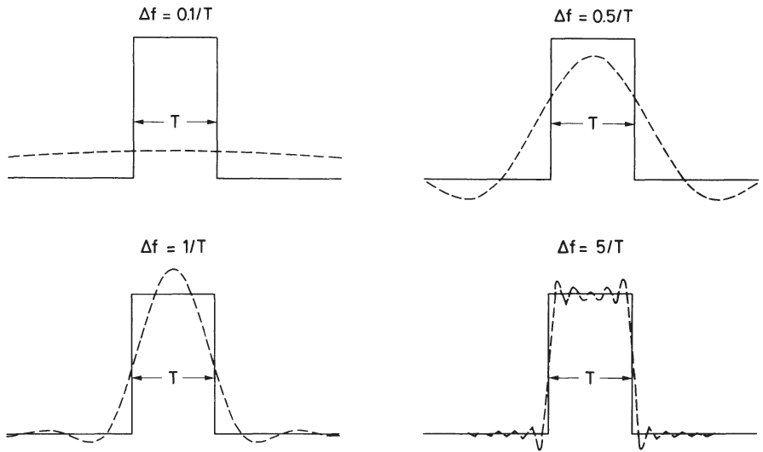





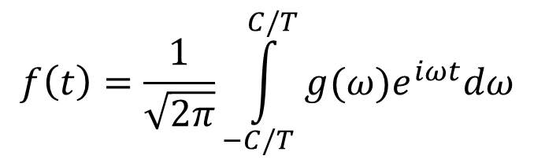
Bandwidth
All frequencies contribute in a perfect reproduction…but who wants to be perfect?
If you perform the inverse Fourier transform over a fixed interval:
$Δν>1/T$ for reasonable approximation
  For a 10 ns pulse: $Δν≥100$ MHz
$$f\left(t\right)=\frac{1}{\sqrt{2π}}\int_{−C/T}^{C/T}{g(ω)e^{iωt}dω}$$
$$Δν=1/T$$
$$Δν=5/T$$
$$Δν=0.1/T$$
$$Δν=0.5/T$$

Slide 47
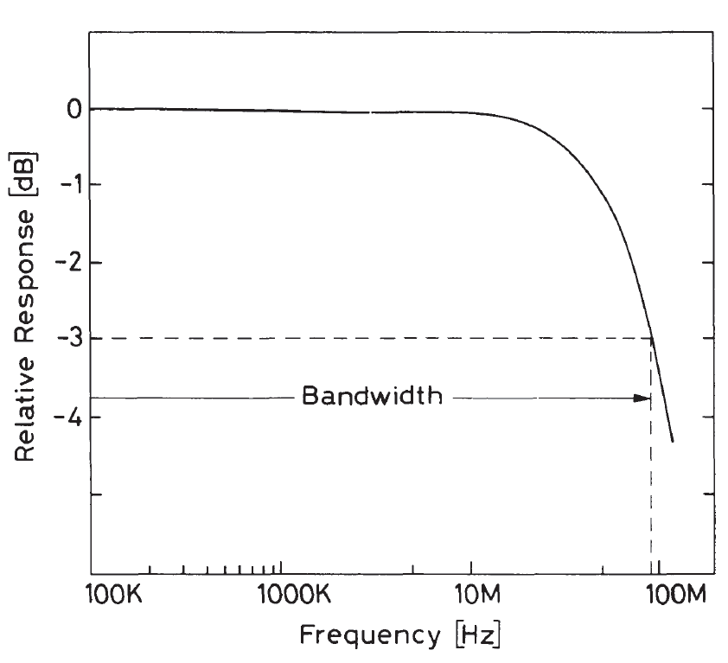
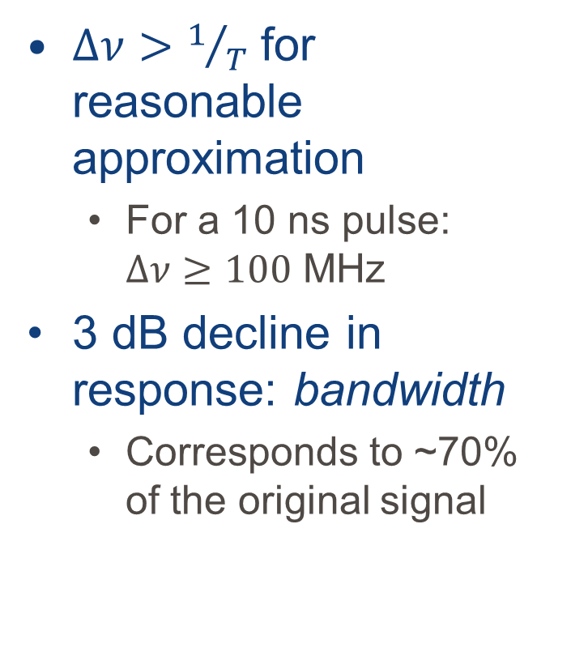
Bandwidth
$Δν>1/T$ for reasonable approximation
  For a 10 ns pulse: $Δν≥100$ MHz
3 dB decline in response: bandwidth
  Corresponds to ~70% of the original signal

Slide 48
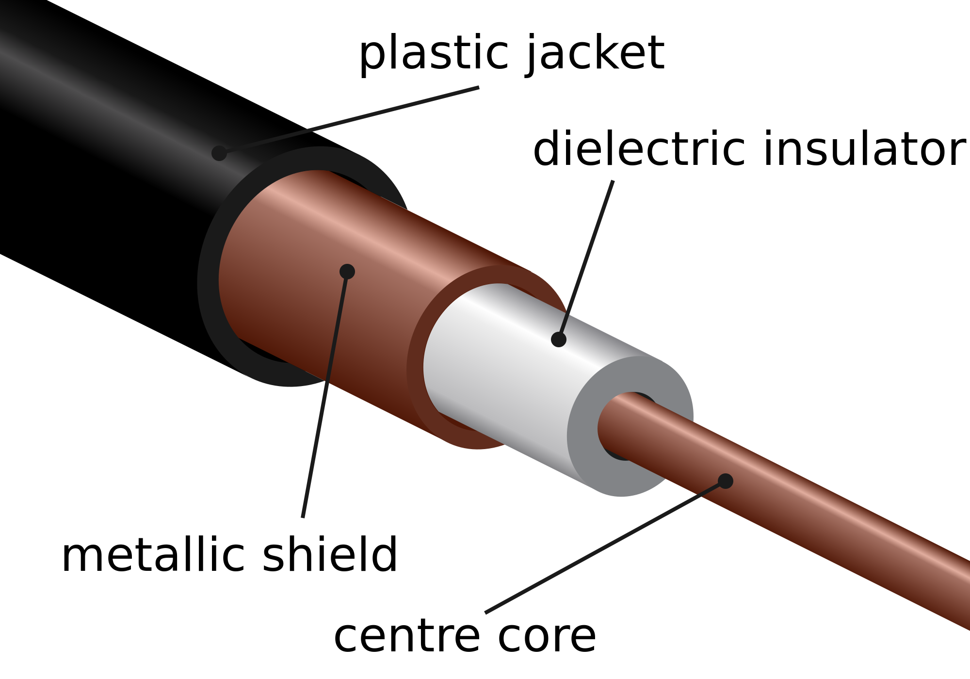
The coaxial cable
Source: Wikimedia commons

Slide 49
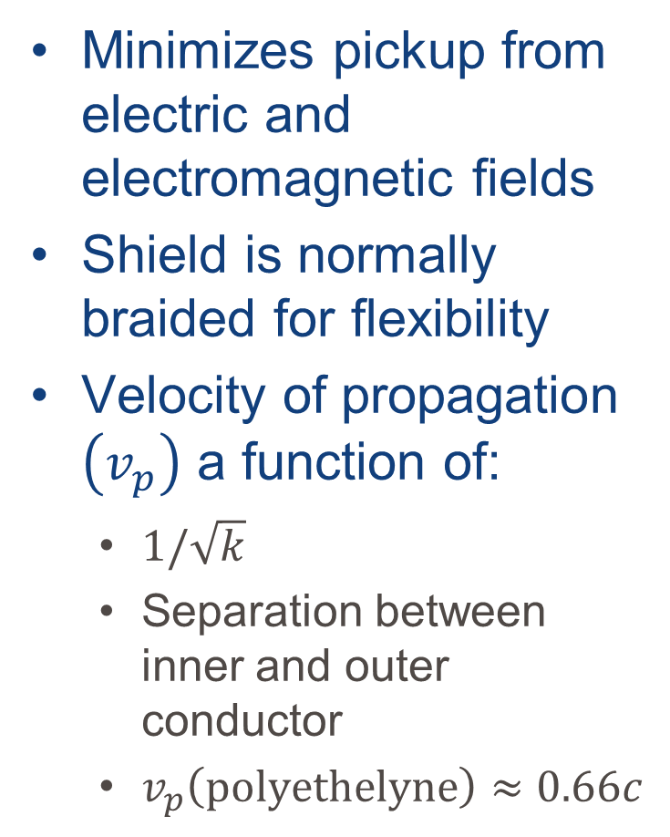
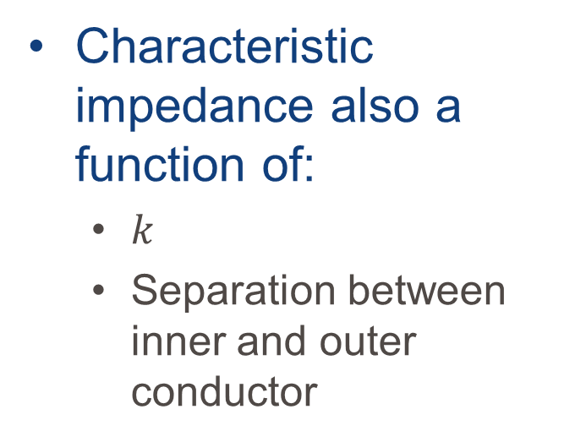
The coaxial cable
Minimizes pickup from electric and electromagnetic fields
Shield is normally braided for flexibility
Velocity of propagation $\left(v_{p}\right)$ a function of:
  $1/\sqrt{k}$
  Separation between inner and outer conductor
  $v_{p}\left(\text{polyethelyne}\right)≈0.66c$
Characteristic impedance also a function of:
  $k$
  Separation between inner and outer conductor
Notes:
K is the dielectric constant of the insulator

Slide 50
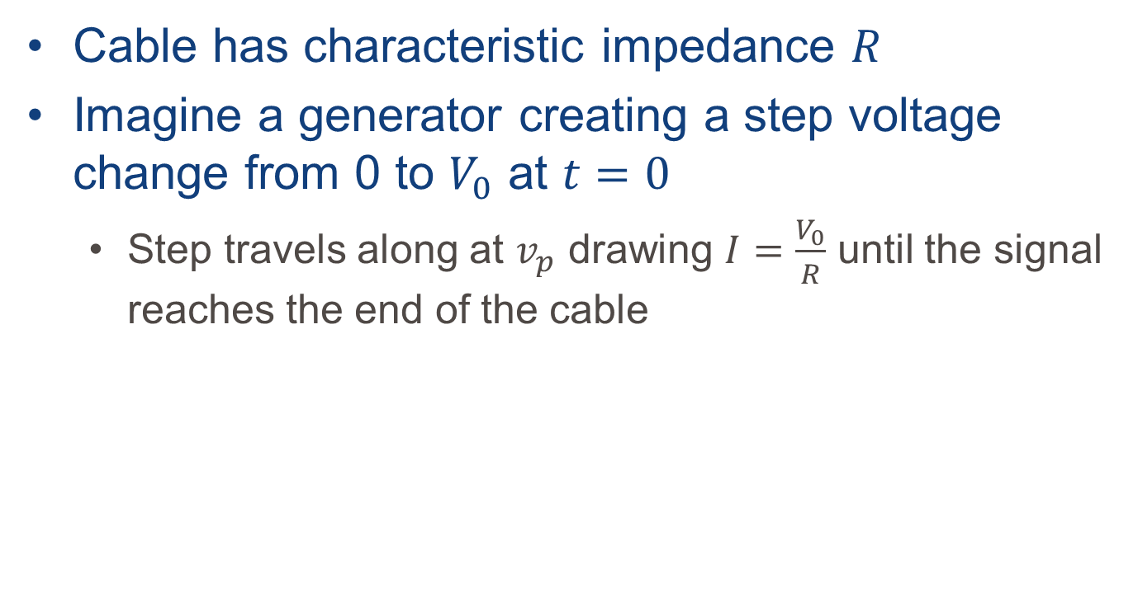

Termination
v_{s}
$$R_{t}$$
Cable has characteristic impedance $R$
Imagine a generator creating a step voltage change from 0 to $V_{0}$ at $t=0$
  Step travels along at $v_{p}$ drawing $I=\frac{V_{0}}{R}$ until the signal reaches the end of the cable
Notes:
At the end, the cable is charged.

Slide 51
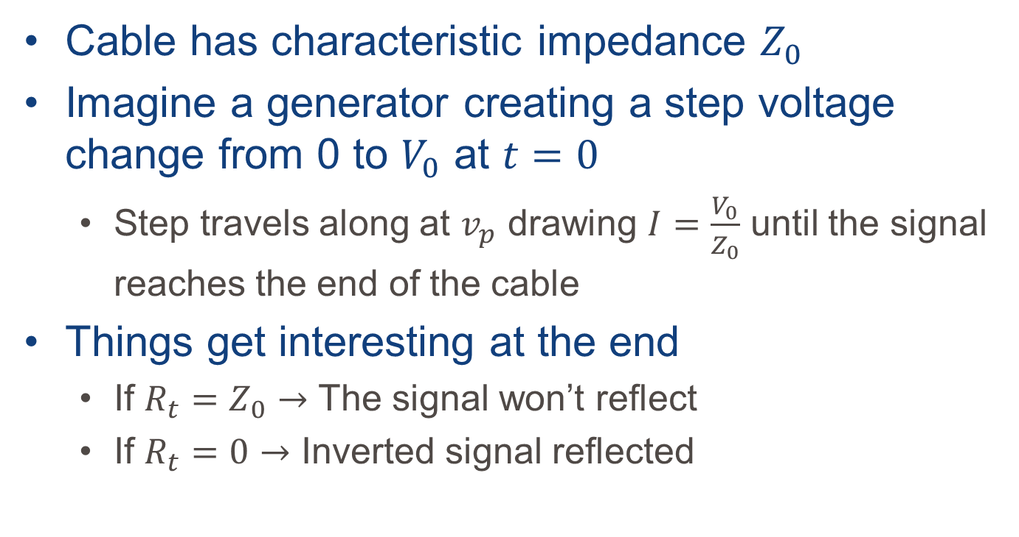
Termination
v_{s}
$$R_{t}$$
Cable has characteristic impedance $Z_{0}$
Imagine a generator creating a step voltage change from 0 to $V_{0}$ at $t=0$
  Step travels along at $v_{p}$ drawing $I=\frac{V_{0}}{Z_{0}}$ until the signal reaches the end of the cable
Things get interesting at the end
  If $R_{t}=Z_{0}→$ The signal won’t reflect
  If $R_{t}=0→$ Inverted signal reflected

Slide 52
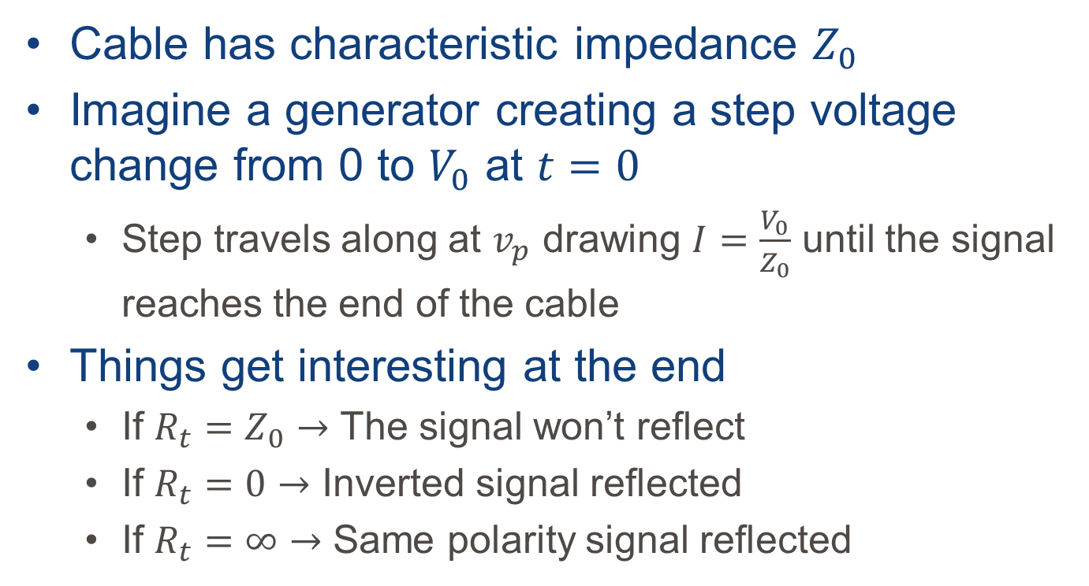
Termination
v_{s}
$$R_{t}$$
Cable has characteristic impedance $Z_{0}$
Imagine a generator creating a step voltage change from 0 to $V_{0}$ at $t=0$
  Step travels along at $v_{p}$ drawing $I=\frac{V_{0}}{Z_{0}}$ until the signal reaches the end of the cable
Things get interesting at the end
  If $R_{t}=Z_{0}→$ The signal won’t reflect
  If $R_{t}=0→$ Inverted signal reflected
  If $R_{t}=∞→$ Same polarity signal reflected
Notes:
We normally talk about terminating the cable but we’re really terminating the device.
If the input impedance doesn’t match the characteristic impedance of the cable, the input has to be brought down

Slide 53
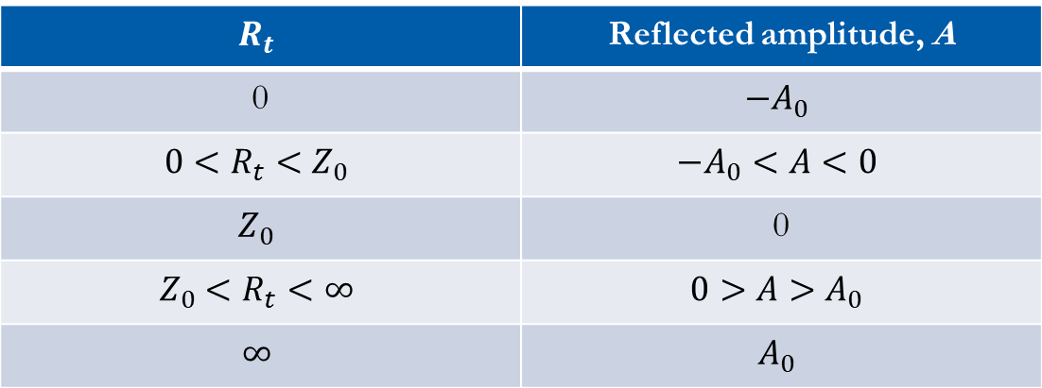
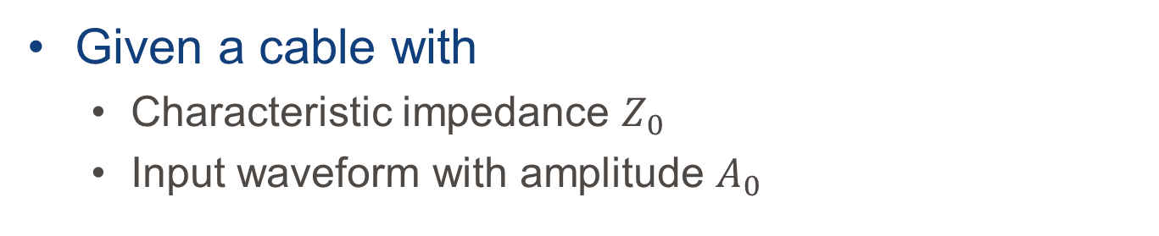
Termination
v_{s}
$$R_{t}$$
Given a cable with
  Characteristic impedance $Z_{0}$
  Input waveform with amplitude $A_{0}$
$$R_{t}$$ | Reflected amplitude, A
0 | $$−A_{0}$$
$$0<R_{t}<Z_{0}$$ | $$−A_{0}<A<0$$
$$Z_{0}$$ | 0
$$Z_{0}<R_{t}<∞$$ | $$0>A>A_{0}$$
$$∞$$ | $$A_{0}$$

Slide 55

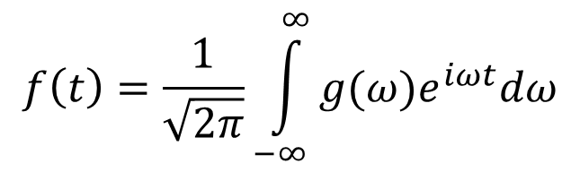
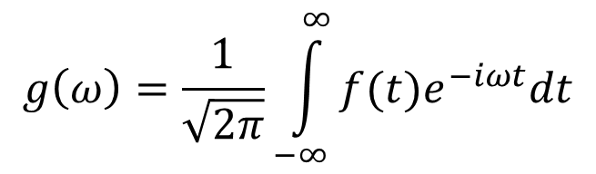


Fourier Analysis
Any pulse can be decomposed into a superposition of many pure sinusoidal frequencies
A pulse:
  Shape in time $f(t)$
$$V$$
$$V$$
$$t$$
$$f\left(t\right)=\frac{1}{\sqrt{2π}}\int_{−∞}^{∞}{g(ω)e^{iωt}dω}$$
$$g\left(ω\right)=\frac{1}{\sqrt{2π}}\int_{−∞}^{∞}{f(t)e^{−iωt}dt}$$
$$t$$
Notes:
When we perform a Fourier transform on the pulse we can see that the pulse contains a continuous spectrum of frequency components from 0 to $∞$.
As long as the bandwidth is sufficient, you can transmit anything over a transmission line.
$g(ω)$ is the Fourier transform or frequency spectrum of the pulse

Slide 56

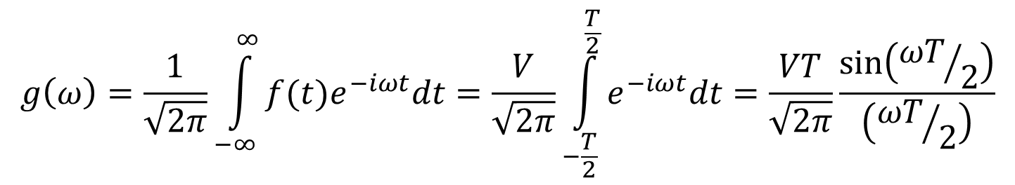



Fourier Analysis
Any pulse can be decomposed into a superposition of many pure sinusoidal frequencies
A pulse:
  Shape in time $f(t)$
$$V$$
$$VT$$
$$f\left(t\right)=\frac{1}{\sqrt{2π}}\int_{−∞}^{∞}{g(ω)e^{iωt}dω}$$
$$t$$
$$g\left(ω\right)=\frac{1}{\sqrt{2π}}\int_{−∞}^{∞}{f(t)e^{−iωt}dt}=\frac{V}{\sqrt{2π}}\int_{−\frac{T}{2}}^{\frac{T}{2}}{e^{−iωt}dt}=\frac{VT}{\sqrt{2π}}\frac{\sin\left({ωT}/2\right)}{\left({ωT}/2\right)}$$
$$f\left(t\right)=\left\{\begin{matrix}V \left|t\right|<T/2 \\ 0 \left|t\right|>T/2\end{matrix}\right.$$
Notes:
When we perform a Fourier transform on the pulse we can see that the pulse contains a continuous spectrum of frequency components from 0 to $∞$.
As long as the bandwidth is sufficient, you can transmit anything over a transmission line.
$g(ω)$ is the Fourier transform or frequency spectrum of the pulse
Negative frequencies are imaginary

Slide 57
Analog to digital conversion
Signal attributes are most easily processed when converted to a digital signal

